Slide 1
MARTA’s Riders’ Advisory Council
November 1, 2023
Larry Prescott, AGM Keli Davis, Director
Design, Engineering, & Infrastructure Facilities Program Management
Capital Programs Update
Clayton County Multipurpose Operations & Maintenance Facility
Clayton County Justice Center Transit Hub

Slide 2
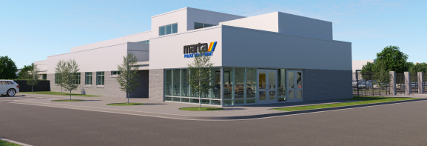
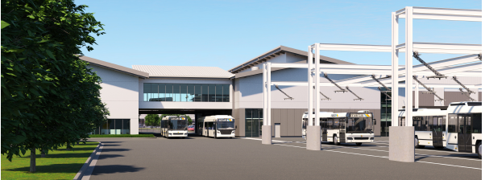
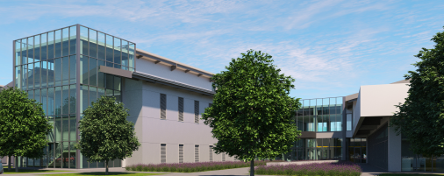
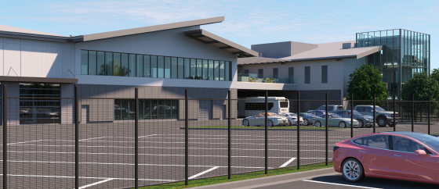
Clayton County Multipurpose Operations & Maintenance Facility
PURPOSE
As part of the More MARTA Program – Clayton County, the multi-purpose Operations and Maintenance facility will provide support for the transit expansion into Clayton County. The Facility will include:
31 regional bus routes
Parking for 250+ buses
Administration office with a wellness center and training rooms
Bus maintenance/Inspection/Repairs/Cleaning
Transit operations office
Bus wash
Fueling points (including EV charging)
Fare retrieval points
Employee parking
MARTA police precinct
MPD Training Facility
The site is in the City of Forest Park, Georgia comprised of two parcels totaling 31 acres.
Notes:
As part of the More Marta program in Clayton Co., this new facility will provide O&M support and provide security for the expanded bus services in Clayton Co. The current operations located at the Hamilton Garage will shift to this facility.
Proposed layout plan…

Slide 3
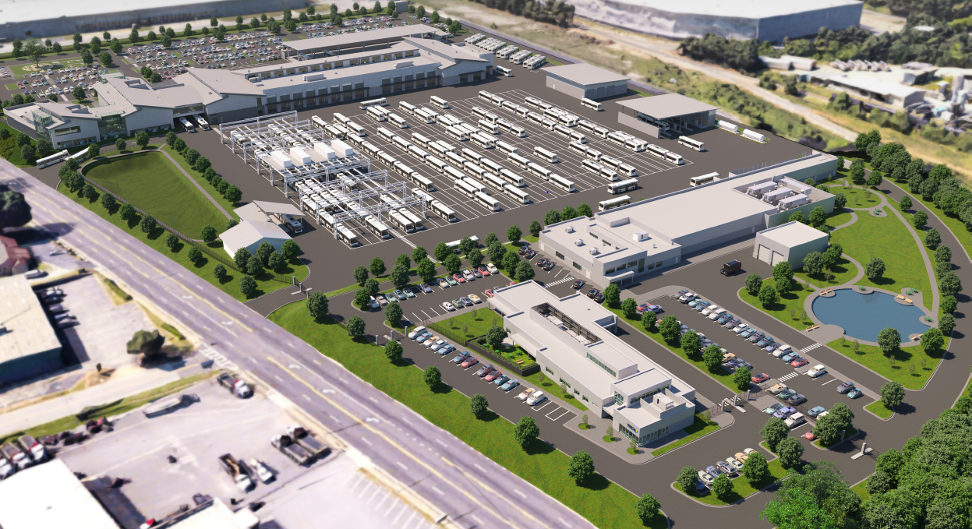
Clayton County Multipurpose Operations & Maintenance Facility Facility
STATUS
The advanced site demolition design is 100% for a summer 2024 start
The final design is at 60% with 100% completion in March 2024

Slide 4
Clayton County Multipurpose Operations & Maintenance Facility Facility
COST
The current total project cost is at $220M*
* Project cost is currently under 60% review
SCHEDULE
Final design is in-progress with construction starting in 2024 and operational the end of 2026
FINAL DESIGN
Aug. 2022 - Mar. 2024
Procurement
Apr. 2024 – Oct 2024
CONSTRUCTION
OPEN/
OPERATIONAL
Oct. 2024 - Jun. 2026
Dec.2026
2023
2024
2025
2026
2027
4
08/13/2021
Notes:
The Office of D&I assigned a 15% DBE goal which STV is committed to 17%

Slide 5
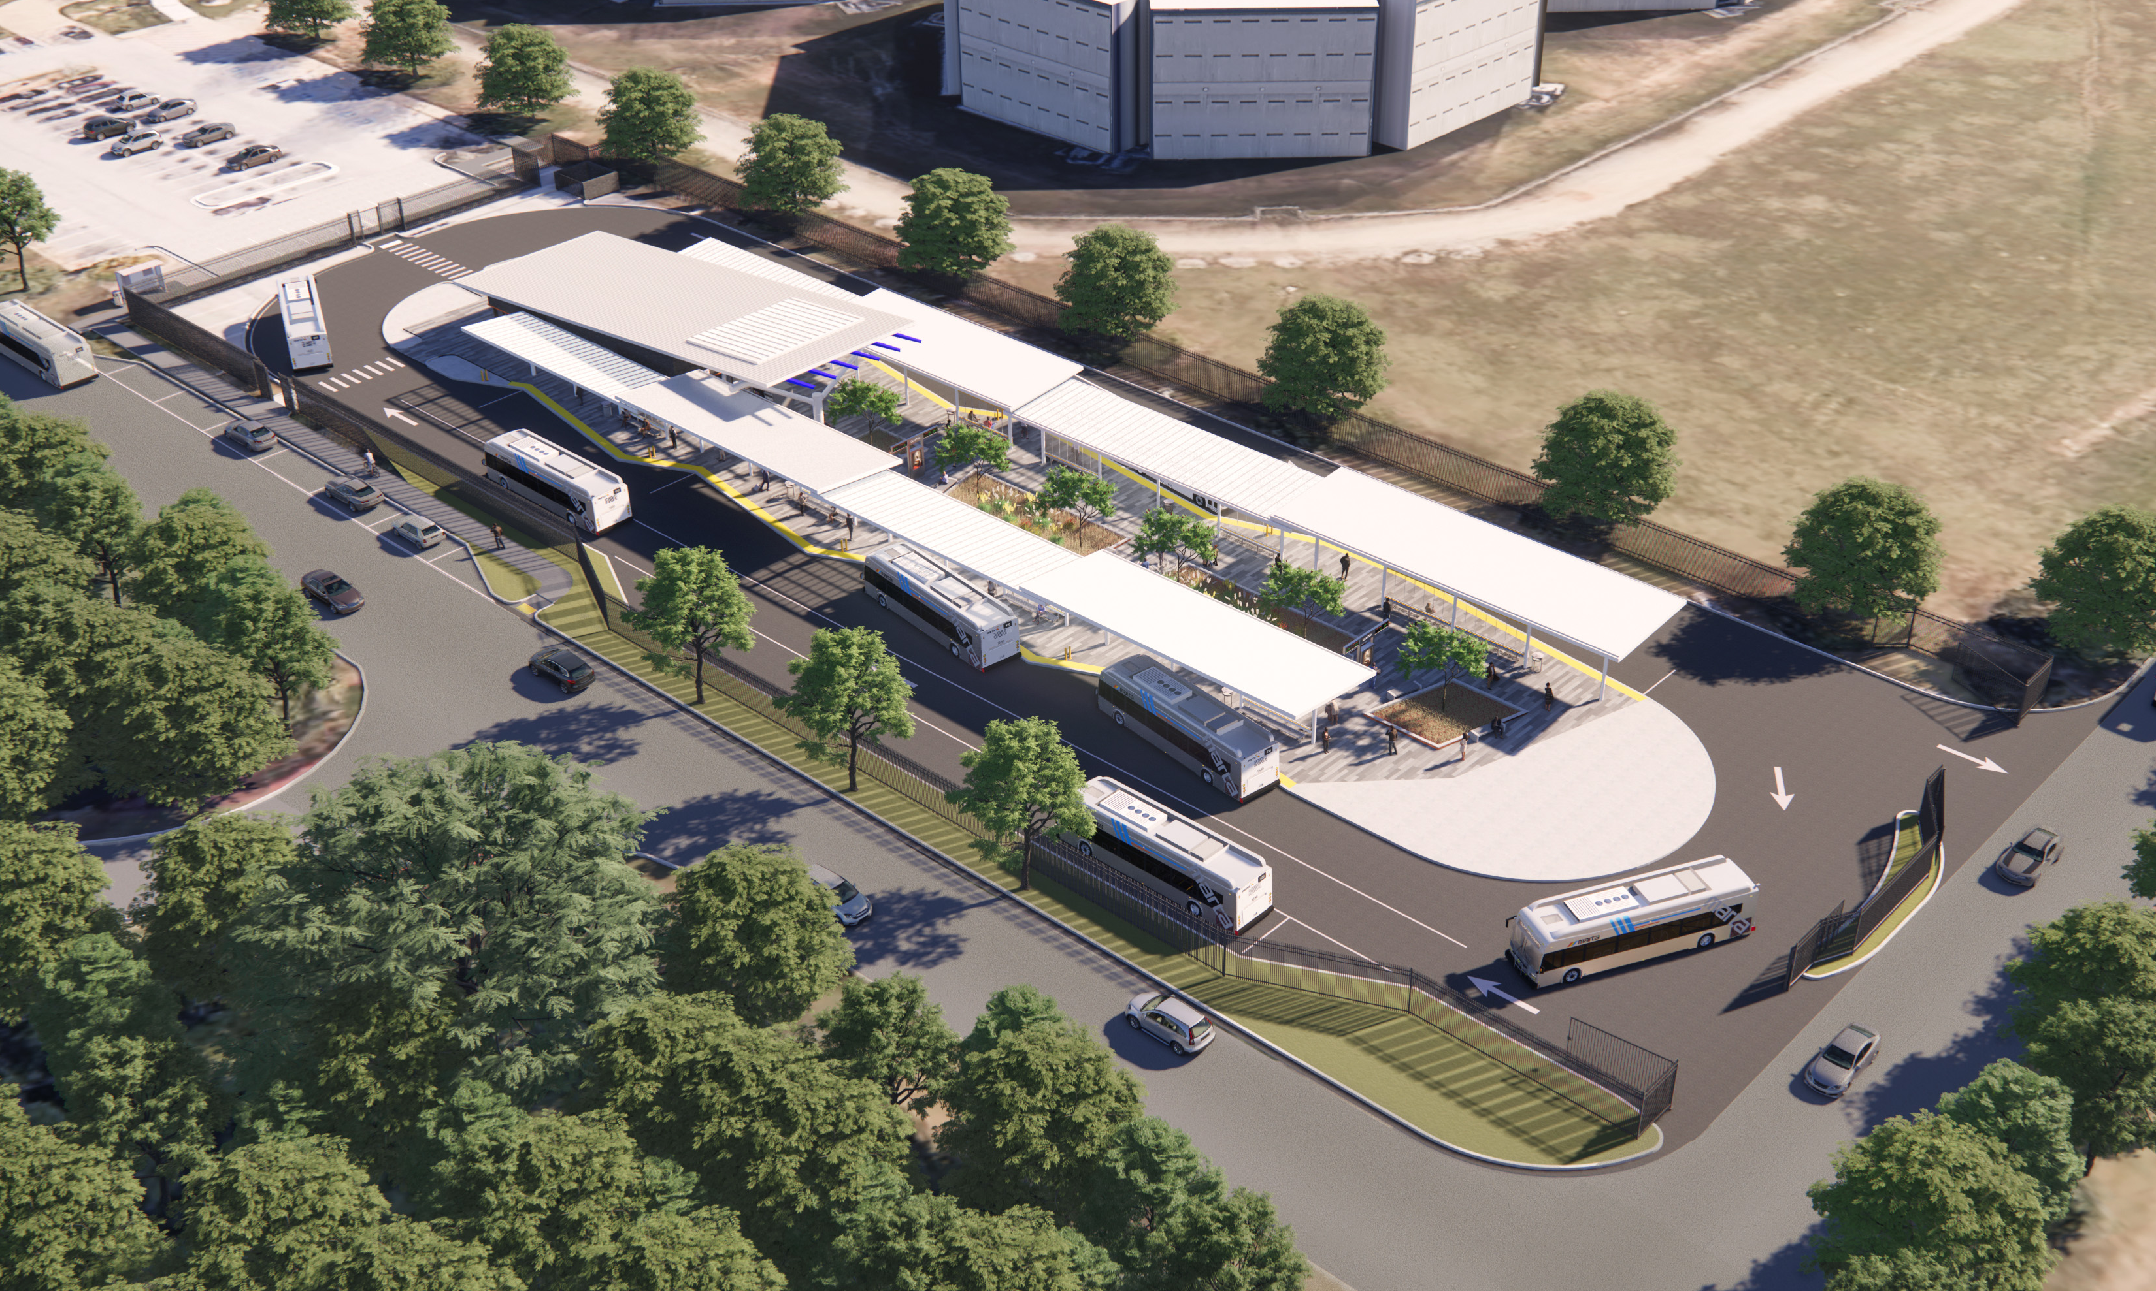
Clayton County Justice Center Transit Hub
PURPOSE
The Clayton County Justice Center Transit Hub had the first phase opened in July 2020 as a safe, convenient place for passengers to transfer between buses with enhanced amenities and services.
This second phase of the hub will replace the phase one quick-build facilities,
Enhanced amenities and services to passengers and operators
Connect MARTA’s bus services to other travel modes – these could include:
  other first/last mile options such as carpooling and ridesharing
  MARTA Mobility
  Biking
  Walking
The hub will be located western side of the
Harold R. Banke Justice Center at the
corner of Post Way and Deputy Rick
Daly Memorial Boulevard.

Slide 6
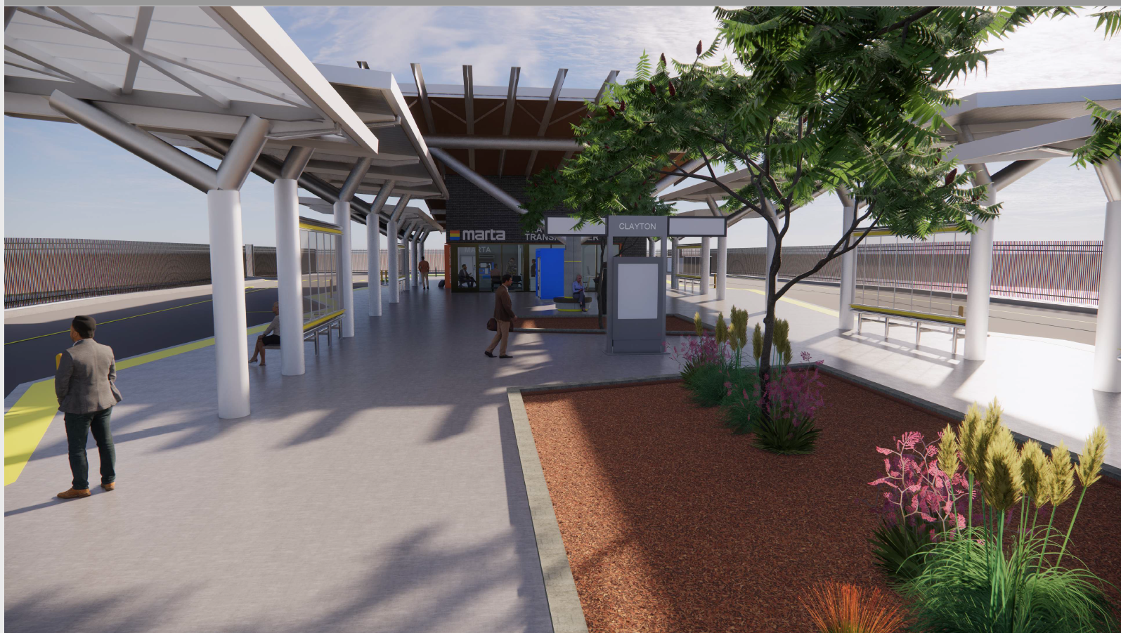
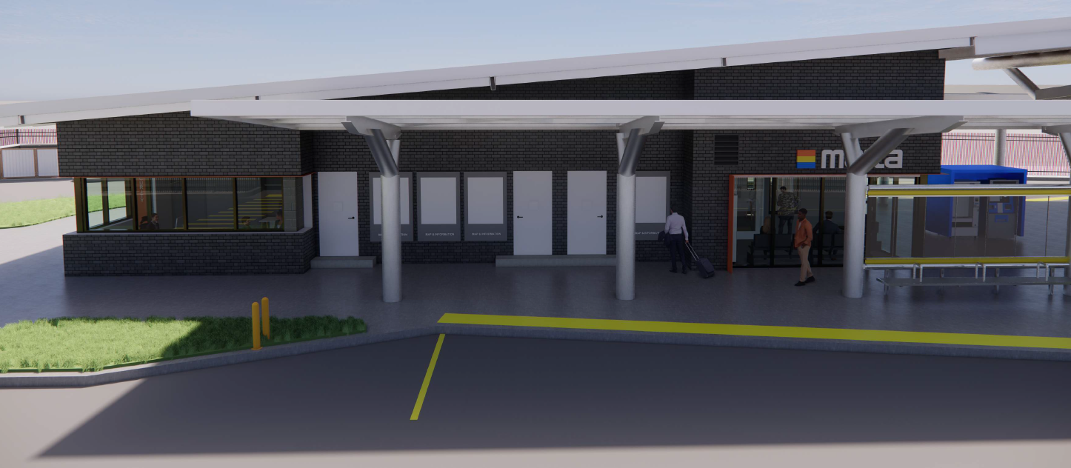
Clayton County Justice Center Transit Hub
STATUS
Pond and Co., delivered 60% Design Package 9/28
MARTA provided initial review comments on 10/12, 90% design now starting
MARTA discussing inclusion of EV Bus Charging at the site

Slide 7
Clayton County Justice Center Transit Hub
COST
The current total construction cost is at $15M
The current Work Order for design services is $2.3M
SCHEDULE
Accelerating Final Design to be complete by May 2024
Procurement
Mar. - Jul. 2023
FINAL DESIGN
Jul. 2023 – May 2024
Procurement
OPEN/
OPERATIONAL
June 2024 – Aug. 2024
CONSTRUCTION
Oct. 2024 - Dec. 2026
July 2027
2023
2024
2025
2026
2027
2028
08/13/2021

Slide 8

Clayton County Capital Programs Update
THANK YOU!!

