Slide 1
ATL RIDES Launch
Abby Marinelli
October 5, 2023

Slide 2
What is the ATL?
The Atlanta-Region Transit Link Authority (ATL) was created to better connect transit options across the 13-county Atlanta region.
Planning
  ATL was created in 2018 through HB930.
  Requires various planning efforts and reporting on behalf Atlanta-region transit operators.
  Also enables Cobb and Gwinnett counties to hold referenda to join MARTA.
Funding
  ATL is a state authority and receives funding through various state and federal sources.
  ATL is the “designated recipient” for the Atlanta urbanized area.
Operations
  ATL operates ATL Xpress commuter service.

Slide 3
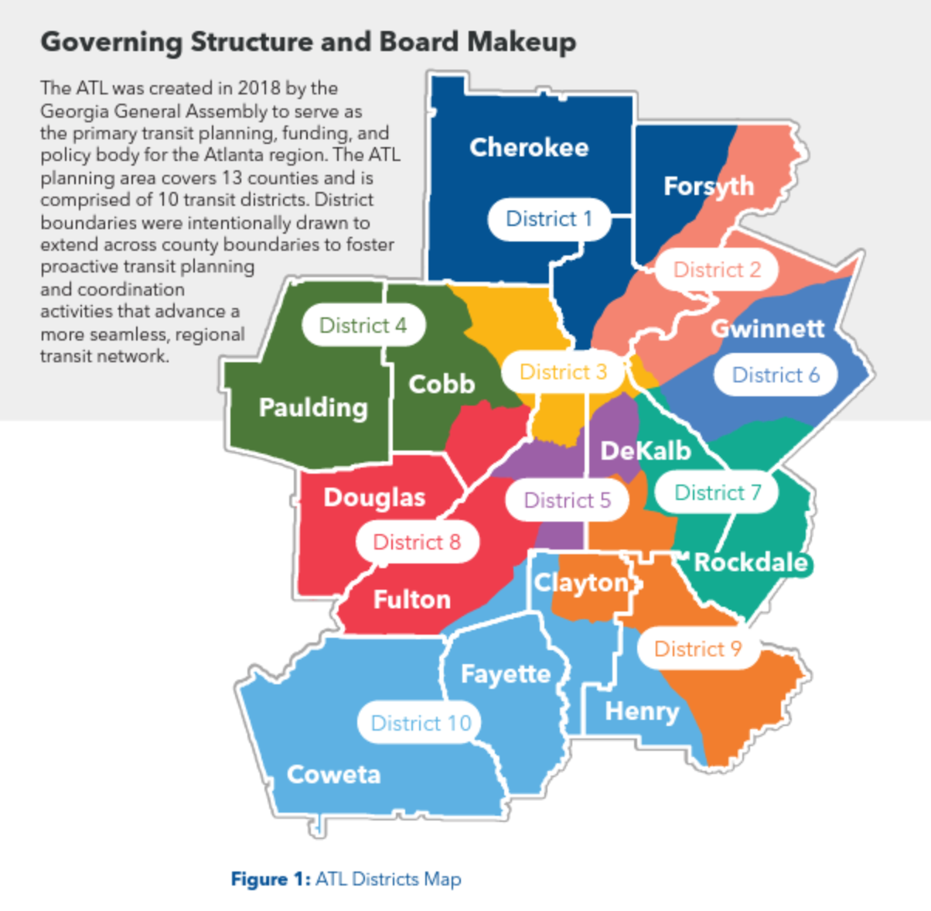
What is the ATL?

Slide 4
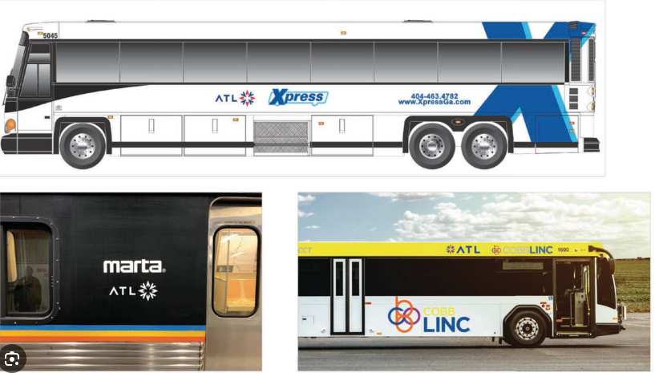

What is the ATL?

Slide 5
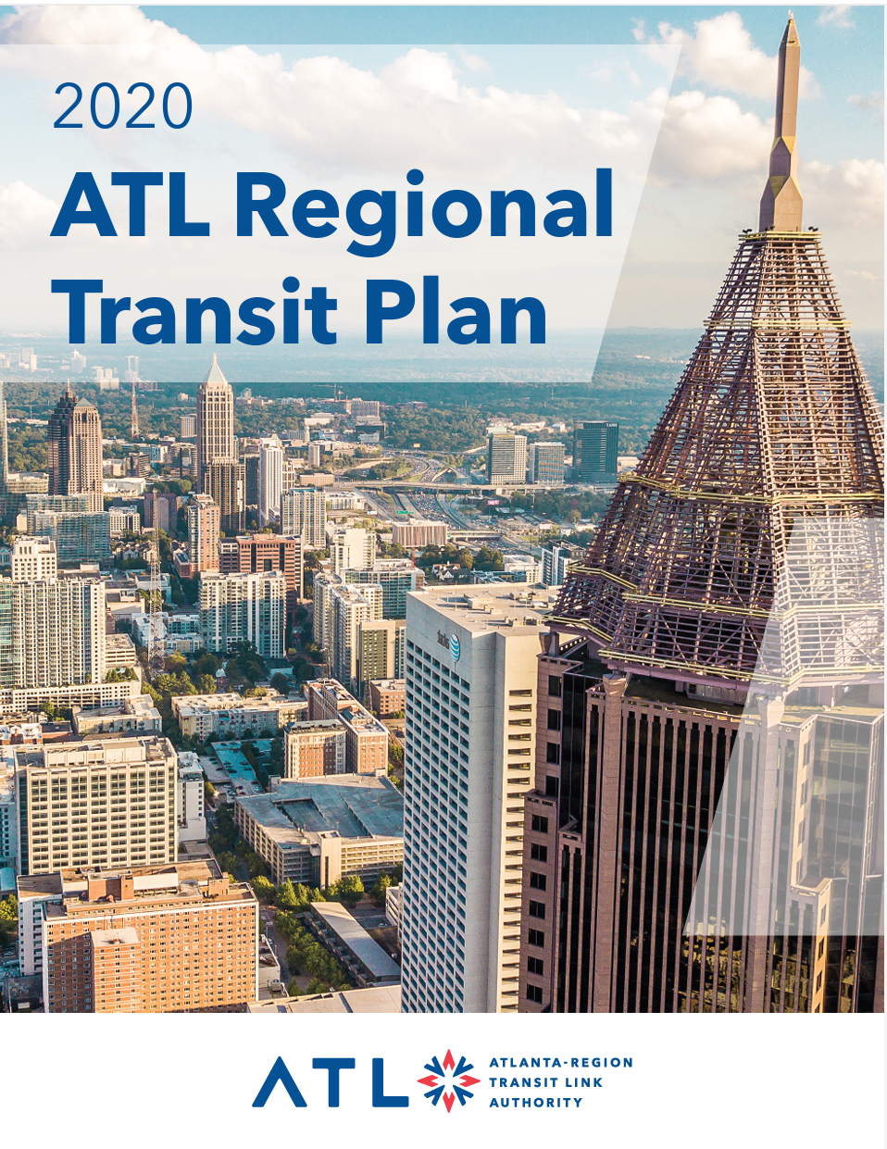
What is The ATL?
ATL planning documents:
  ATL Regional Transit Plan
  Annual Report and Audit
Plans in partnership with other agencies:
  Zero Emission Bus Fleet Transition Plan
  Transit Asset Management Plan
  Transit Master Plans
Examples of other work:
  Facilitating Breeze Mobile 2.0 outside of MARTA
  ATL RIDES

Slide 6
ATL RIDES
ATL RIDES is the region’s first multi-agency trip planning app that provides real-time arrival information.
Demand for a robust, cross-jurisdictional trip planner that included key customer-focused tools like real-time arrival and departure data led to a partnership among the region’s transit agencies.
The ATL RIDES project began in 2019 when ATL applied for an Integrated Mobility Innovations (IMI) grant.
  ATL partnered with Arcadis IBI Group to develop the app and with local transit agencies and GDOT to provide data to the app.
*

Slide 7
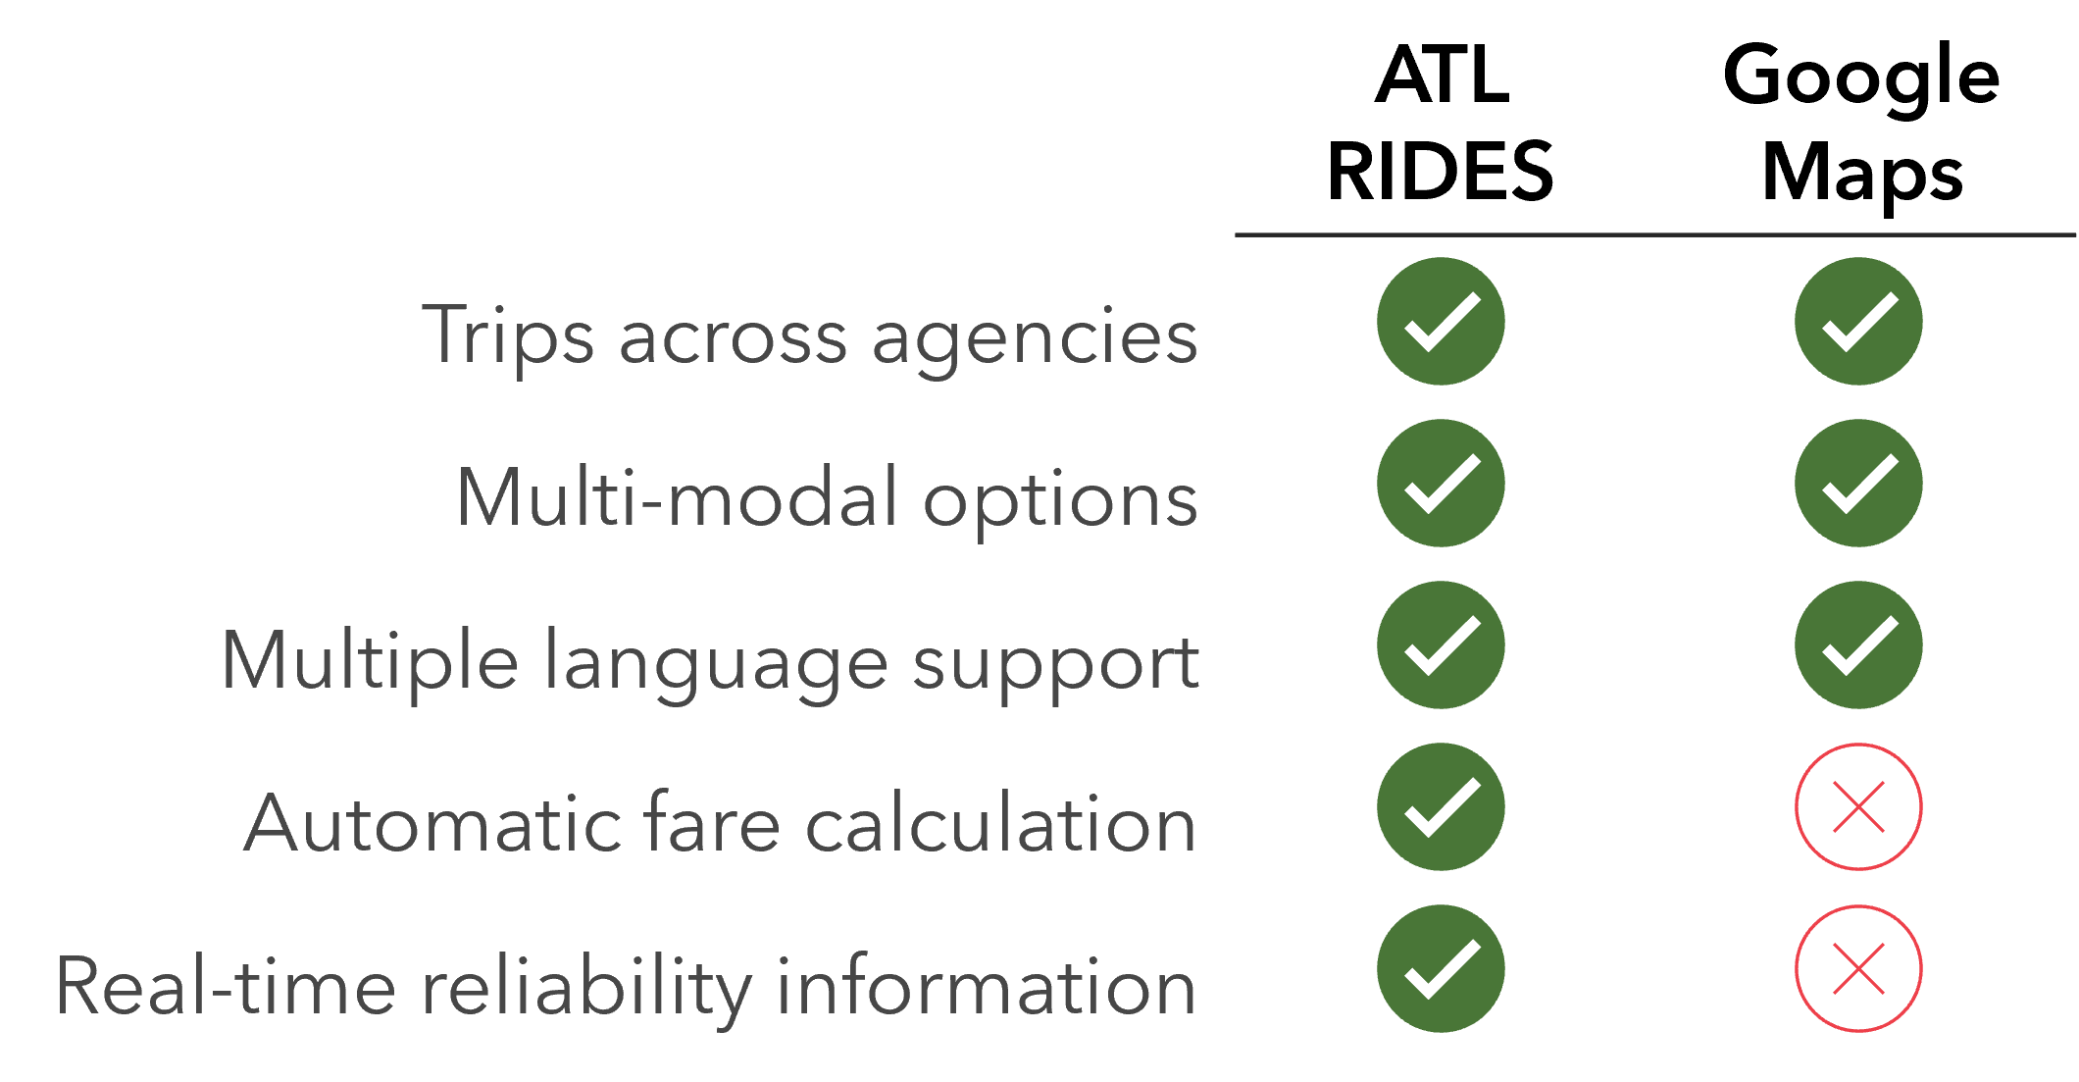
ATL RIDES
ATL hosted GTFS-Real Time development workshops with partner agencies to prepare for feed consumption by ATL RIDES.
*

Slide 8
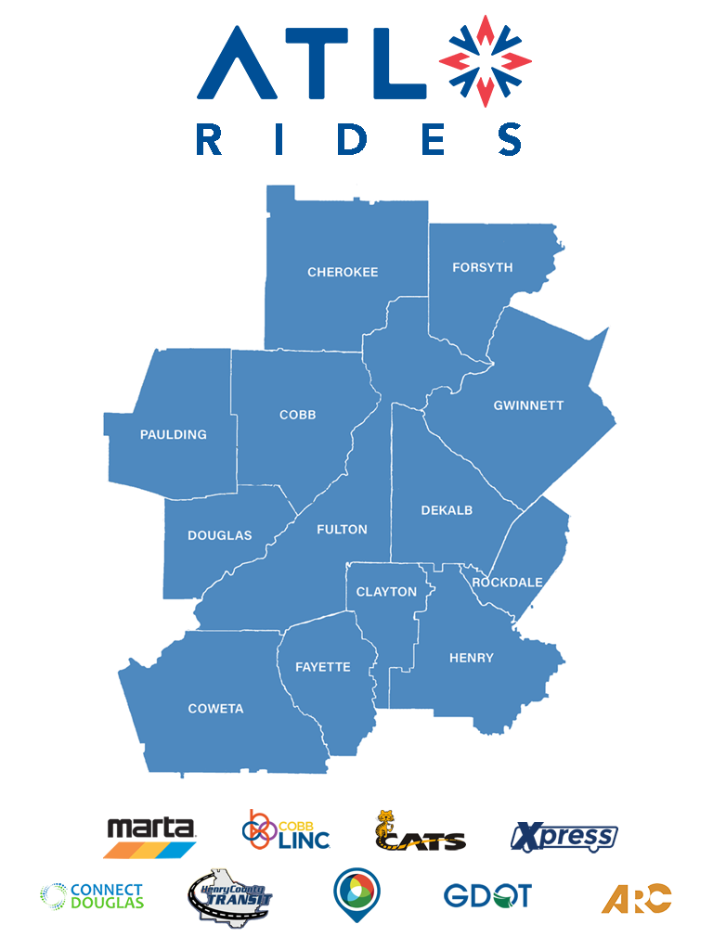
ATL RIDES Beta Test
ATL RIDES opened for beta testing on March 1, 2023
Available at atlrides.com and through the Apple App Store and Google Play Store by invitation
160+ routes
1000+ buses and trains
*
Fayette does not have fixed route service.

Slide 9
ATL RIDES Beta Test
User feedback incorporated over a 7-month beta period
  Route corrections
  Stop name refinement
  GTFS feed enhancements
*
Fayette does not have fixed route service.

Slide 10

ATL RIDES is live!
Live as of
October 2, 2023

Slide 11
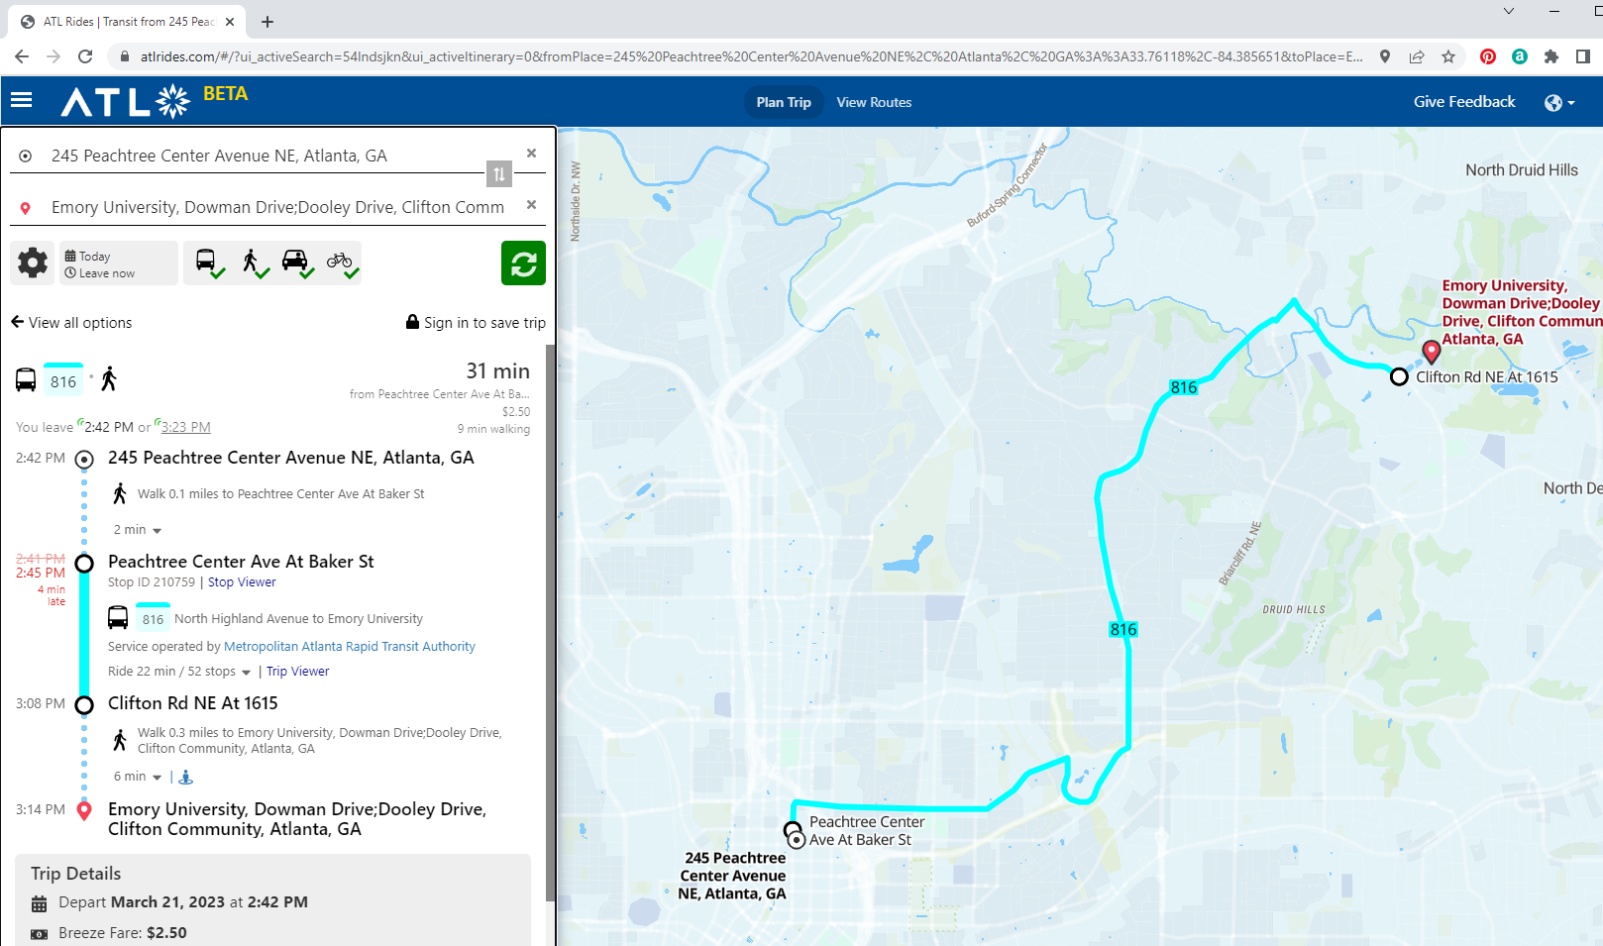
Search start and end locations

Slide 12
Specify trip preferences:
- Mode
- Wheelchair accessibility
Walking distance and speed

Slide 13
Route options
and directions

Slide 14
Real Time information

Slide 15
Trip details

Slide 16
Questions?
Abby Marinelli
Transit Funding Manager, The ATL amarinelli@atltransit.ga.gov

