Slide 1
Digital Signage Enhancements Project
MARTA Riders’ Advisory Council
October 5, 2022

Slide 2
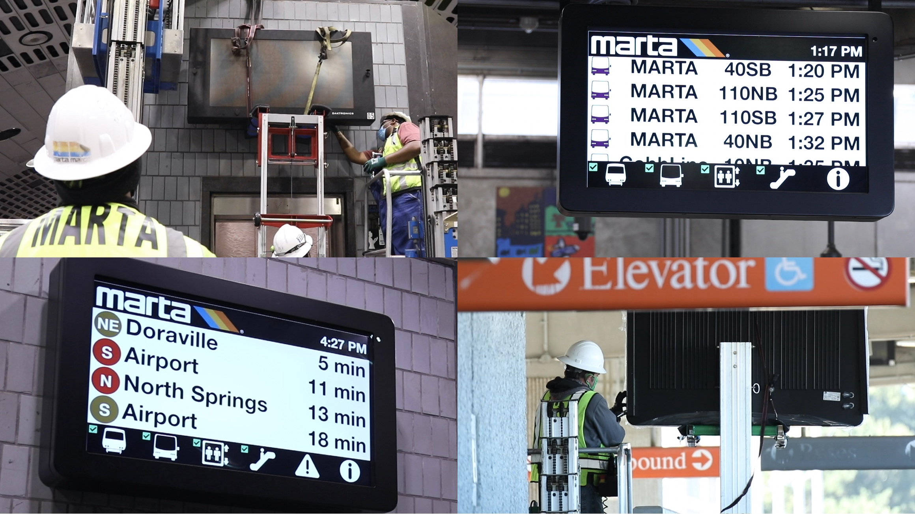
What is AVIS?
AVIS is MARTA’s in-station digital information system
AVIS stands for:
Audio-Visual Information System
This system entails all MARTA public address systems and electronic signage at MARTA’s 38 rail stations.
Photos of AVIS screens being installed

Slide 3
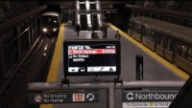
MARTA Heroes | Alphonso: Better Real-time Information

Slide 4
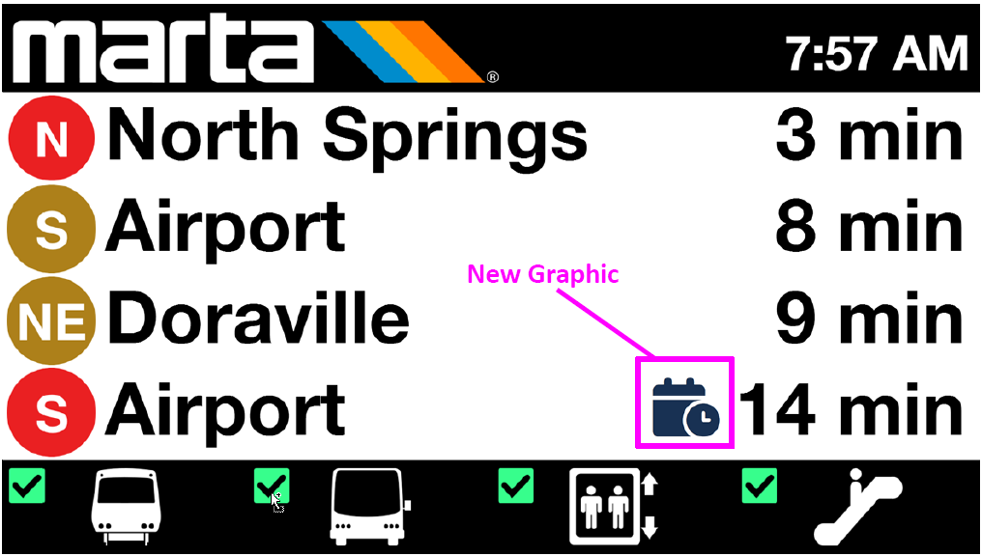
Improving AVIS: Including Scheduled Train Departures
Currently, only actively moving trains are displayed on AVIS signs.
At Terminal Stations (e.g., Airport, H.E. Holmes, N. Springs) that means customers don’t know when the next train will be leaving.
At near terminal stations (e.g., College Park, West Lake, Sandy Springs) customers don’t know when to expect a train until it has departed the terminal station.
Improvement: Begin displaying expected scheduled departure/arrival of trains before they have departed. Convert to real-time once the train departs.
Mockup of new AVIS rail info (depicting College Park Station)

Slide 5
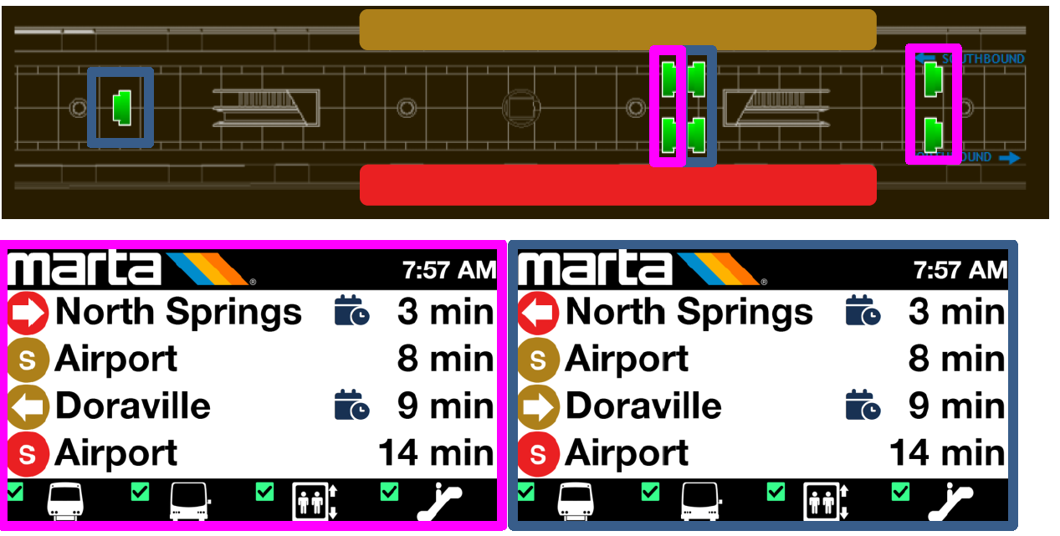
Improving AVIS: Providing Center Platform Boarding Info
Currently, AVIS does not provide information about which side of the platform will be used for the upcoming train. This is especially difficult for customers waiting for the trains at Airport Station.
Improvement: Begin displaying upcoming platform information for stations with center platforms.
Mockup of new AVIS rail info including platform

Slide 6
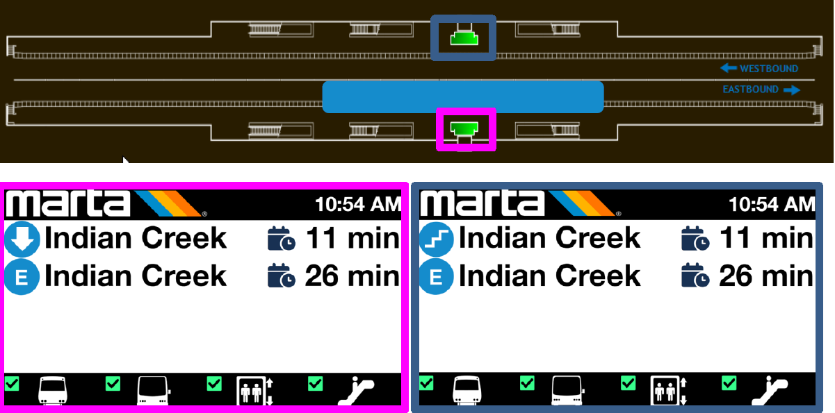
Improving AVIS: Providing Side Platform Boarding Info
Currently, AVIS does not provide information about which side of the platform will be used for the upcoming train. For stations with side boarding platforms, this is especially difficult as customers may need to travel between floors to switch platforms.
Improvement: Begin to display upcoming platform information for stations with side platforms. Q: what is the best way to display this?
Mockup of new AVIS rail info including platform

Slide 7
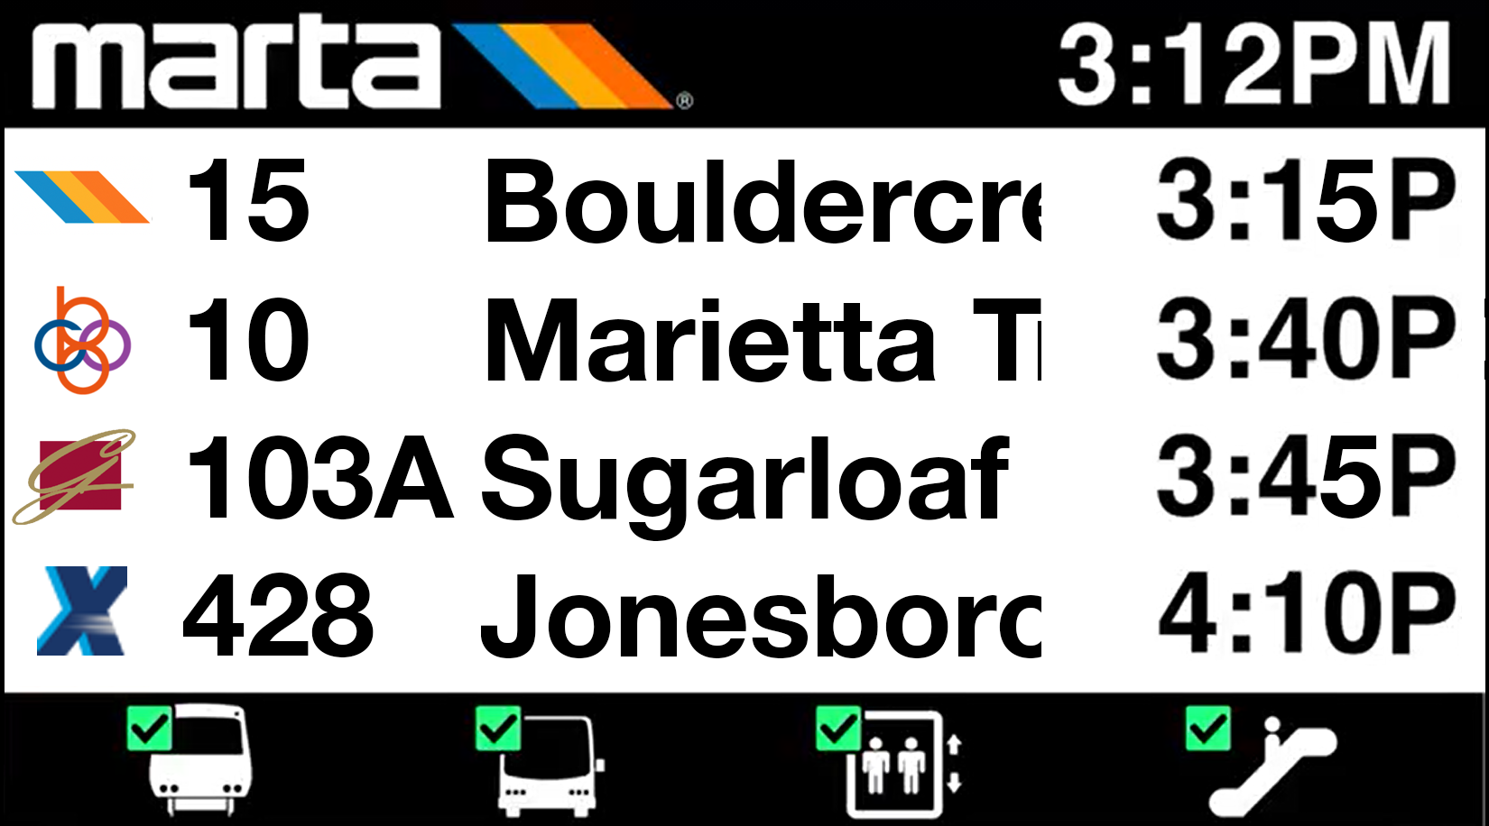
Improving AVIS: Improved Info on Upcoming Bus Departures
Currently, AVIS information about upcoming bus departures is limited, and difficult for customers to understand.
Improvement: Begin displaying agency logos, bus numbers, route names, and destinations for bus departures.
Mockup of new AVIS bus departure page info

Slide 8

Questions?
Anthony Thomas
Program Manager Customer Experience Innovation
Department of Customer Experience

