Slide 1
Overview of MARTA’s New Fare System Project
MARTA Riders’ Advisory Council
September 7, 2022

Slide 2
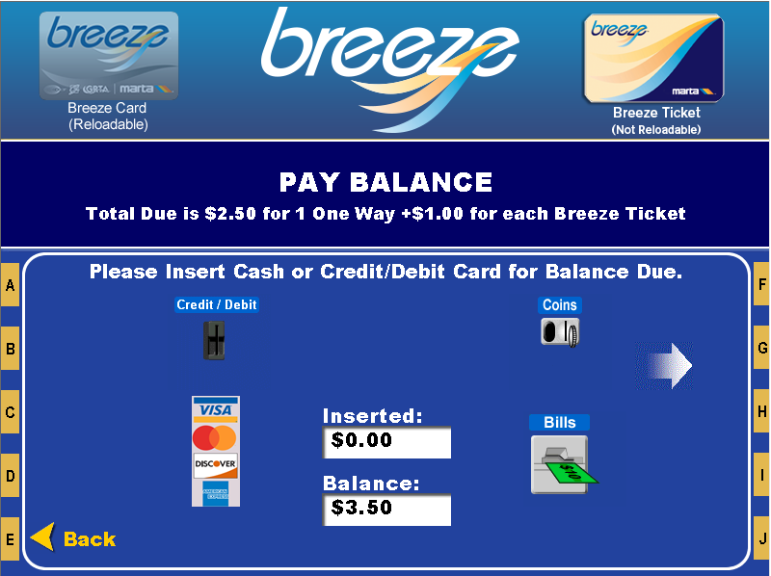
What is Automated Fare Collection (AFC)?
The current AFC System is called Breeze!
The system entails all things Breeze. From components that are customer-facing:
  Ticket vending machines (TVMs)
  Breeze Cards and Tickets
  Faregates
  Fareboxes
  Breeze website
  Breeze mobile
And components not so customer-facing:
  Ticket office machines (TOMs)
  Back Offices
  Bins/Vaults for Cash Collection

Slide 3
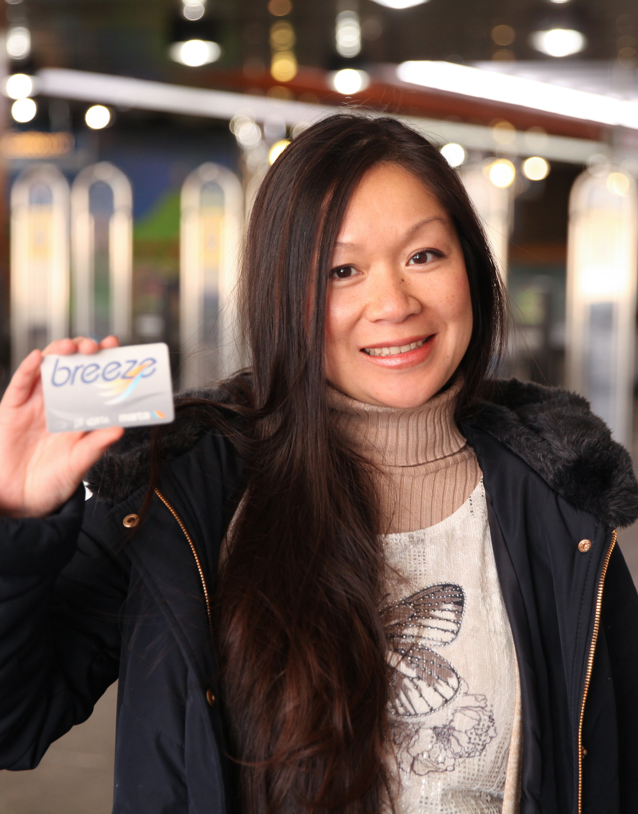
Why is MARTA Replacing Breeze?
Did You Know? MARTA was the first system in the United States to move towards only smart cards for fare? The Breeze installation was completed in September 2006.
Since Breeze was implemented in 2005-2006, fare collection technology has improved considerably. Consider that the first iPhone was released in 2007! Today’s modern fare collection systems include:
Account-based technology vs. card-based technology
Open payments and contactless credit/debit cards
Flexible fare policy (incl. fare capping, distance-based/time-based fares)
New mobile apps and website for account management
Instant reloads of value and products
Distributed sales and reload locations

Slide 4
MARTA’s Goals for our Next Gen Fare System
Vision: A reliable customer-focused fare collection system that is easy to use, and that supports equity and regional mobility.
Enhance the customer experience through system design;
Interoperate with regional partners and transportation network companies (TNCs);
Support an equitable fare policy through system design;
Support and encourage regional trips through system design;
Support rail and bus operational efficiencies;
Consider and prepare for MARTA’s future (e.g., new modes of service);
Maintain and improve farebox recovery ratio; and,
Reduce the capital, operations, and maintenance costs of the fare collection system.

Slide 5
Steps to achieve AFC 2.0
- We are currently collecting and documenting the technical specifications for the new system. This involves internal MARTA staff from around the agency, as well as representatives from our partner agencies (Xpress, CCT, and GCT). Feedback from earlier rider focus groups and the RAC will help to inform the development of these specs.
- We will also hear from vendors on what their technology offerings look like before finalizing our specifications.
- Once the specs are complete, we will go to our Board for approval to solicit these services. This is expected by December 2022. The RFP will be open for several months, and MARTA and partners will then review the responses received.
- Once a successful bidder has been identified, we will work to design and implement the new system.

Slide 6
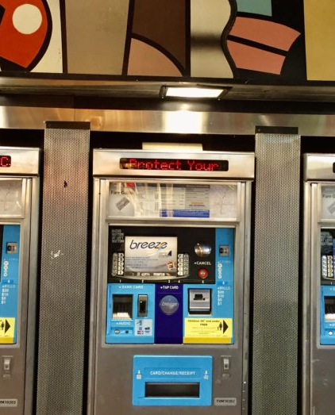
Components of the new fare system

Slide 7
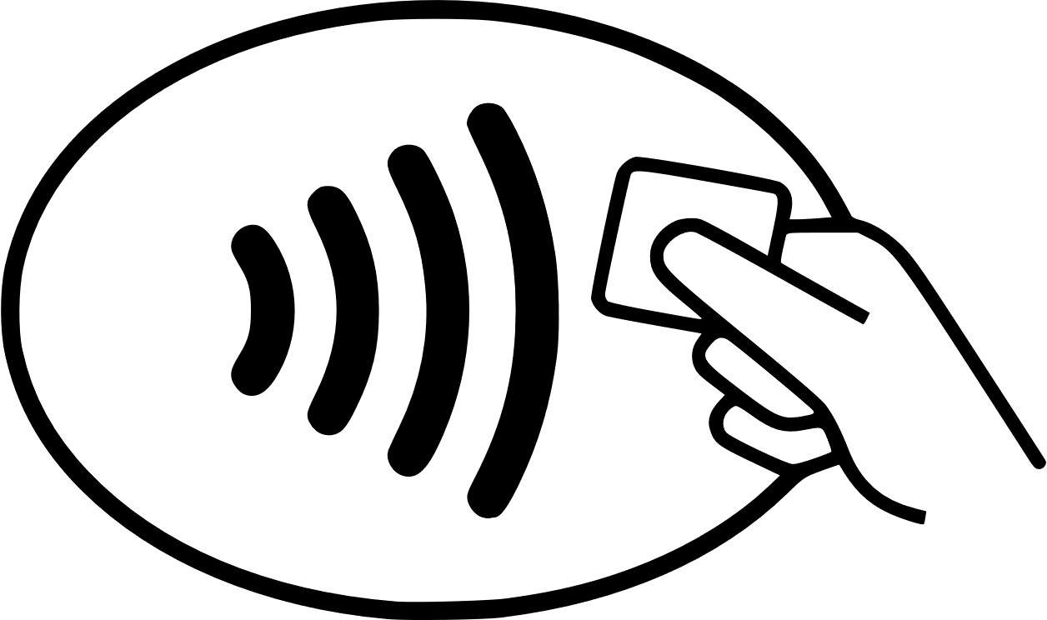
Open Loop Payments
Open Loop Payments enable any customer with a credit or debit card (including mobile versions like Google Pay or Apple Pay) to tap at any device (on the bus, at BRT platforms, or at rail faregates) directly without having to buy a ticket.

Slide 8
Fare Capping
Fare Capping tracks a customer’s use of their media and awards them discounts based on their actual use, without having to pre-purchase a daily, multi-day, or monthly pass.
This is also known as best value fares.
Scenario: You have a rider who only takes MARTA for work, so ~40 trips per month.
 | Monthly Pass | Pay as You Go | Fare Capping
Price per ride | $0 | $2.50 | $2.50
Number of rides per month | 40 | 40 | 40
30-day cost | $95 | N/A | N/A
Total Cost Paid | $95 (paid upfront) | $100 | $95 (paid incrementally)

Slide 9
Retail Reload Locations
Retail outlets allow customers without a credit card to add value to their accounts by paying cash directly to the cashier at a wide range of local stores and have the value immediately available for travel on bus/rail on either their card or mobile device.
Account Management
A rider can add value to their account, track rides, manage autoload, and set account preferences.
When they tap at a device, the device simply checks whether the account is valid and in good standing; this allows for faster transaction time. If the physical card is lost, the account remains so no value is lost so the card can be replaced (if registered).

Slide 10
New Hardware
Enhanced Ticket Vending Machines that allow cash patrons to add value to their accounts, in the same way as the retail outlet, on both cards and mobile devices
New, faster processing fareboxes, that process all ticket/pass/device types and still allow cash payments
New, more secure, and reliable fare gates

Slide 11
Thank You!
MARTA Riders’ Advisory Council
September 7, 2022

