Slide 1
SEE MARTA Communications Framework
October 2023
Notes:
Intro of Self
Transit story

Slide 2
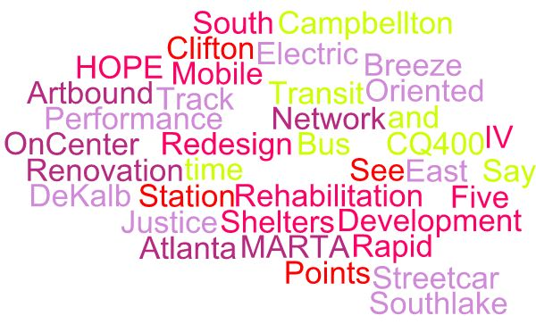
Communication Problem: MARTA has a LOT of initiatives

Slide 3
Communications Rule of 3
The rule of three is a writing principle that states a trio of ideas is more satisfying and effective than other numbers.
The audience is more likely to remember the information conveyed because having three ideas combines both brevity and rhythm with having the smallest amount of information to create a pattern.

Slide 4
SEE MARTA is our long-term framework to more strategically and effectively communicate our progress. We plan to celebrate our ongoing wins across three main categories:
Introducing…
Notes:
What the External Affairs team is proposing is that we adopt the SEE MARTA framework to denote the Collie Greenwood era of MARTA, which will allow us to focus on the three major initiatives we are undertaking, which all fall into Service, Experience or Expansion

Slide 5
S - Service & Service Reliability
MARTA is working to improve our services with:
The basics:
Hiring/absenteeism/CBA
Return to pre-pandemic service
Eliminate DNRs and improve OTP
Bus Network Redesign
CQ400
Reliable, real-time customer info
CAD/AVL
Track renovation/replacement
MARTAConnect
Notes:
Trio – three legs of the stool – first one is Service.
Service: Investing in our people and restoring bus and rail l service to pre-pandemic levels
Big wins might have their own marketing campaigns.
Part of board presentations, community meetings, etc.
CAD/AVL – Computer Assisted Dispatch – Auto Vehicle Locator

Slide 6
E - Experience Improvements
MARTA is improving the customer experience with:
Stations
38 Station Rehab
SMART Restrooms
Lighting
Elevator/Escalator
Station Management & Cleaning
Safety
Breeze Mobile 2.0/AFC 2.0
Artbound
Transit Oriented Development (lines and dots)
Notes:
Experience: Investing in more robust maintenance, technology and the “dots,” the places we connect
More about customer experience – how people “feel” about riding MARTA, not necessarily service (i.e. head ways, on-time)
Enhancing the “sense of place” – from stations to TOD

Slide 7
E - Expansion Projects
MARTA is expanding its footprint to better serve the region with:
More MARTA Atlanta: MARTA Rapid, MARTA Plus+, Streetcar Station Transformation, Enhanced Bus Service
More MARTA Clayton: Justice Center Transit Hub, Multipurpose Operations and Maintenance Facility, SR 54 BRT, Southlake BRT
DeKalb: Transit Hubs and MARTA Plus+
Fulton: GA 400 MARTA Rapid
Notes:
Expansion: Deliver the state of good repair and expansion programs
Drumbeat of milestones, half-birthdays for all these projects
Puts all these different projects under one umbrella.
Allows us to frame each win around same theme – i.e. Summergill BRT
Can claim ownership with SEE message
Gives YOU and everyone at MARTA the framework to talk about your accomplishments

Slide 8
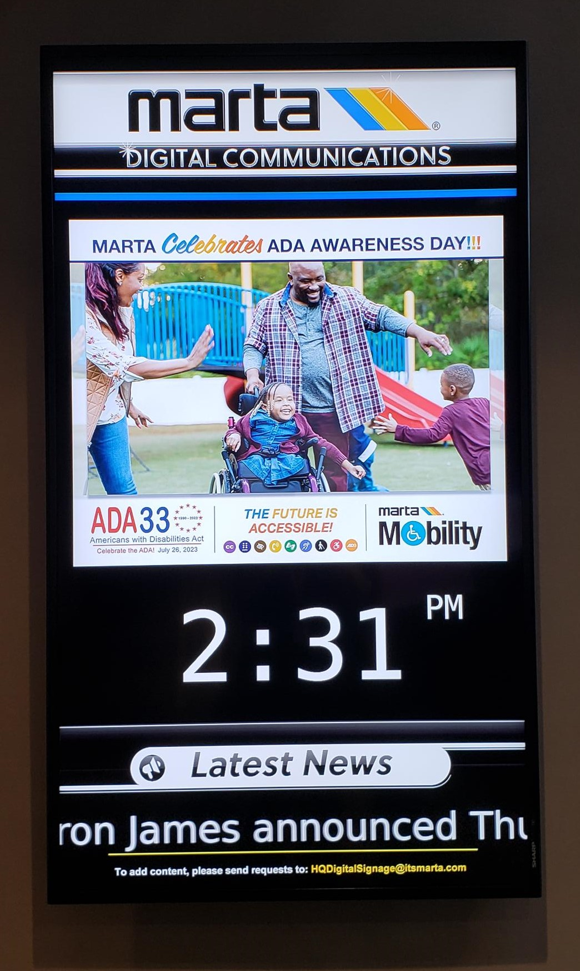
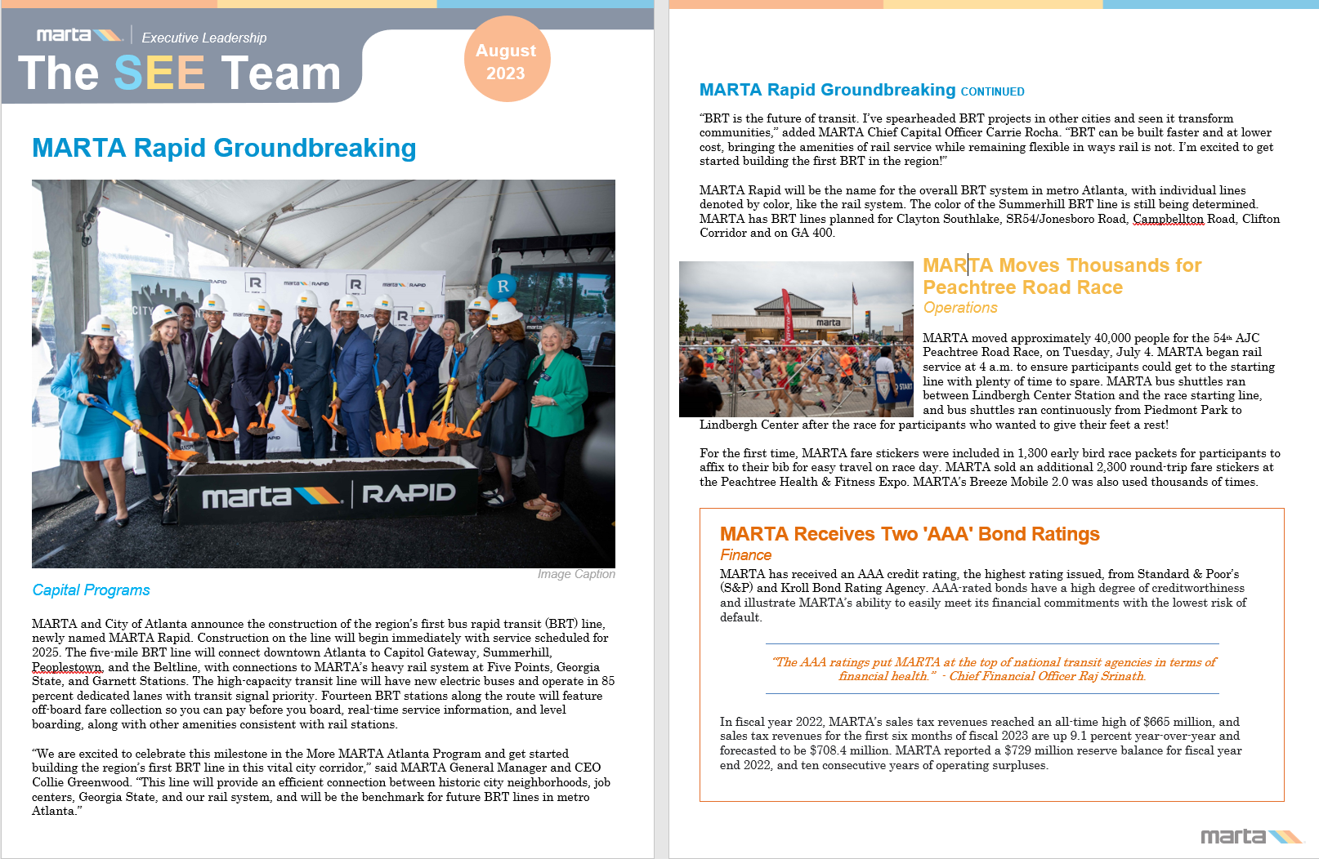
MARTA News Network
Employee Newsletter
Notes:
Luz’s internal newsletter
Rhonda MARTA News Network

Slide 9
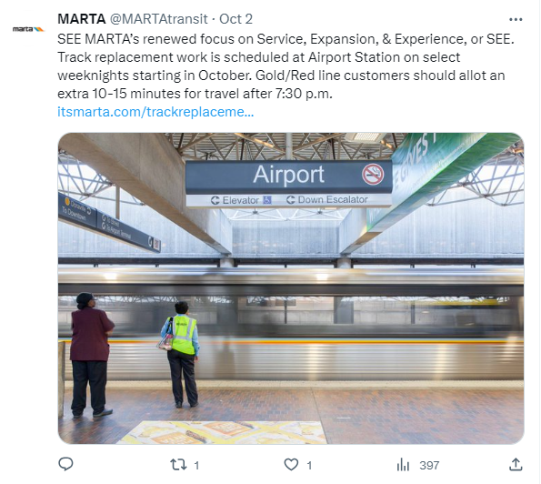
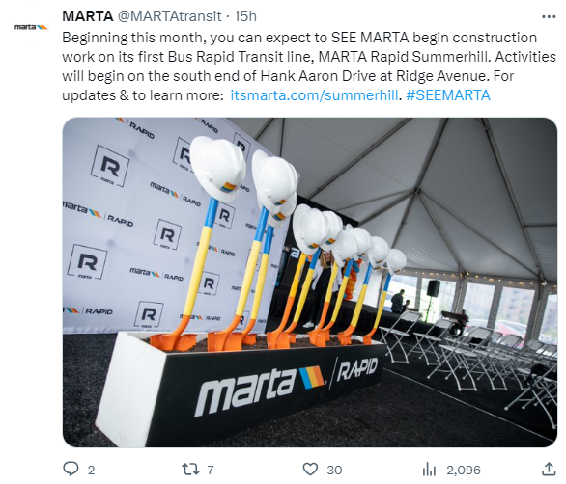
Recent Posts
Notes:
Luz’s internal newsletter
Rhonda MARTA News Network

Slide 10
Catch Phrases
SEE yourself in this effort ‘Tis the SEEson (holiday sweaters)
Come back and SEE us SEE a light at the end of the tunnel
Good to SEE you again (ridership return) SEE what we've done
SEE how MARTA is improving your experience SEE for yourself
SEE you soon Come SEE what MARTA is doing
SEE the writing on the wall (Artbound) Long time no SEE
SEE stars (concert ridership) SEE what we did there?
SEE the big picture SEE in a new light or SEE the light

Slide 11
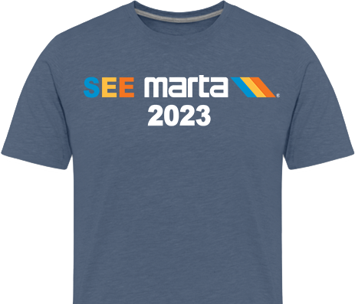
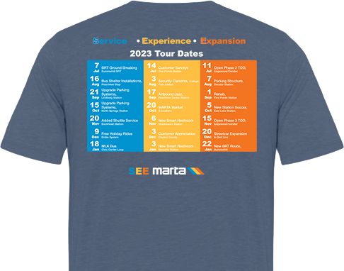

Slide 12
Why SEE MARTA?
Our goal is to encourage current and future customers, jurisdictional partners, and stakeholders to SEE that MARTA is delivering service and experience enhancements and expansion projects, and to give everyone in the Authority a framework for communicating Collie’s vision.
Celebrate Wins
Build the MARTA Brand
Gain New Customers
Align employees around vision/priorities

Slide 13
Notes:
Keith had Ride with Respect, Jeff had Lines and Dots
Heroes was pandemic framework.
We are now past that and we need a new framework to open the path forward.
Ask: bless and develop out a full year plan with tactics/timeline to present to cteam

Slide 14
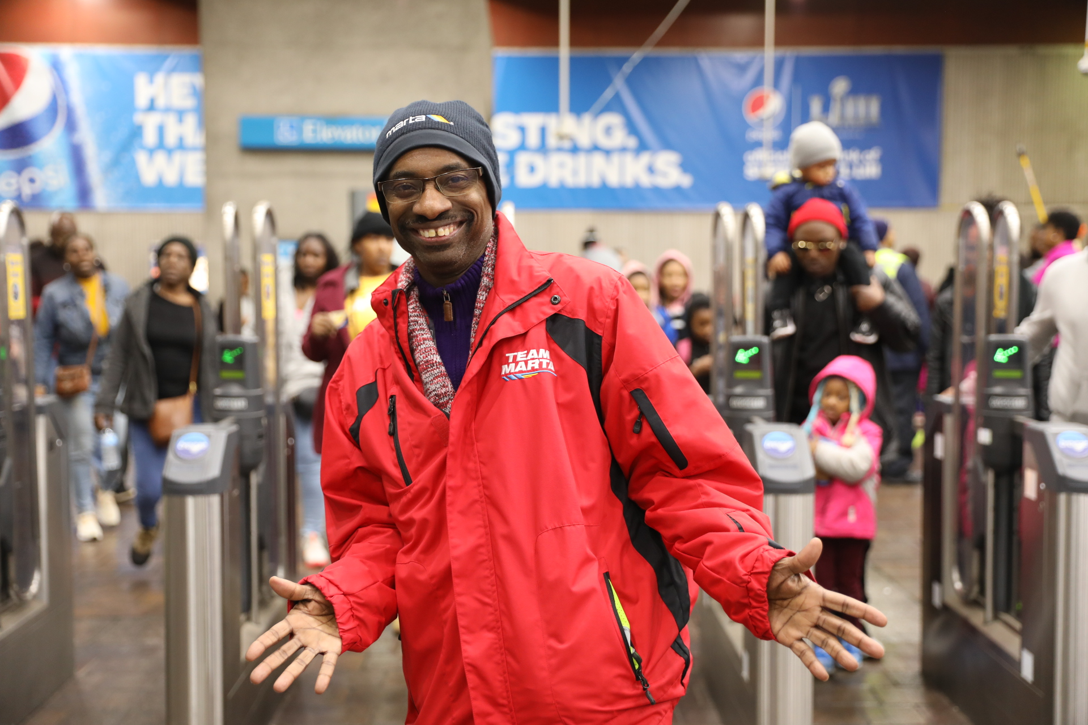
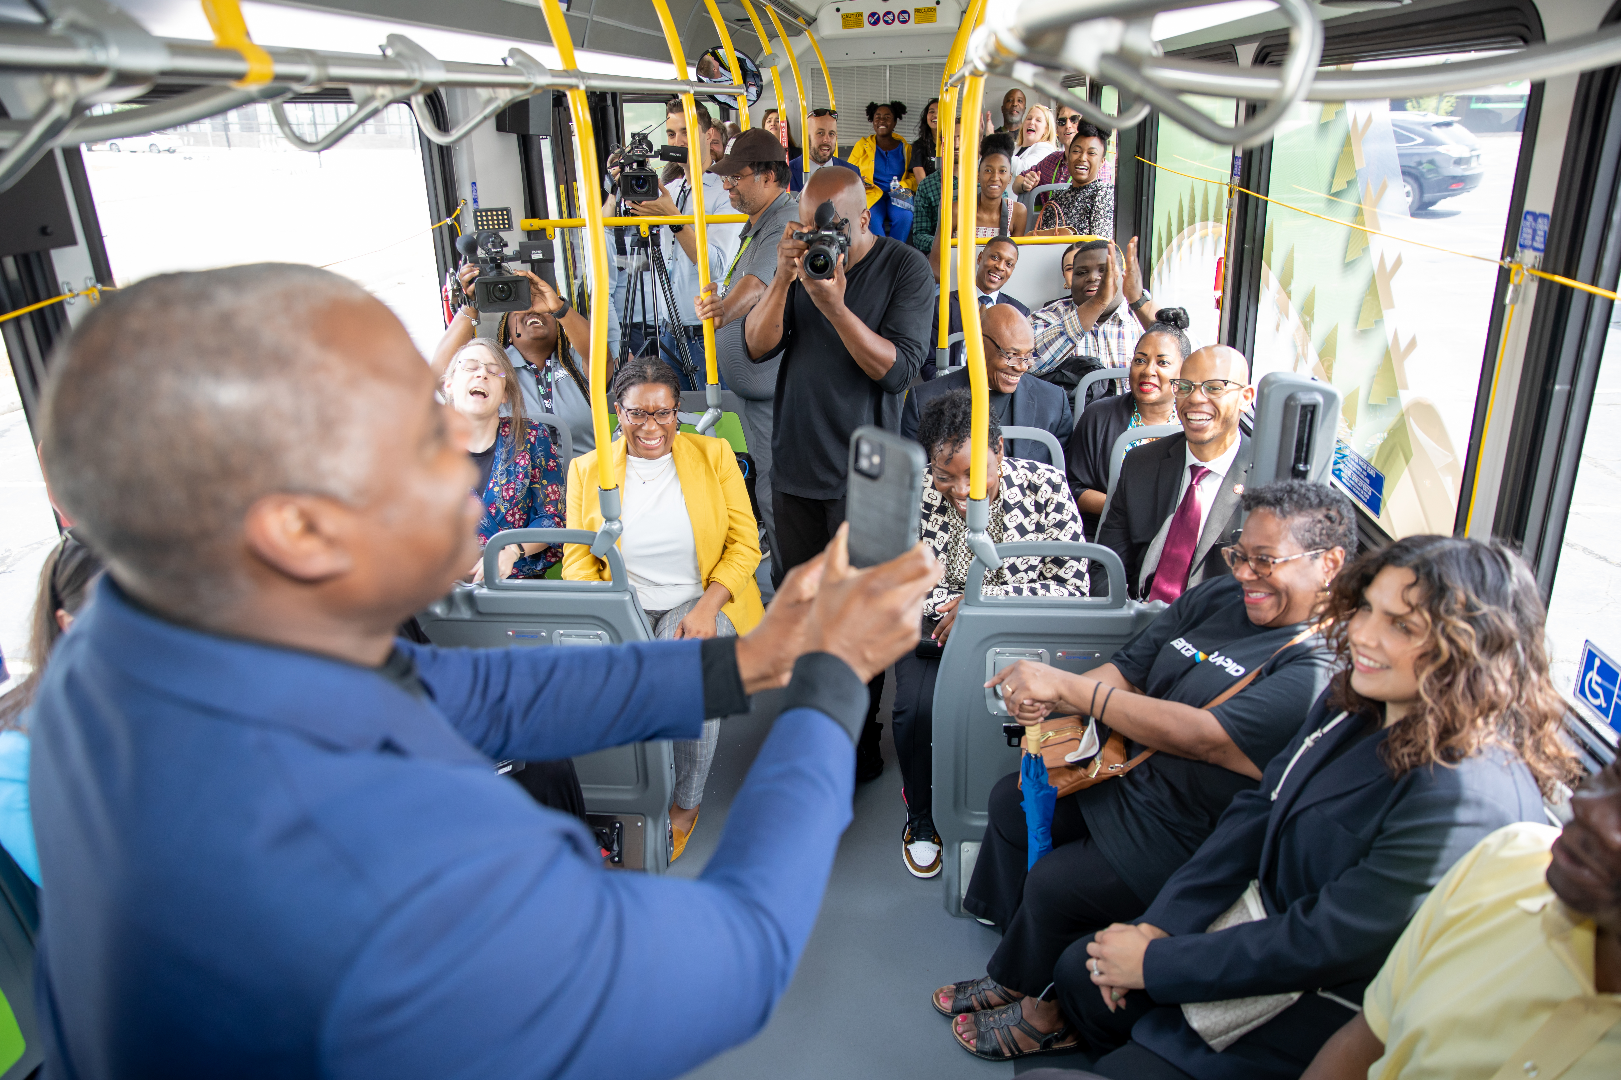
SEE Action Statement
IF WE…
Communications Framework
SO THAT…
THEN WE…
Notes:
If We… ● Create and execute a framework through which to communicate MARTA news Then We… ● Are able to better manage the communications needs of the Authority and communicate more effectively and strategically everything MARTA is doing with internal and external audiences
So That… ● Customers and employees feel informed, supported, and engaged with MARTA, positive media coverage and public sentiment increases, and employee morale improves.

