Slide 1
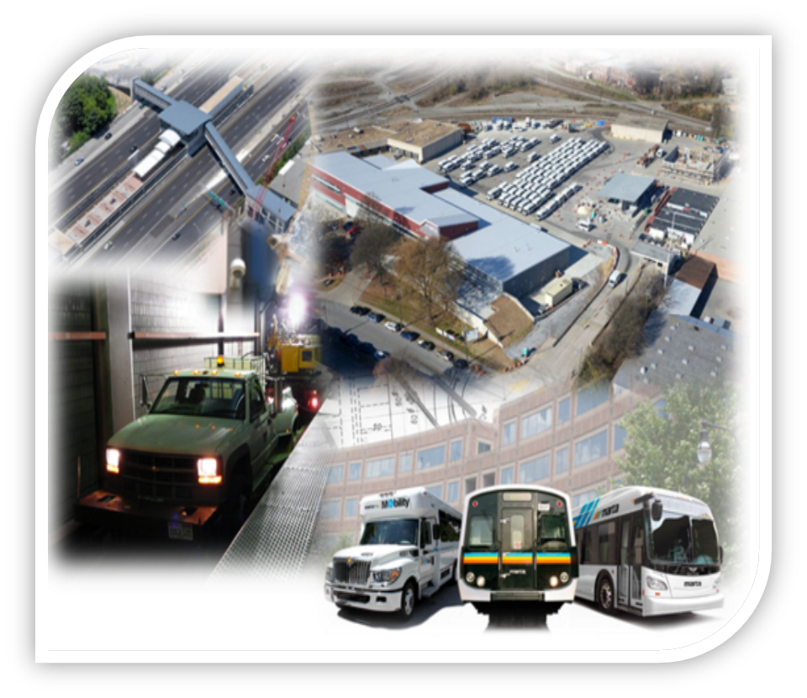
SMART Restrooms Program
Station Rehabilitation
MARTA ​
Jermaine White, Sr. Project Manager
Capital Programs Expansion and Innovation

Slide 2
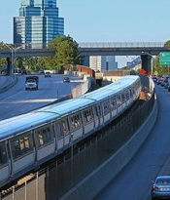
SMART Restrooms Program
Project Background:
For many years MARTA station managers often told riders that there were no station restrooms or that they were for employees only which resulted in several complaints. Due to complaints from MARTA’s riders the MARTA Board voted to open restrooms at 13 MARTA Rail Stations that requires Station Agents for access. As MARTA aims to improve the customer experience MARTA is looking to install Smart Restrooms at all 38 Rail Stations.

Slide 3
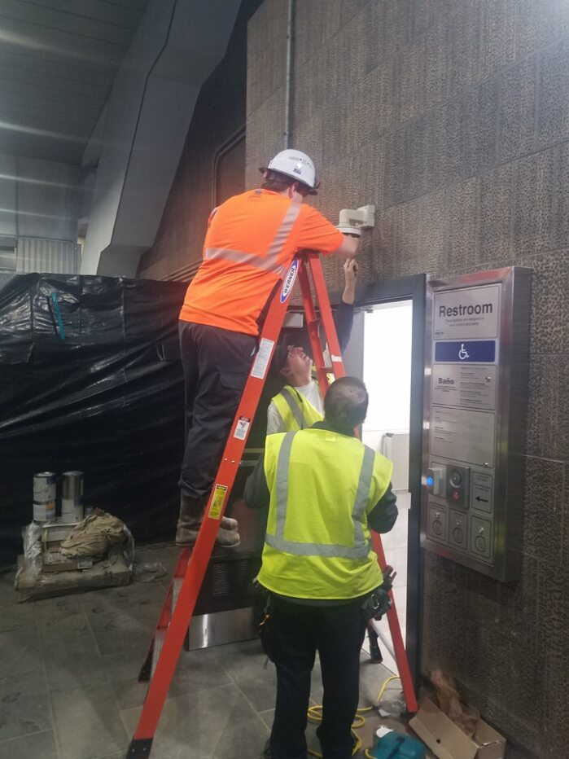
SMART Restrooms Program
The Vision:
The SMART Restrooms Program will encompass a full-gut demolition of restrooms at MARTA rail stations to install a fully automated, controlled entry restroom that features exterior monitoring and access system, interior motion sensors, metered bathroom supplies, and a regulated water dispenser.
To assist with the deliverance of this program, MARTA will use the Construction Manager At Risk (CMAR) method. The CMAR will allow for MARTA to execute capital projects more effectively and efficiently. This allows MARTA to progressively design and start the building process once milestones are executed. This removes the years of design then build.

Slide 4
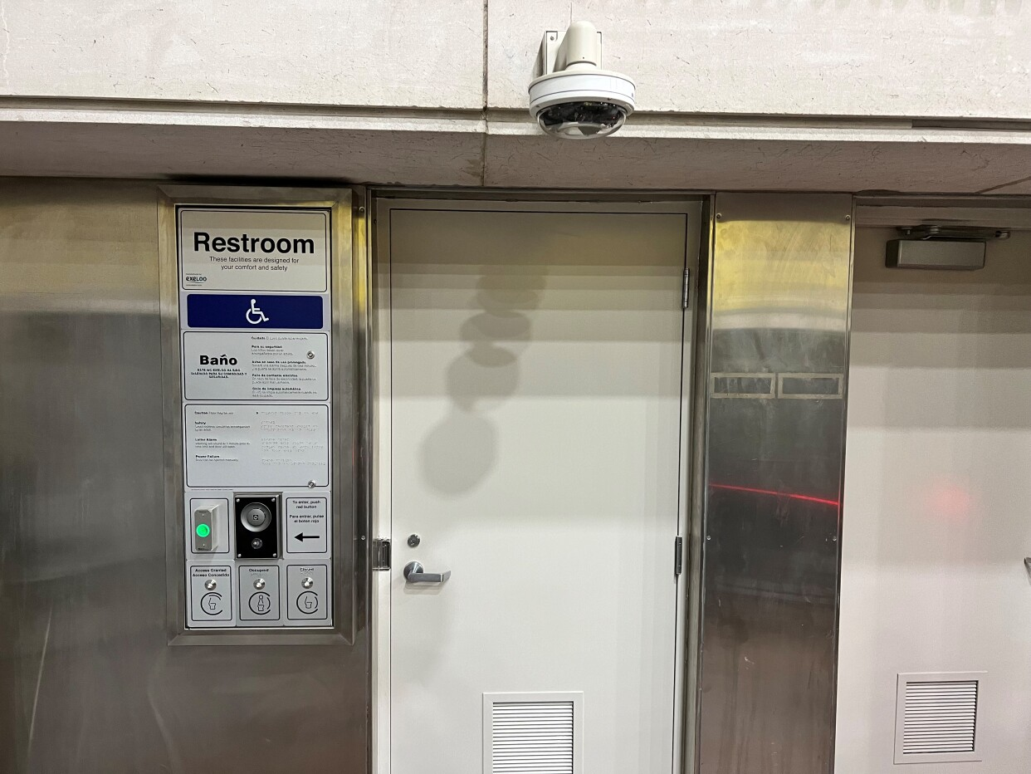
SMART Restrooms Program
Objectives
Improved Sanitation and Hygiene of restrooms.
Enhance access for ADA and general passengers.
Reduce Customer complaints.
Monitoring and controlling of restrooms supplies.
Increased productivity of Rail Station Staff.
Development of internal and external communication on facility use and accessibility.
Improved Rail Station security and passenger safety.

Slide 5
SMART Restrooms
Program
Updated Features
Touchless toilet, sink, soap and toilet paper features.
Electronic access control monitored through MARTA Maintenance Control Center.
Loitering control‐time usage with smart motion sensors.
Monitoring and controlling of restrooms supplies.
Two-way Emergency alarm system.
New wall & floor finishes

Slide 6
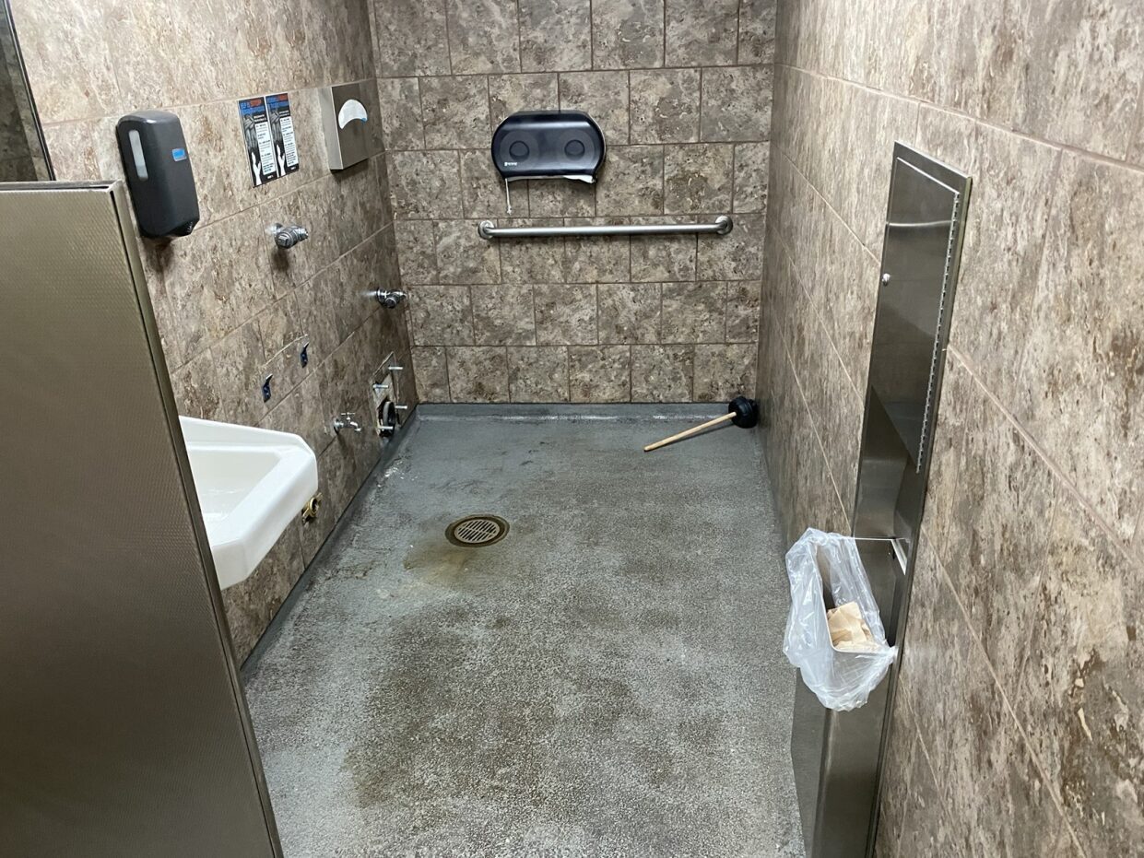
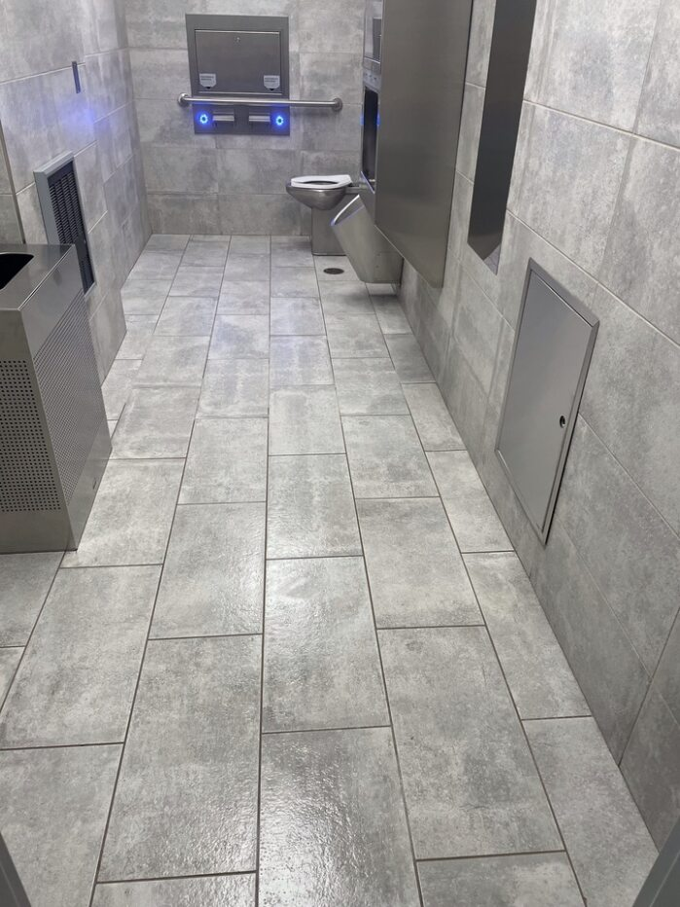
SMART Restrooms
Program
Before
After

Slide 7
SMART Restrooms
Program
Upcoming Schedule
The SMART Restrooms Program has implemented fully-functional restrooms at the following stations:
East Lake Station
Doraville Station
GWCC/Dome Station
H.E. Holmes Station

Slide 8
SMART Restrooms
Program
Upcoming Schedule
The remaining stations will be implemented in waves of 4 over the next 4 -5 years.
Wave 1
  Vine City
  Peachtree Center
  Georgia State
  Garnett
Wave 2
  Civic Center
  Ashby
  King Memorial
  North Ave
Wave 3
  Midtown
  Lenox
  Brookhaven
  Inman Park
Wave 4
  Edgewood/Candler
  Buckhead
  Medical Center
  Arts Center
Wave 5
  Lakewood
  College Park
  Indian Creek
  Kensington
Wave 6
  West End
  Oakland
  East Lake
  Lindbergh
Wave 7
  Avondale
  Decatur
  West Lake
  Bankhead
Wave 8
  Dunwoody
  Chamblee
  Sandy Springs
  North Springs

