Slide 1
The Digital Commute: The Role of Social Media in Transit
Presented By:
Vivian Stuart – Sr. Customer Service Social Media Specialist
Amanda Jackson – Social Media Specialist
Wednesday, November 1, 2023

Slide 2
Identifying the Need for Customer Service Responses on Social Channels
Existing Bus & Rail real-time service information generated from the Integrated Operations Center (IOC) that’s visible on @MARTAservice Twitter
Marketing and Digital Media scheduling social media posts for brand content, major service changes, upcoming events, and providing limited responses
Customers asking for additional/specific service information or creating their own narratives on social media with no immediate response from MARTA
Notes:
Existing real-time service information from the IOC from Bus and Rail Communications team- automatically generated to Twitter from the passenger alerts system.
The Marketing Office scheduled posts regarding service changes, such as holiday and weekend schedules, upcoming major events, brand content, and other promotional posts.
The Office of Digital Media provided limited customer responses on social media that occasionally provided additional information about service but mostly requested that customers contact the Customer Service Center for complaints and feedback or the Customer Information Center for service questions.
Due to no Customer Service-trained personnel responding on social media, there would sometimes be a negative image and response from customers
We realized that service communications were mostly a one-way channel on social media; customers requesting any specific service information did not receive an immediate response, and some customers began to create their own “narratives” about any service changes or disruptions, especially in the pandemic world.

Slide 3
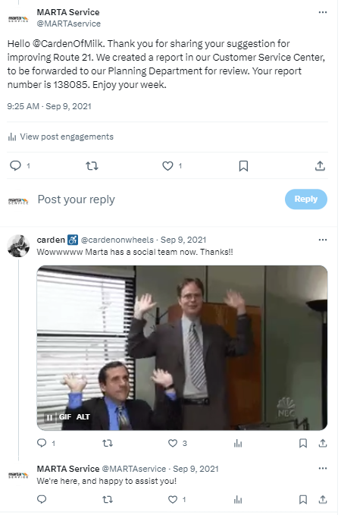
Introducing MARTA’s Customer Service Social Media Team
Newest area of the Office of Customer Services launched in August 2021
Dedicated staff of three (3) Specialists and one (1) Senior Specialist to monitor MARTA’s core social media channels and respond to customer commentary, while also engaging with transit influencers regarding service-related topics
Follow the formal Customer Service process for customer complaints, commendations, suggestions, and feedback
Maintain close collaboration with External Affairs, Operations, Planning, and other departments
Notes:
The newest segment of the Office of Customer Services was launched in August 2021, as MARTA continued navigating pandemic-related staffing shortages months before our announcement of reduced bus services (most routes operating on weekend schedules).
We have dedicated staff (currently a team of 4) to monitor MARTA’s dedicated service page on Twitter (@MARTAservice) and our sole Facebook page and the sole Instagram page (shared with the external affairs team- both named MARTA Transit). That’s 3 Social Media Specialists and 1 Senior Social Media Specialist.
There’s specialized training for the team that combines customer service standard operating procedures with guidance on responding within brand guidelines.
Our responses are customer-experience focused to resolve concerns and restore customer trust.
Our team also manages the elevator entrapment follow-up process, which includes contacting the customer to apologize for their experience, gathering feedback about their experience (which we forward to our Vertical Transportation and Rail Operations team for review and action, if necessary), and offering compensation as an act of good faith on behalf of MARTA.
During planned and unplanned service outages, we provide support for the MARTAConnect process for Uber and Lyft subsidized vouchers.
Additionally, the team schedules posts for planned and unplanned service changes, which include special weekend schedules, holiday operations, major events, bus bridge emergencies, and service outages.
We generate weekly, monthly, quarterly, and fiscal year reports on customer sentiments and social media metrics. We also closely collaborate with departments across MARTA to stay abreast of and relay service changes and any customer experience improvement efforts.

Slide 4
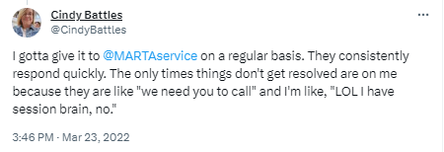
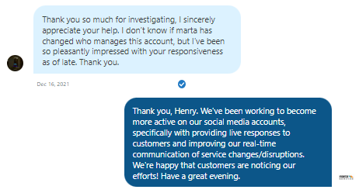
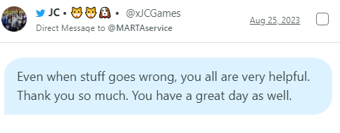
Improved Customer Feedback Regarding Social Responses
Notes:
We noticed an immediate improvement in customer communication with our real-time customer service responses. Customers were excited that a dedicated social media team was available to answer questions, address concerns, and forward feedback through direct correspondence from our social channels.

Slide 5
Growth in Social Metrics
 | Total Replies | Avg. Response Time (minutes) | Total Service Posts | Impressions # times post was displayed | Engagements Total likes, shares, clicks, comments, reposts, etc. | Engagement Rate | Avg. Reach per Post # people that viewed each post | Video Views | Post Link Clicks
FY 2022 (August 2021 - June 2022) | 3,839 | 206 | 799 | 788,908 | 28,650 | 3.9% | 1,069.54 | 34,351 | 4,929
FY 2023 (July 2022 –June 2023) | 6,823 | 47 | 1,619 | 1,589,491 | 71,431 | 4.5% | 1,227.77 | 65,692 | 8,380
Notes:
In addition to strengthening our relationship with new and current riders and transit advocates on social media, we’ve also improved the social metrics of our service posts.
Within one fiscal year, we’ve doubled our service-related posts, which in turn doubled our impressions, engagements, video views, and post-link clicks.
Additionally, we’ve improved our efficiency with responding to customers on our social channels; our total replies have doubled, but we’ve significantly decreased our average reply time.
With the help of the Digital Media, Marketing and Communications offices, we’re posting more engaging videos, photos, and graphics with our responses and notification posts.

Slide 6
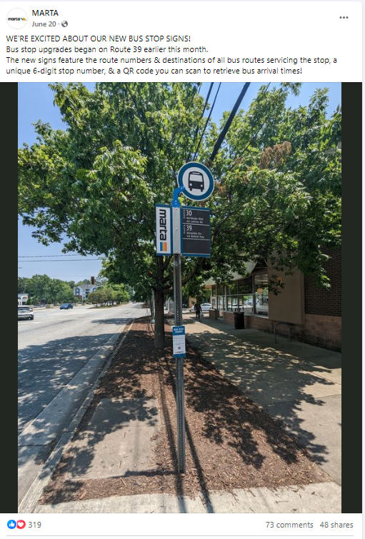
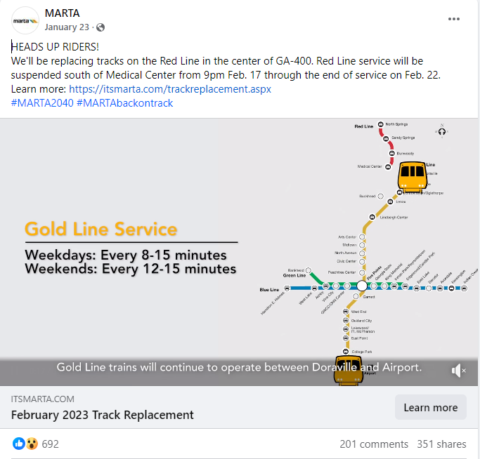
Continued Focus on Relaying Service-Related Information…

Slide 7
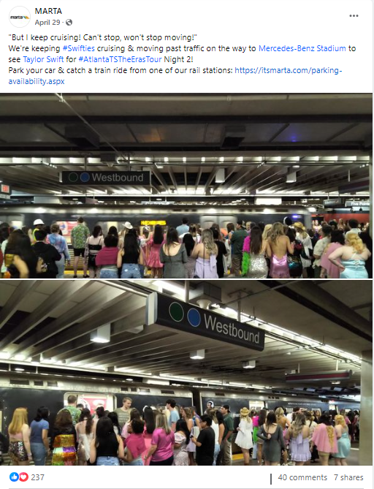
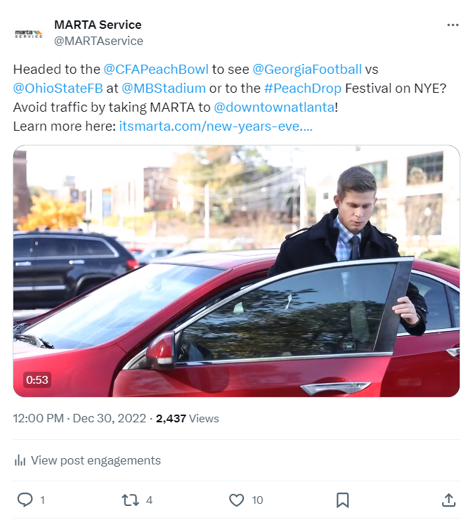
…And Promoting Ridership to Events in Atlanta!

Slide 8
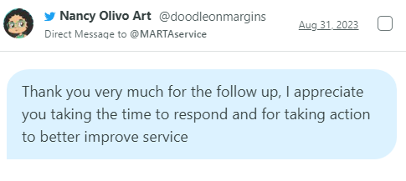
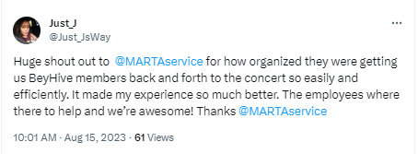
Goals of the Customer Service Social Media Team
Expanded hours of social media support to cover special events and planned/unplanned service changes
Improved customer engagement and sentiments across our social channels
Improved feedback process across internal departments
Notes:
And now, the Goals of the Customer Service Social Media team:
With our team now being fully staffed, we are looking to expand our hours of customer support on social media. We currently provide real-time responses to customers on our social channels on weekdays between 7 a.m. through 7 p.m., with additional monitoring on the weekends and holidays. We also provide support as needed for special events and service emergencies.
As we continue to post and respond to customers with more dynamic content, we look forward to increasing our engagement with riders and social influencers and improving customer sentiments. This would be a collaborative effort with other teams across MARTA with our collective goal to improve the overall transit experience for all riders.
As we continue to work closely with other internal departments, we want to improve our communication of customer feedback related to those areas. We’d like to provide tailored reports to each department to aid in identifying needed areas of improvement and gauging areas of success.

Slide 9
Added Benefits of Social Media in Transit
Our social media platforms offer us an effective way to market our services and promote programs, opportunities, special events, and partnerships.
Notes:
And now, the Goals of the Customer Service Social Media team:
With our team now being fully staffed, we are looking to expand our hours of customer support on social media. We currently provide real-time responses to customers on our social channels on weekdays between 7 a.m. through 7 p.m., with additional monitoring on the weekends and holidays. We also provide support as needed for special events and service emergencies.
As we continue to post and respond to customers with more dynamic content, we look forward to increasing our engagement with riders and social influencers and improving customer sentiments. This would be a collaborative effort with other teams across MARTA with our collective goal to improve the overall transit experience for all riders.
As we continue to work closely with other internal departments, we want to improve our communication of customer feedback related to those areas. We’d like to provide tailored reports to each department to aid in identifying needed areas of improvement and gauging areas of success.

Slide 10
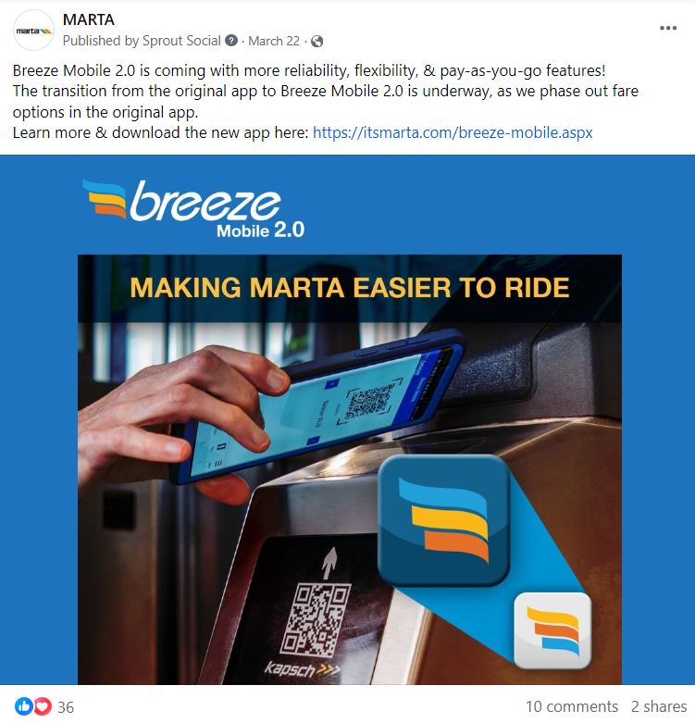
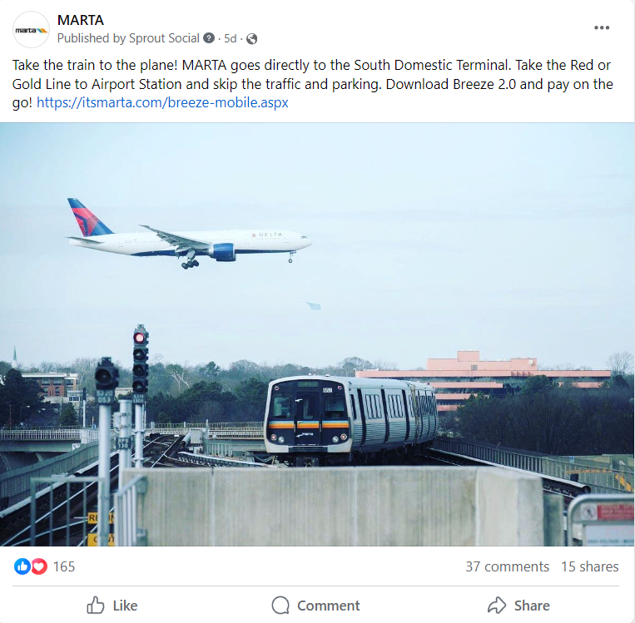
Highlight Products and Service Updates

Slide 11
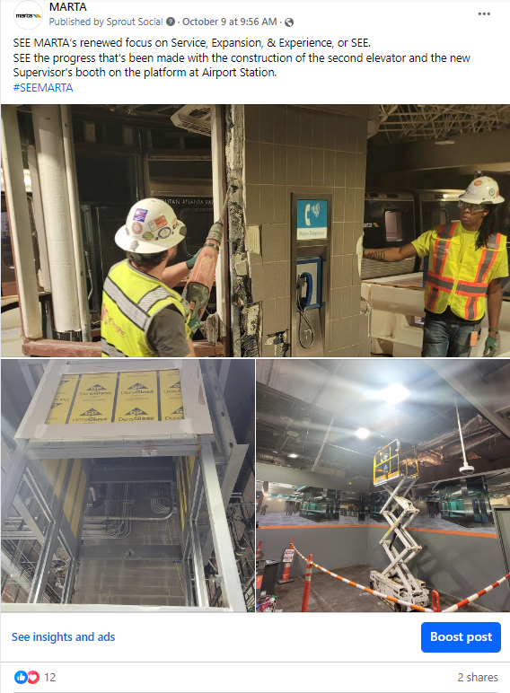
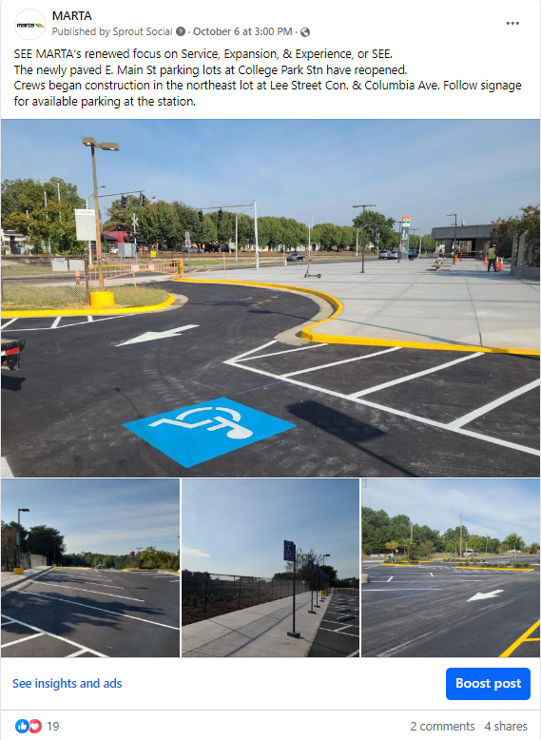
Showcase Station Rehab Improvements

Slide 12
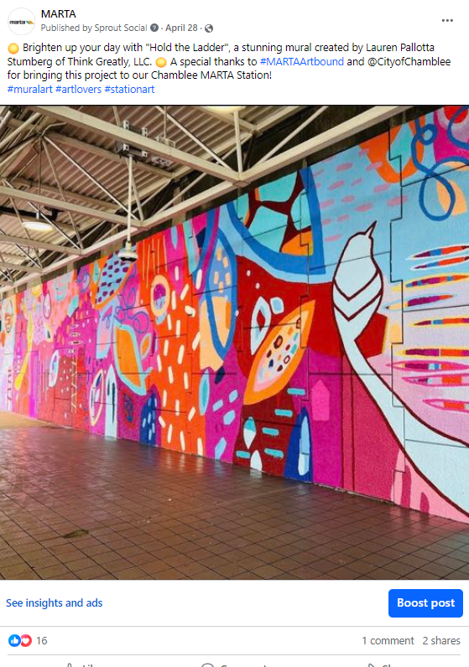
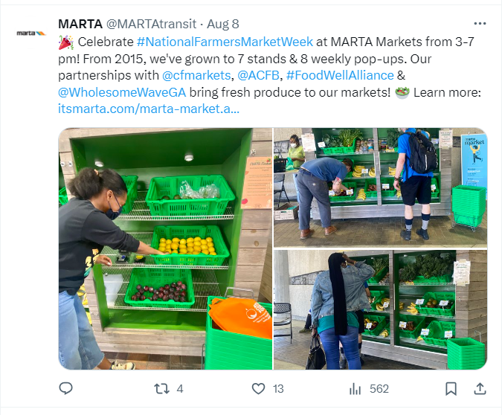
MARTA Programs & Resources

Slide 13
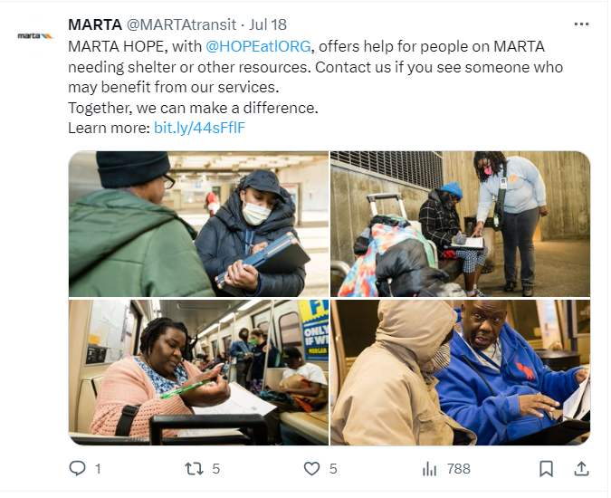
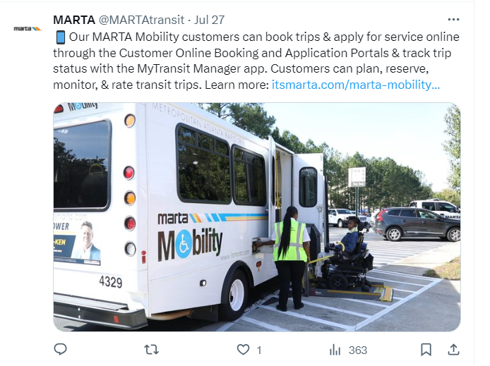
MARTA Programs & Resources

Slide 14
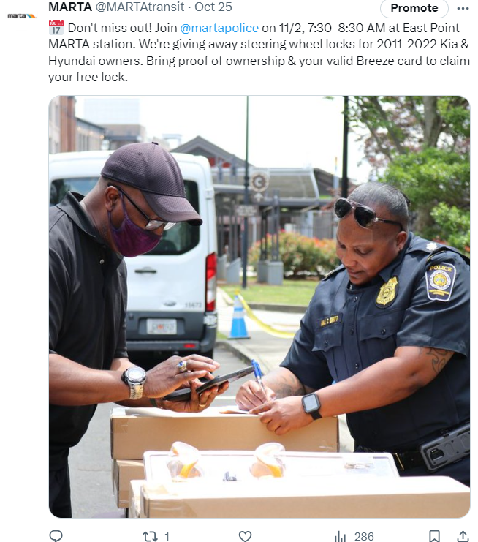
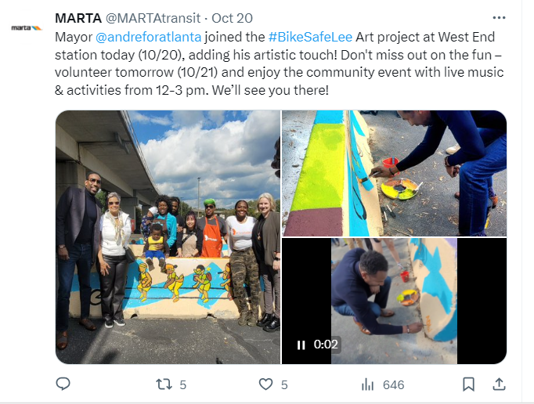
Celebrating Community Engagement

Slide 15
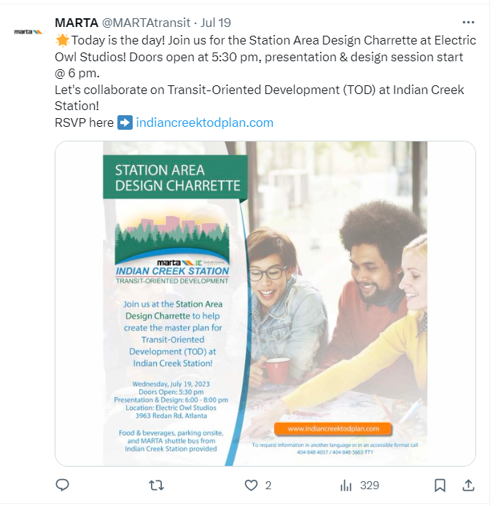
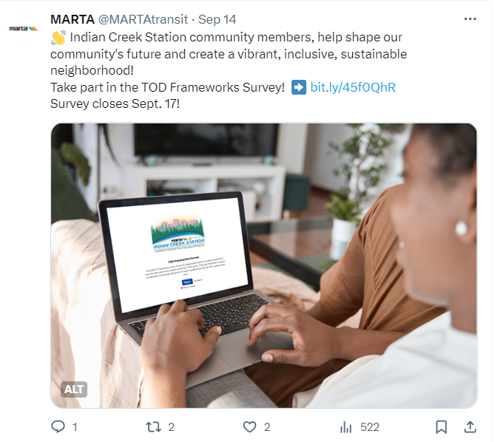
Calls for Participation

Slide 16
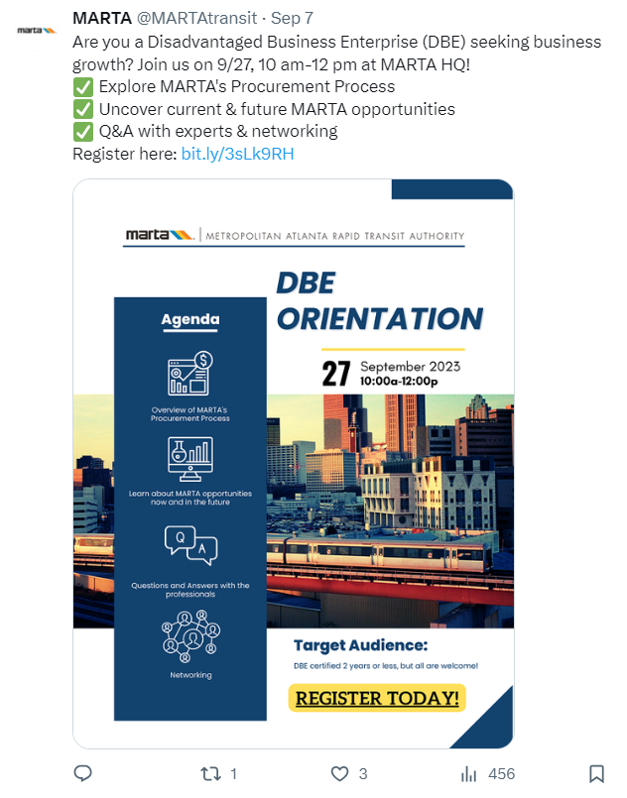
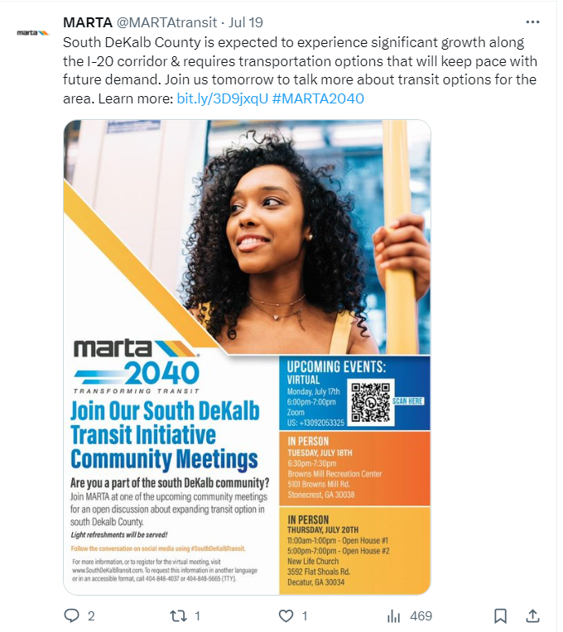
Calls for Participation

Slide 17
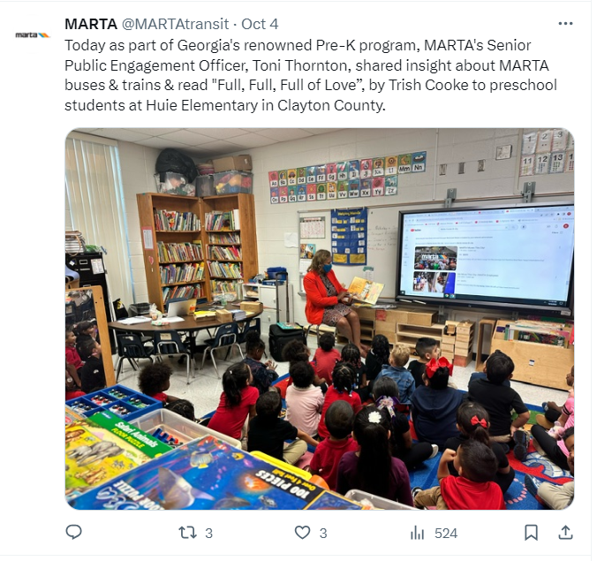
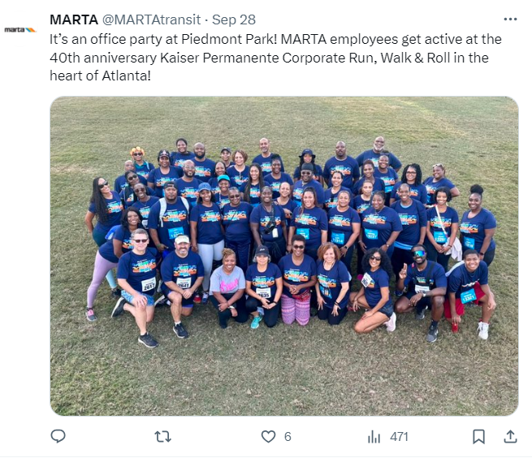
Staff Involvement in Community Initiatives

Slide 18
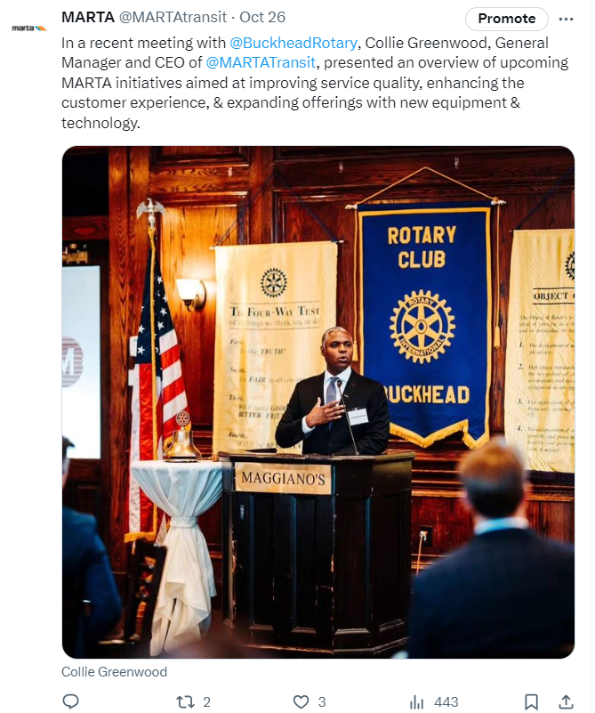
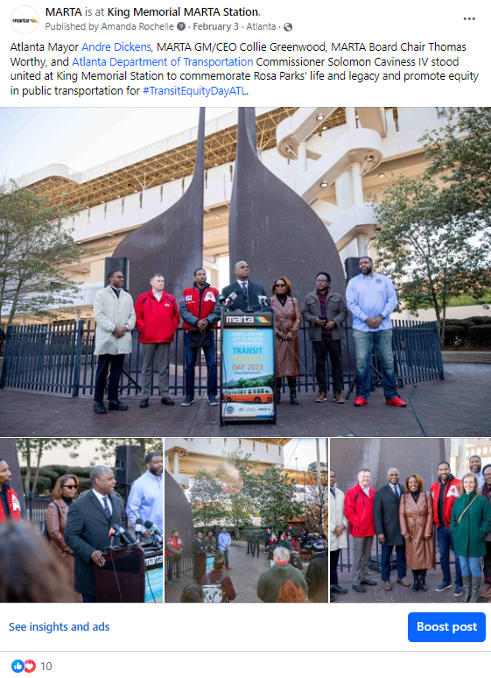
Showcasing Leadership: CEO & General Manager Collie Greenwood

Slide 19
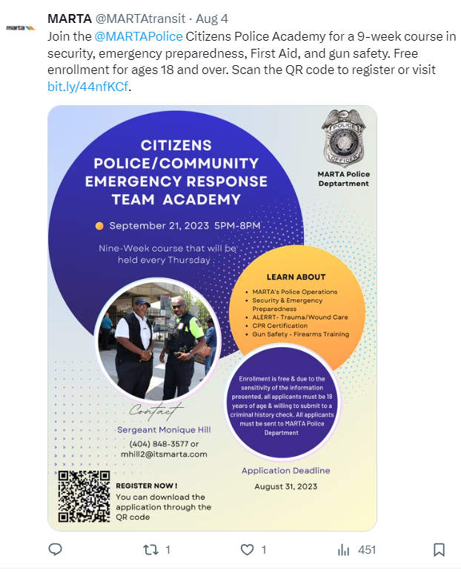
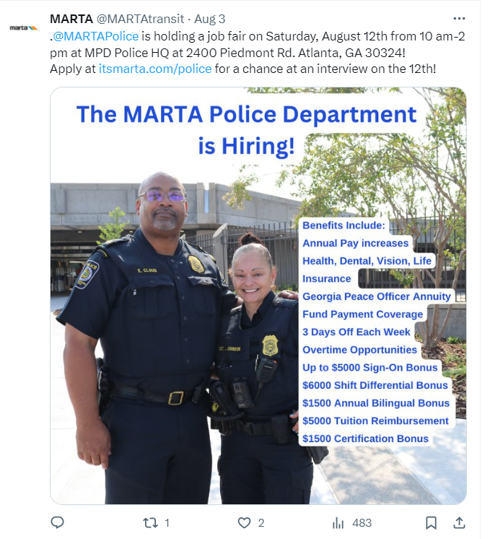
Collaboration Across Departments

Slide 20
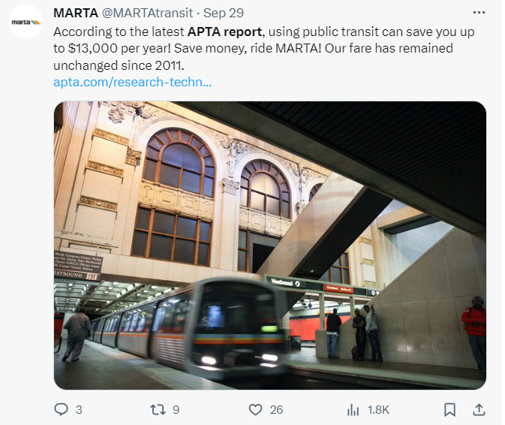
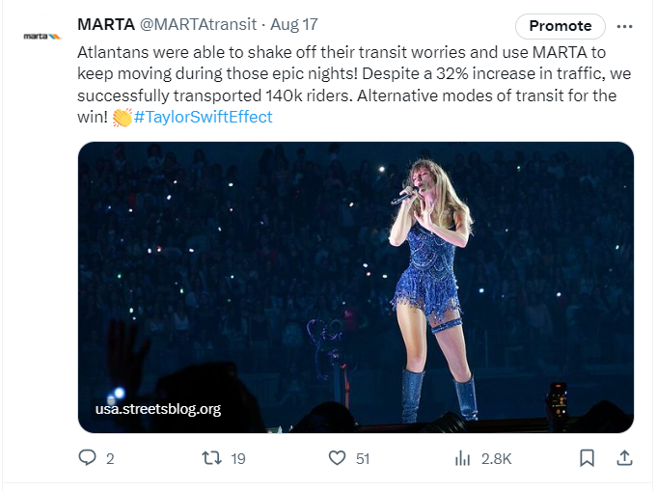
Share Industry Insights & Trends

Slide 21
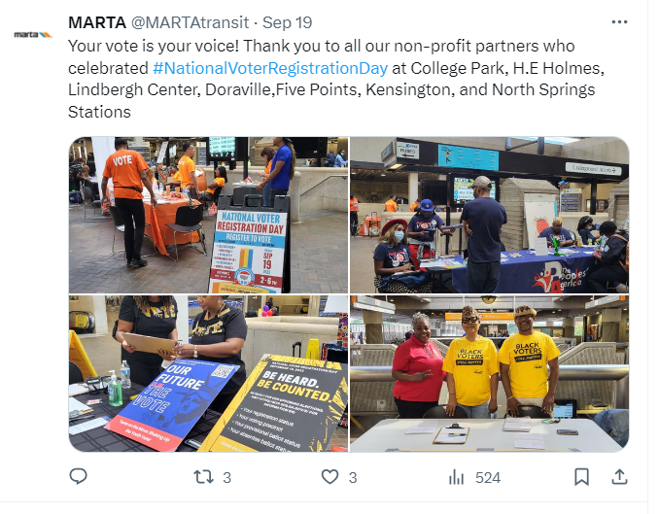
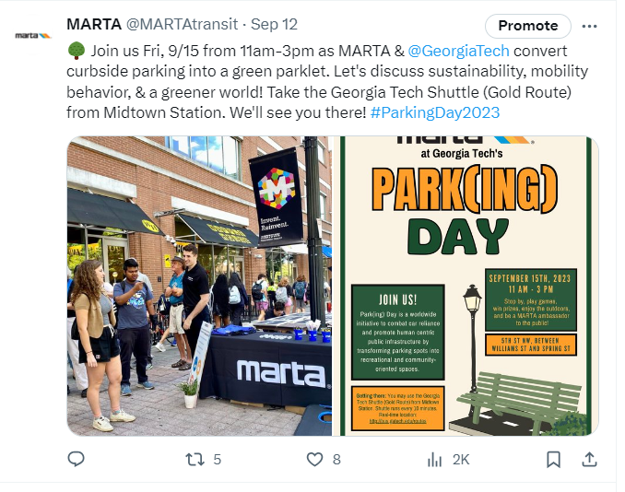
Championing National Awareness & Social Causes

Slide 22
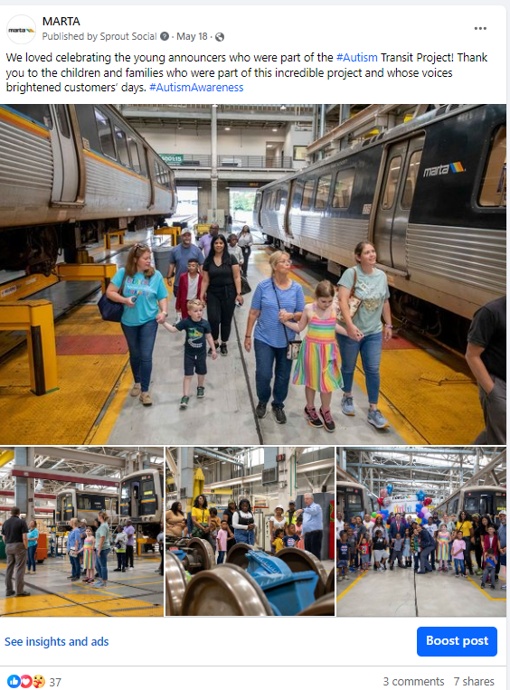
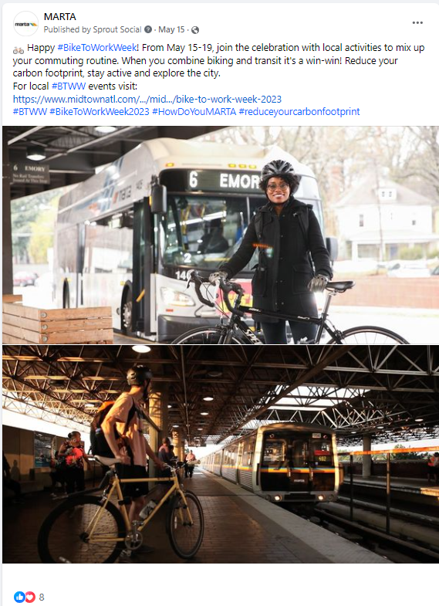
Championing National Awareness & Social Causes

Slide 23
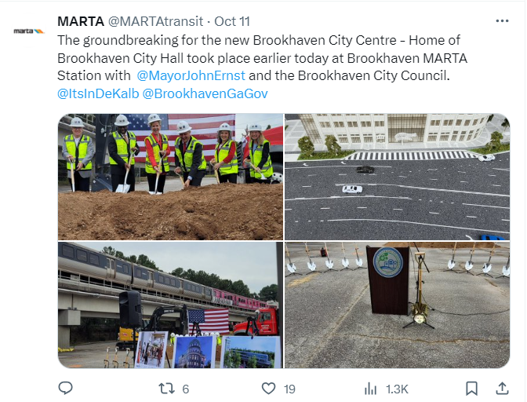
Political Leaders & Partner Developments

Slide 24
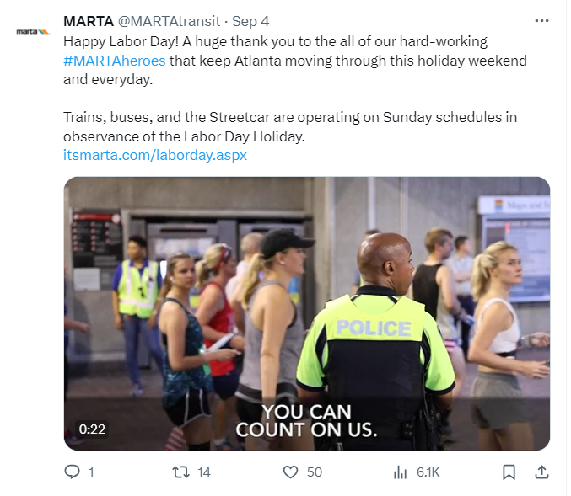
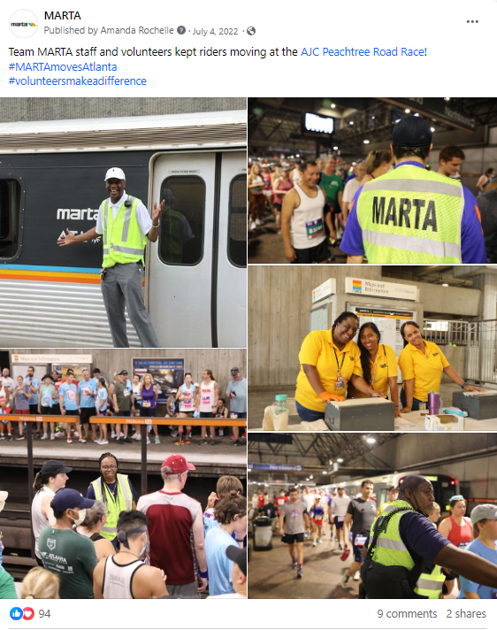
Appreciating Our Valued Customers & Staff

Slide 25
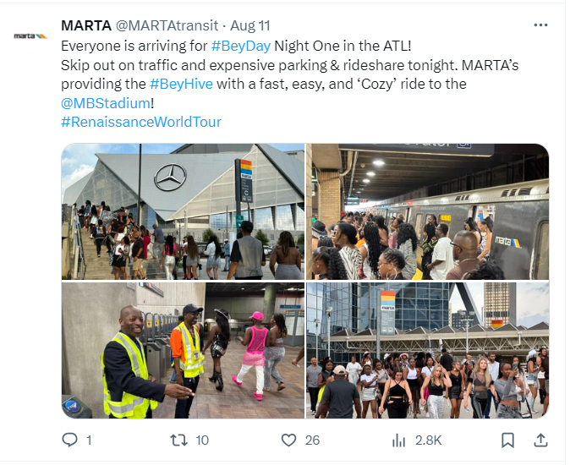
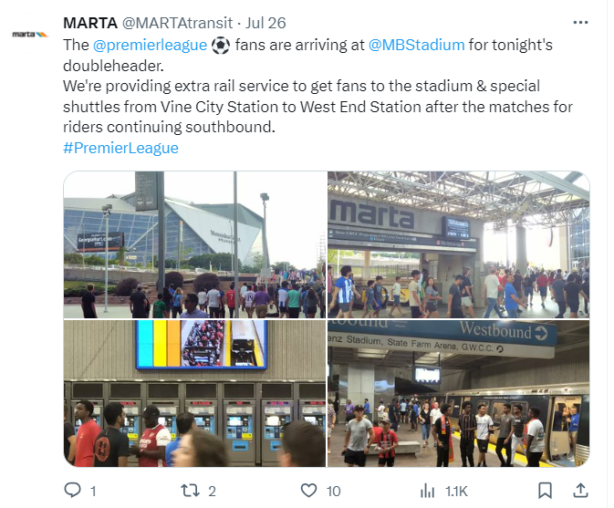
Encouraging Ridership to Downtown & Events

Slide 26
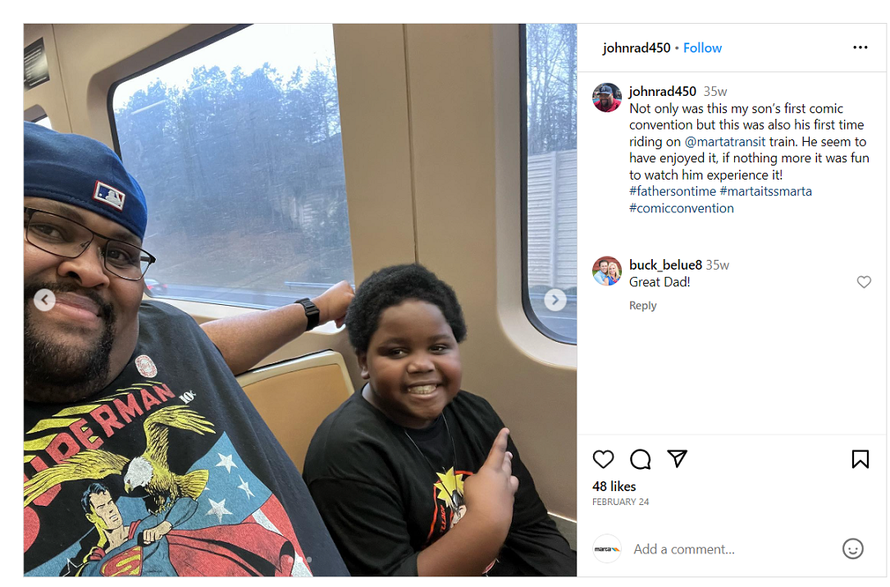
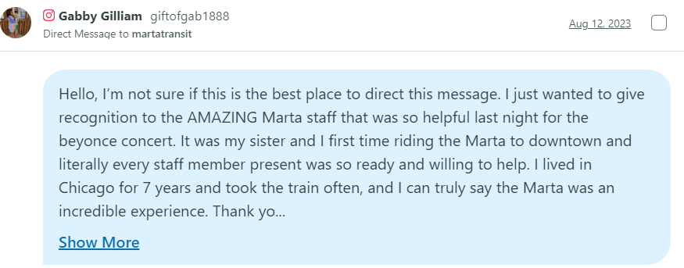
Commuter Chronicles
Notes:
And now, the Goals of the Customer Service Social Media team:
With our team now being fully staffed, we are looking to expand our hours of customer support on social media. We currently provide real-time responses to customers on our social channels on weekdays between 7 a.m. through 7 p.m., with additional monitoring on the weekends and holidays. We also provide support as needed for special events and service emergencies.
As we continue to post and respond to customers with more dynamic content, we look forward to increasing our engagement with riders and social influencers and improving customer sentiments. This would be a collaborative effort with other teams across MARTA with our collective goal to improve the overall transit experience for all riders.
As we continue to work closely with other internal departments, we want to improve our communication of customer feedback related to those areas. We’d like to provide tailored reports to each department to aid in identifying needed areas of improvement and gauging areas of success.

Slide 27
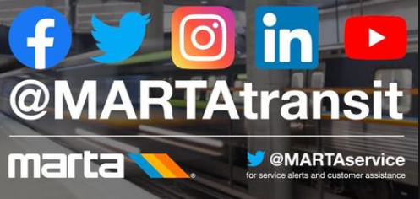
Thank You
We invite you to stay updated on our initiatives and projects by following us on our social media channels. You can find us under the handles @MARTATransit and @MARTAService (for alerts and customer service).
Your support and engagement are greatly appreciated! ☺
Notes:
And now, the Goals of the Customer Service Social Media team:
With our team now being fully staffed, we are looking to expand our hours of customer support on social media. We currently provide real-time responses to customers on our social channels on weekdays between 7 a.m. through 7 p.m., with additional monitoring on the weekends and holidays. We also provide support as needed for special events and service emergencies.
As we continue to post and respond to customers with more dynamic content, we look forward to increasing our engagement with riders and social influencers and improving customer sentiments. This would be a collaborative effort with other teams across MARTA with our collective goal to improve the overall transit experience for all riders.
As we continue to work closely with other internal departments, we want to improve our communication of customer feedback related to those areas. We’d like to provide tailored reports to each department to aid in identifying needed areas of improvement and gauging areas of success.

