Slide 1
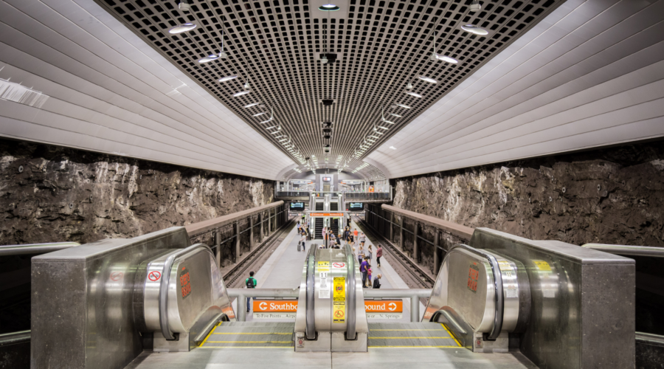
transit scheduling
Factors that go into bus and rail schedule design
Jolando Crane – Manager of Scheduling
Mark McComb – Rail Scheduler (Ctr)
12/6/2023

Slide 2
Basics of transit scheduling
Consists of two elements
How long it takes to get from one end to the other
Time to recover at the end of the line

Slide 3
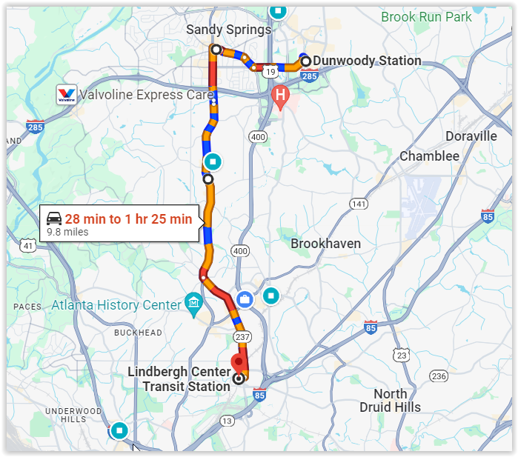
How long to get from one end to the other
Factors that affect scheduled time
Traffic
Number of stops that are made
Number of passengers boarding
Countless other things (construction, traffic signals, development, etc.)
How long it takes varies throughout the day
We group this into bands of time (such as AM peak, midday, or late night)
Averages are used to determine the time that is used
Recovery is a function of how long it takes

Slide 4
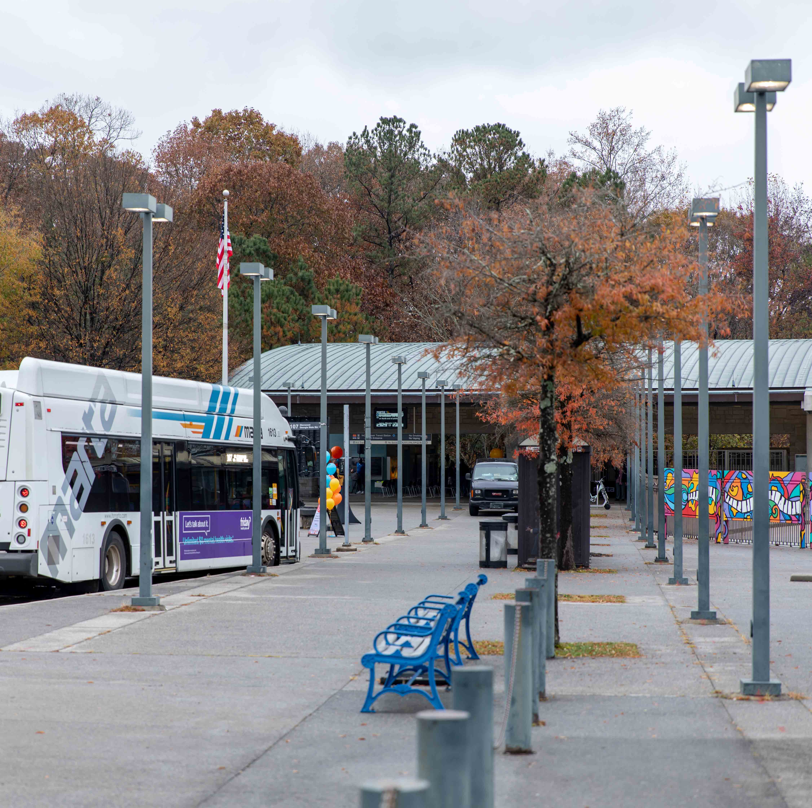
Time to recover at the end of the line
Also known as layover time
Allows time to recover from delays
Allows the operator time to stretch and/or use the restroom

Slide 5
Pulling it all together
When you add together the travel time and the recovery time in both directions then you can begin to schedule the service
A bus route is like a racetrack, buses do laps (round trips)
How long it takes to do a lap is the basis of all scheduling
Then planning lets us know how often service should run
Finally, we figure out how many buses are needed to run service at the desired frequency and create the schedules
Other factors we consider in schedule design

Slide 6
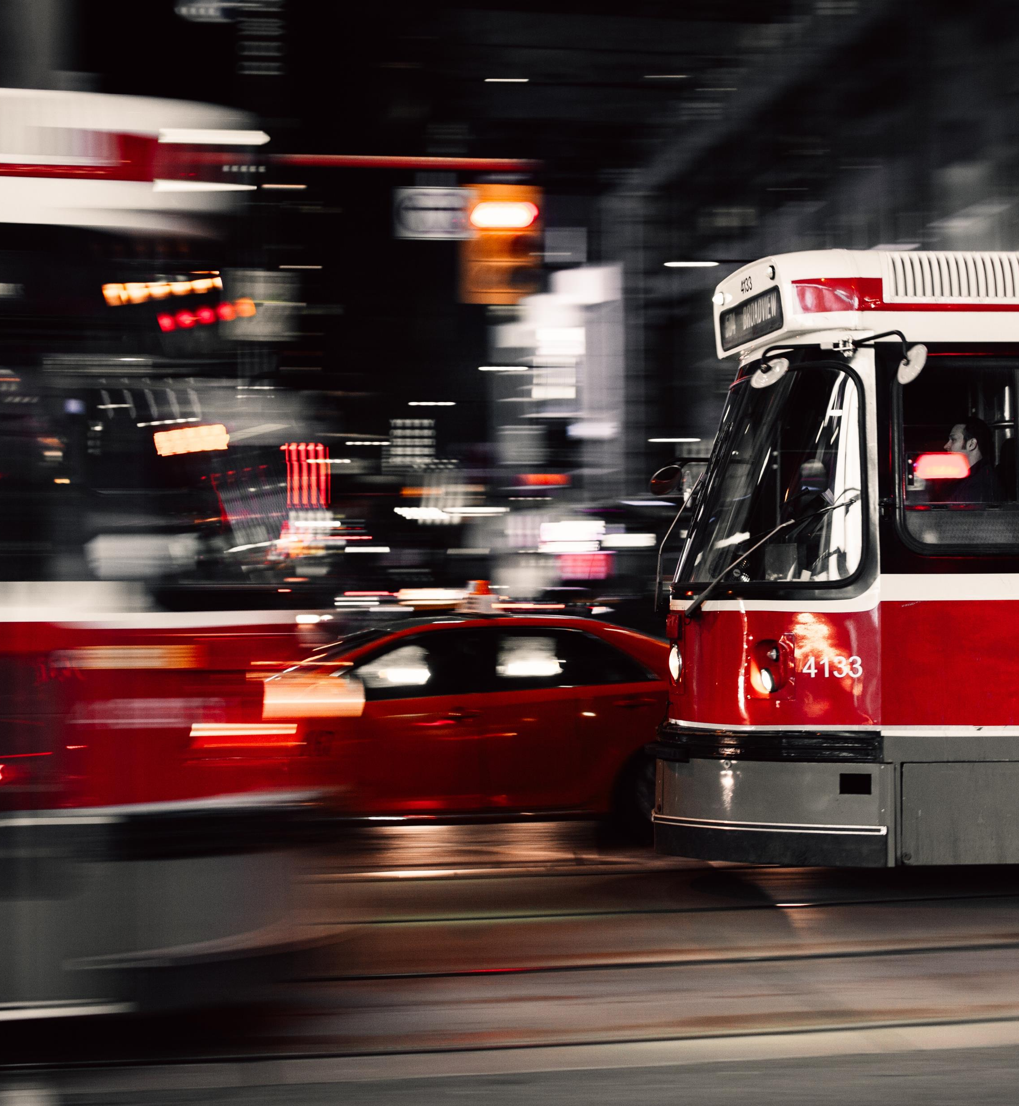
Headway
Time between buses

Slide 7
Headway
Time between buses

Slide 8
Headway
Time between buses

Slide 9
Headway
Time between buses
10
MIN

Slide 10
Cycle Time = 60
# of Buses = 1
Headway = 60

Slide 11
Cycle Time = 60
# of Buses = 2
Headway = 30

Slide 12
Cycle Time = 60
# of Buses = 3
Headway = 20

Slide 13
Cycle Time = 60
# of Buses = 4
Headway = 15

Slide 14
Rail scheduling
At its core, rail scheduling is very similar to bus scheduling
Need to know how long it takes and how much recovery time is needed
Need to figure out how many trains are needed to provide frequency
But it is also different
There is only so much space at the end of the line to stage trains
The travel time is usually consistent throughout the day
Construction means single-tracking
Any change may affect multiple schedules
Most of the scheduling relates to construction and special events

Slide 15
Example – Indian Creek Station Redesign
Construction will close off one of the two tracks
Need to reschedule trains so there won’t be two trains at once
Other end of the line (H.E. Holmes) also is preferred to have one train at a time
Schedule will need to be shifted to line up trains on each end
Also will need to shift Green line
Also will need to adjust 5-8 other single tracking and special event schedules

Slide 16
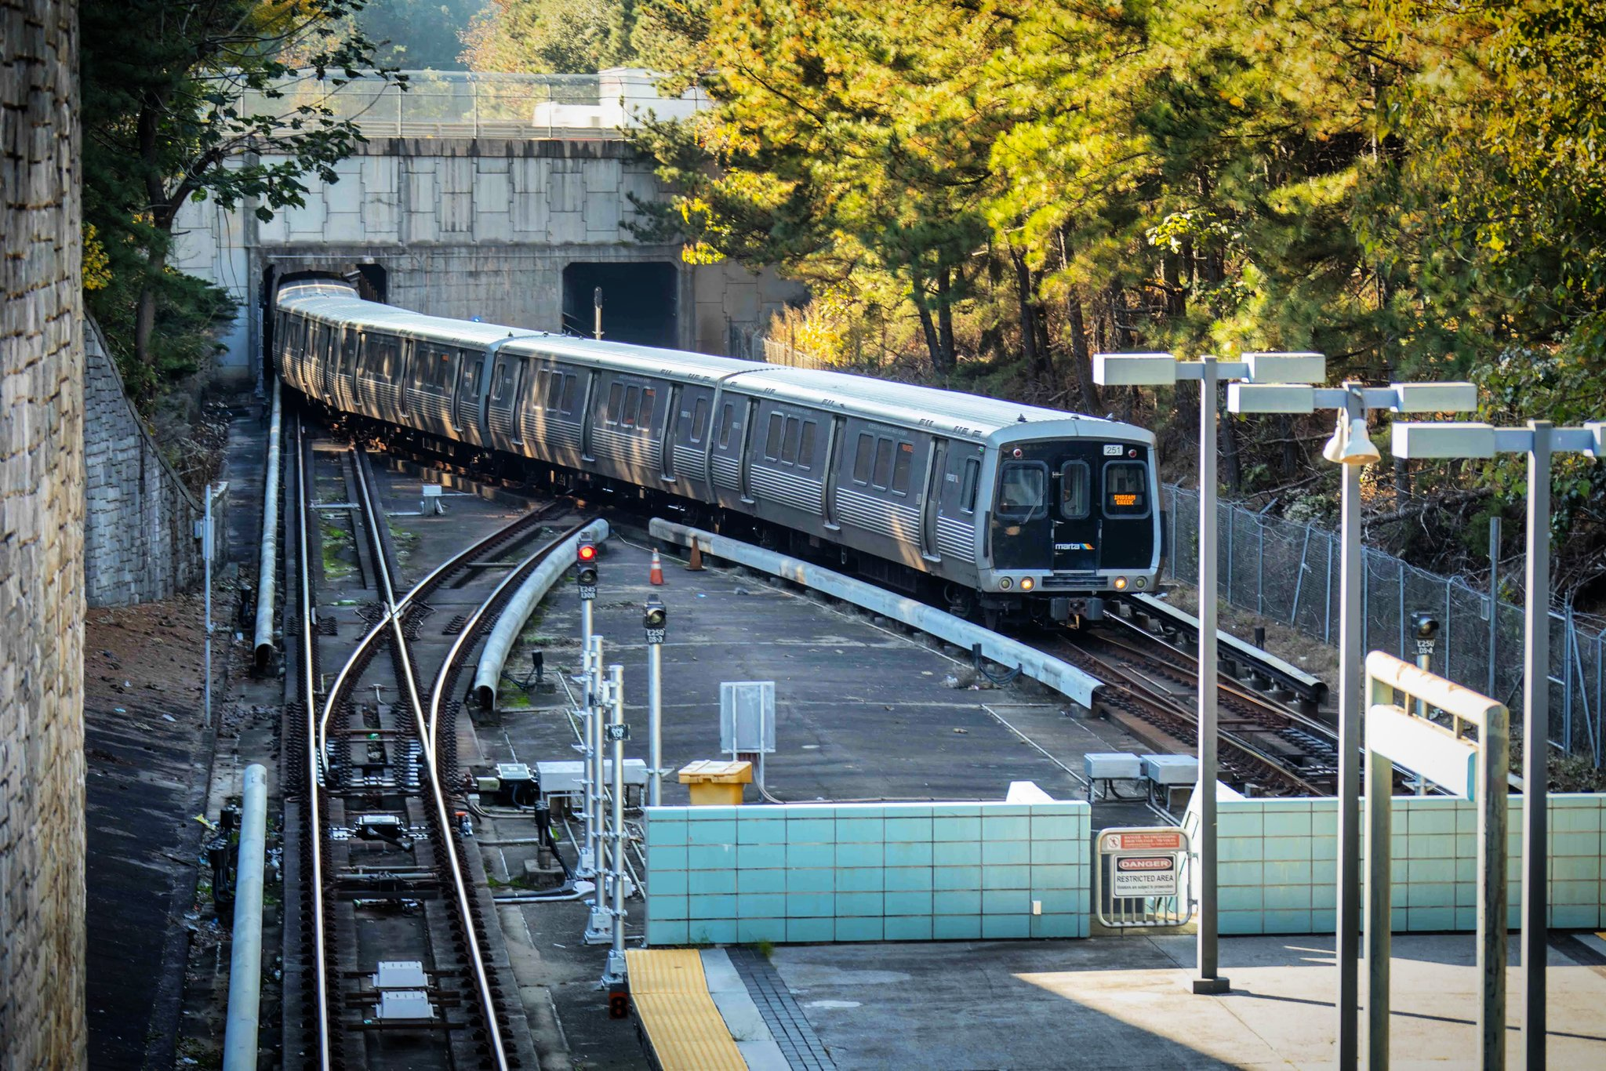

Slide 17
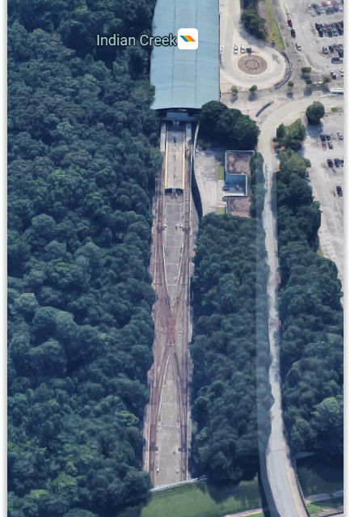
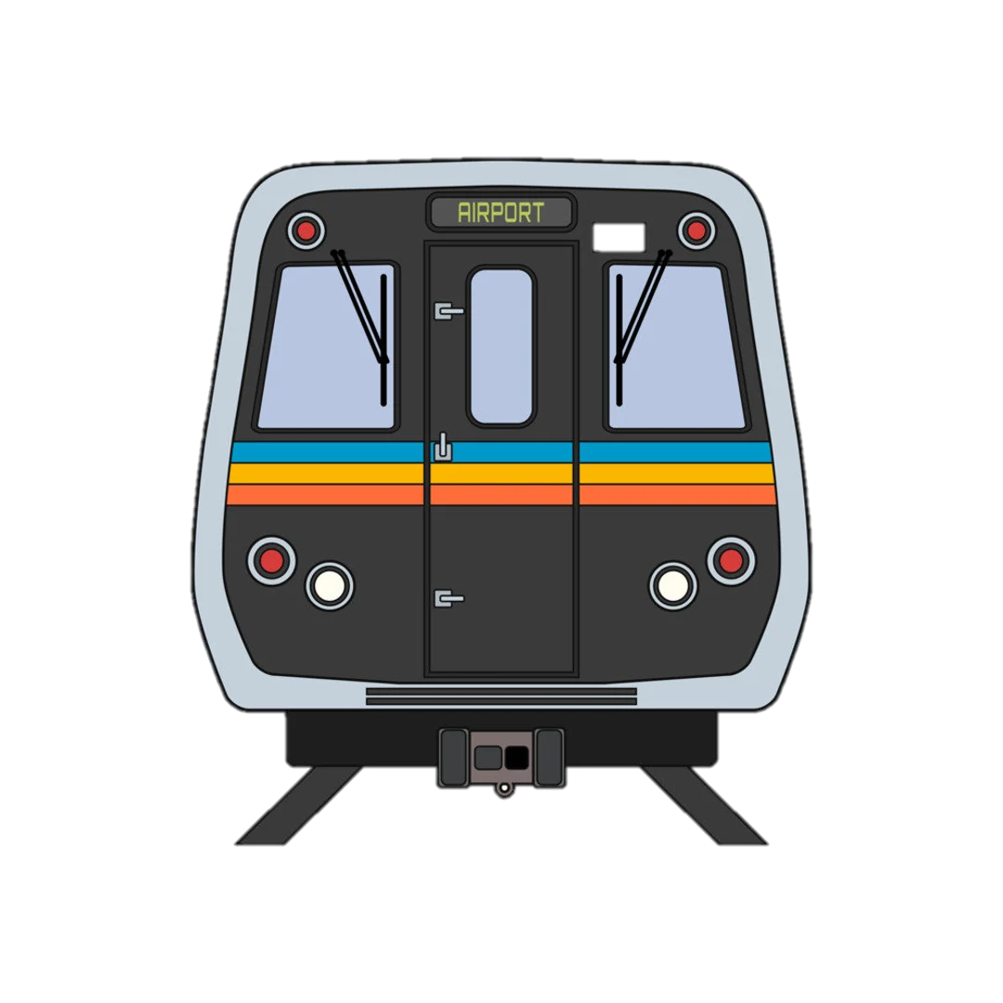
Indian Creek Station
Station will remain open
Island platform, normally train can be accessed from either side
Normally if a train is already at the station, an approaching train can cross and use the other side

Slide 18
Indian Creek Station
XXX Platform Closed XXX
Station will remain open
Island platform, normally train can be accessed from either side
Normally if a train is already at the station, an approaching train can cross and use the other side
With construction only one side (L or R) of the platform will be available
Now, if a train is already at the station, the approaching train will need to wait until the other train leaves

Slide 19
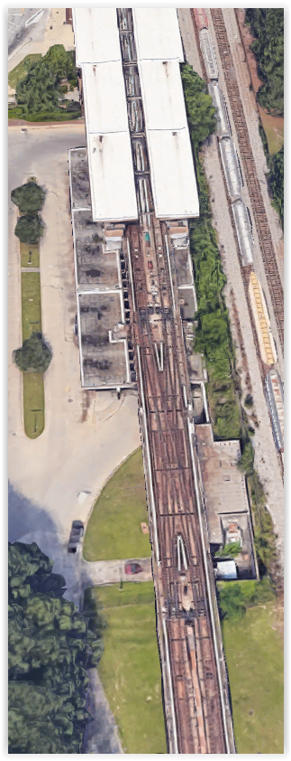
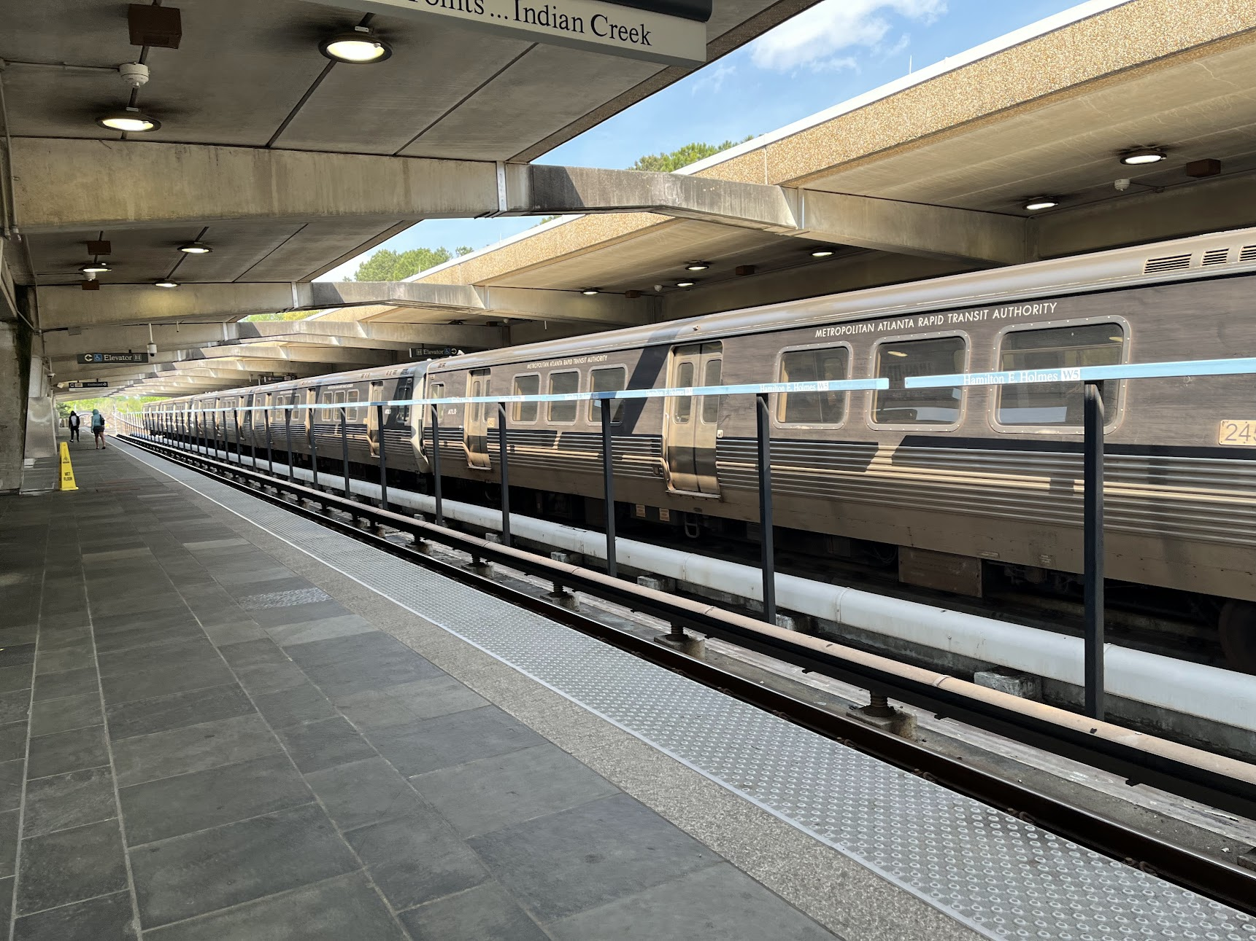
H.E. Holmes station

Slide 20
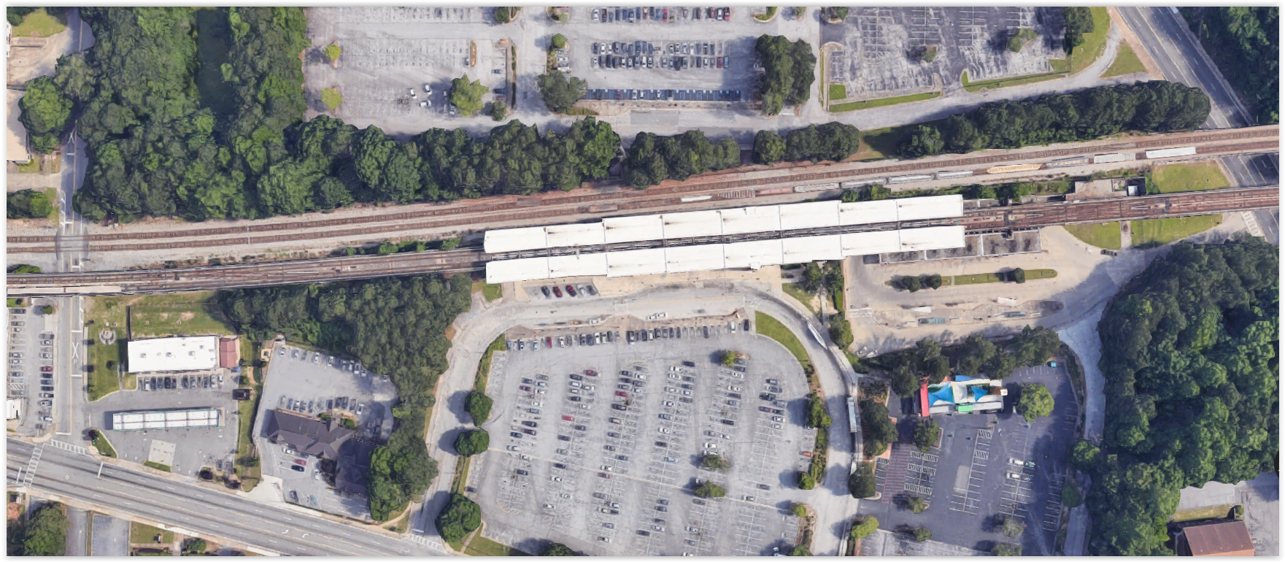
Split platform at H.E. Holmes creates similar issues, prefer only one train there at a time

Slide 21
Split platform at H.E. Holmes creates similar issues, prefer only one train there at a time

Slide 22
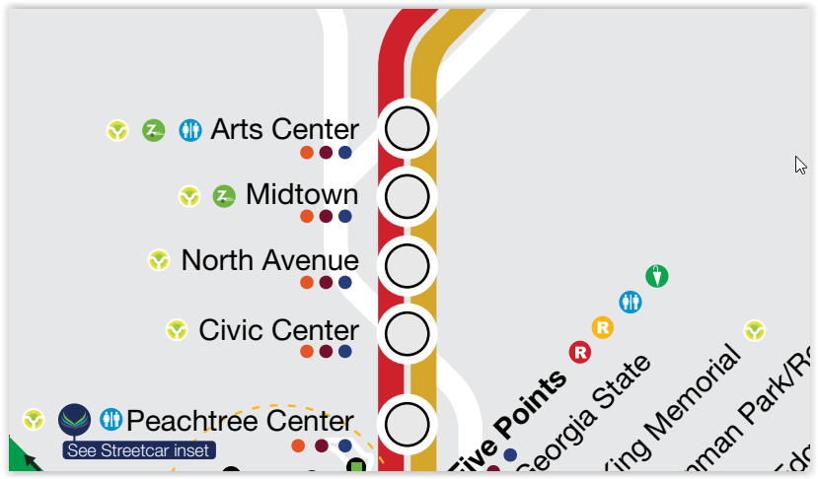
What about single tracking in the middle of the line?

Slide 23
What about single tracking in the middle of the line?
XXXXX TRACK CLOSED XXXXX

Slide 24
What about single tracking in the middle of the line?
XXXXX TRACK CLOSED XXXXX

Slide 25
Thank you!
transit scheduling

