Slide 1
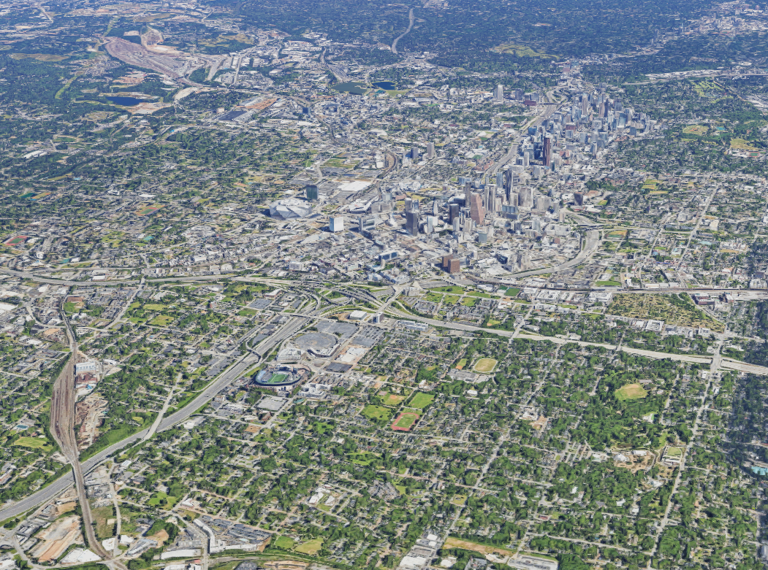





Service Planning 101
12/6/23
Ryan VanSickle
Director of Technical Services and Service Planning
Ezekiel Guza
Manager of Service Development
Office of Technical Services & Service Planning
Notes:
The purpose of this meeting is to discuss where things are in terms of route 70 and finding a terminus that fits well with the space we have available. It would probably be best if someone from the GCT team provide us with an update on the service enhancements. Has anything changed up to this point? Are there any potential things we should be looking out for?​

Slide 2

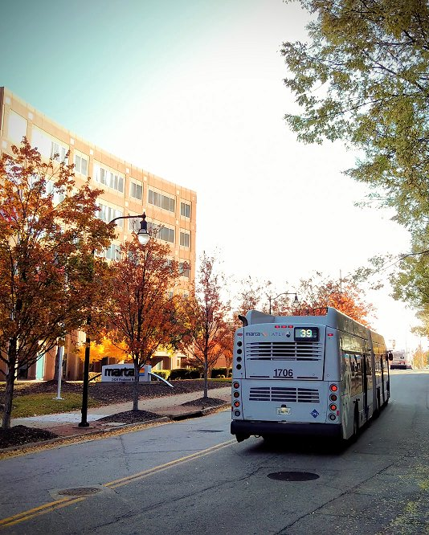
Presentation Overview
About MARTA’s System
What is service planning?
Transit route design
Other service planning activities
Coordinated disciplines
Bus network redesign

Slide 3
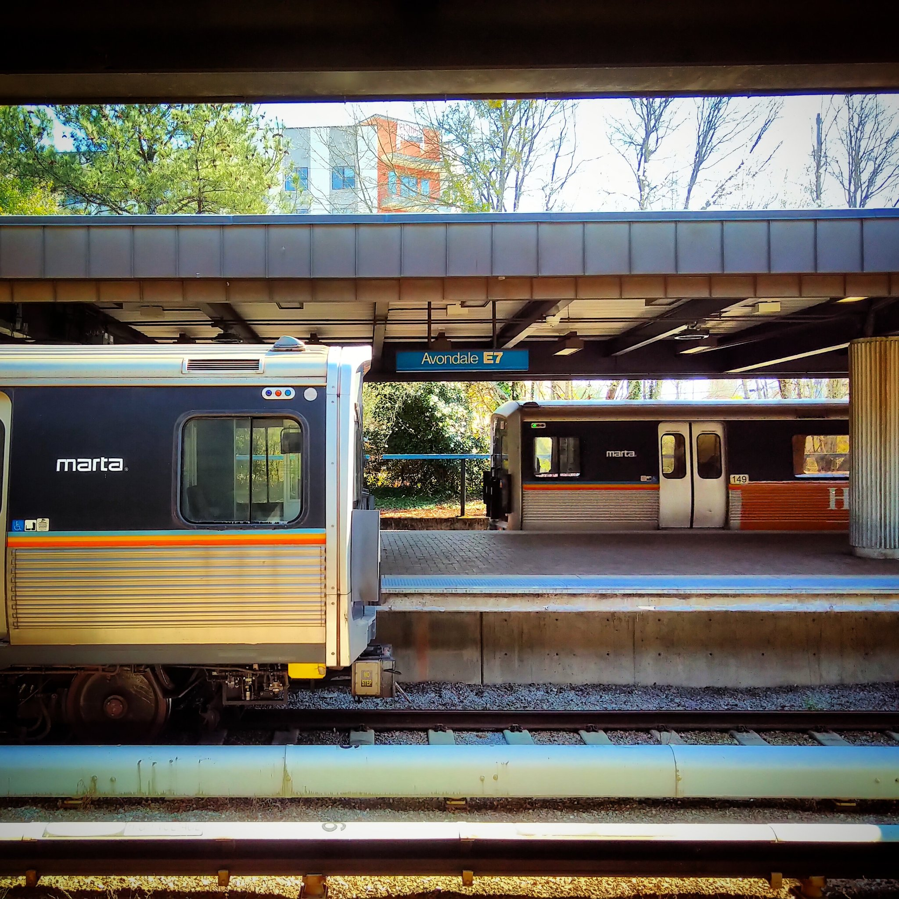
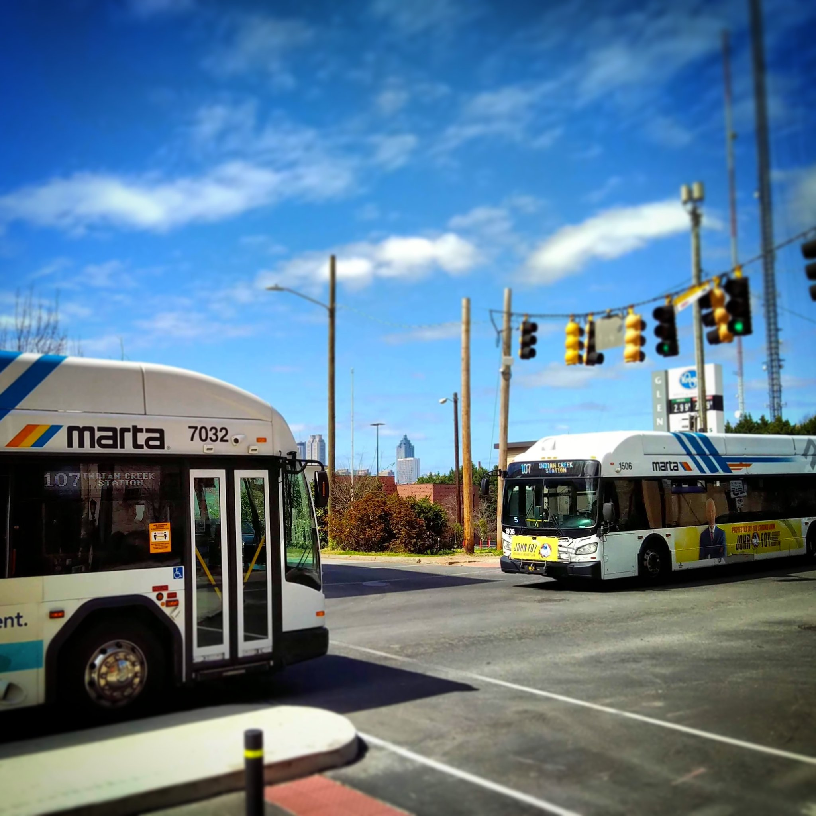
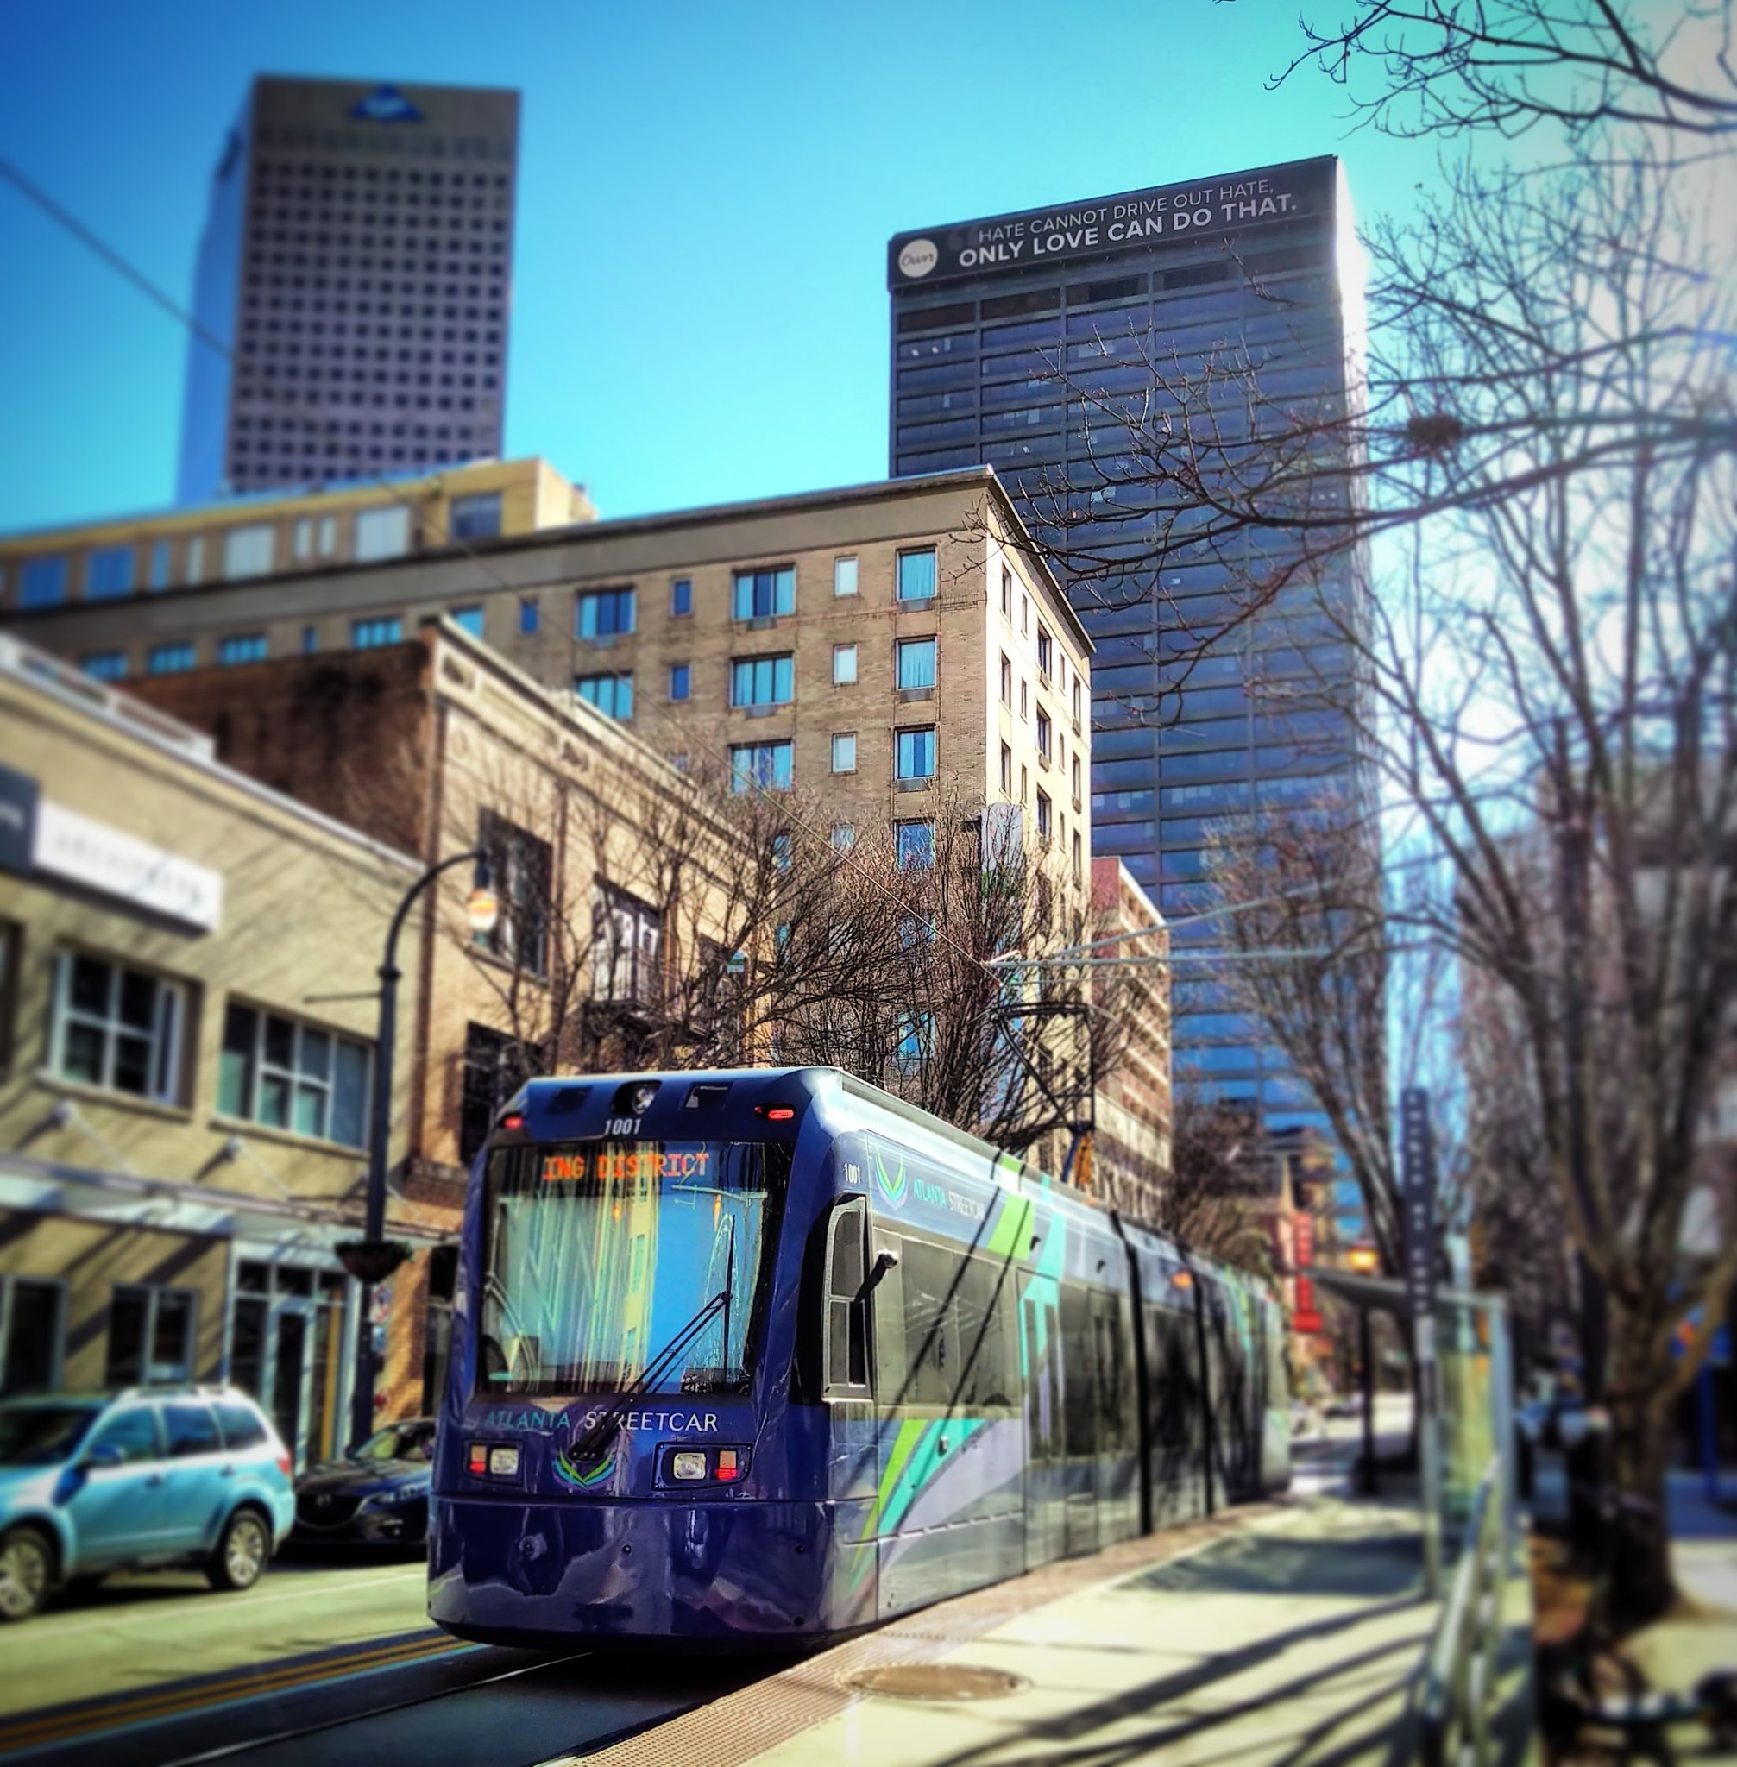
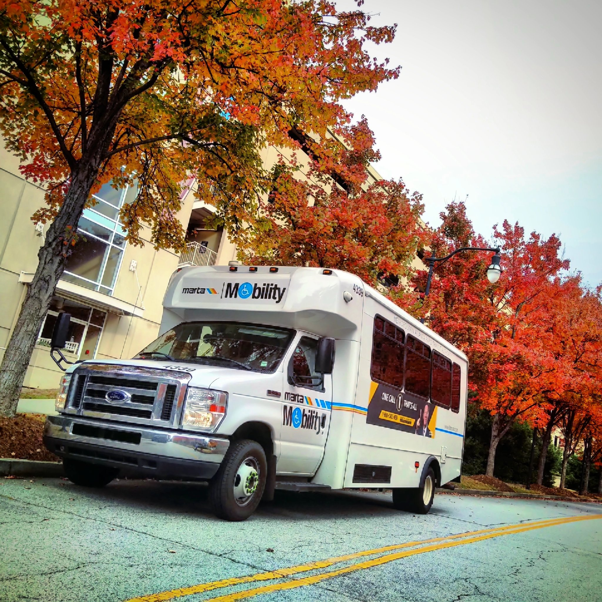

About MARTA
MARTA operates four integrated modes of transportation.
Heavy Rail
4 lines
38 stations
Bus
113 routes
9,000 stops
Streetcar
1 line
12 stops
Mobility
¾ buffer around all fixed routes

Slide 4
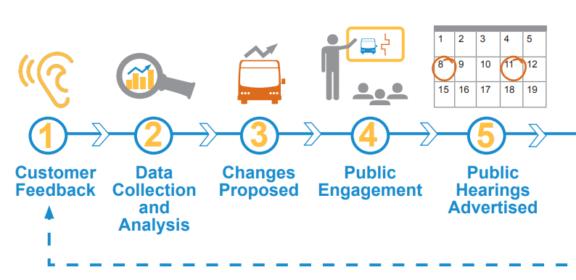
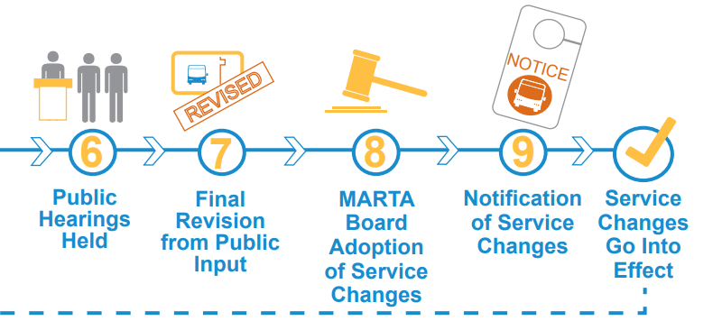
What Is Service Planning?
Service Planning is adapting transit service to better suit the changing needs of customers within MARTA’s resource availability

Slide 5

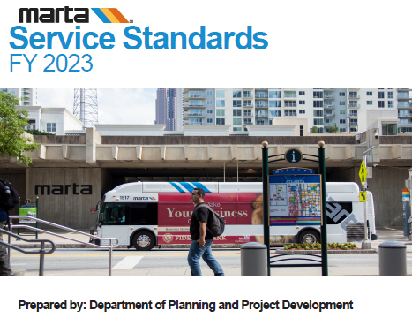





How We Plan Service
Service Standards
Design Guidelines
Refer to Existing Plans
Data Analysis
Field Observations
Listening

Slide 6
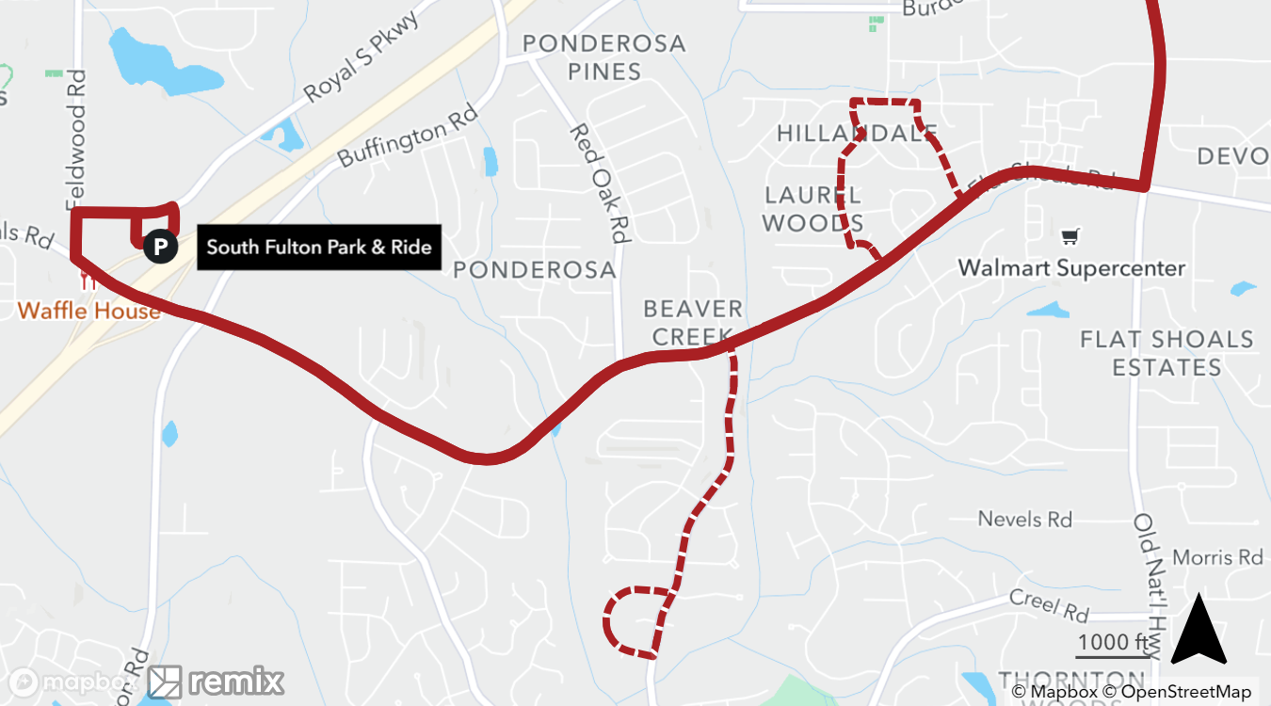
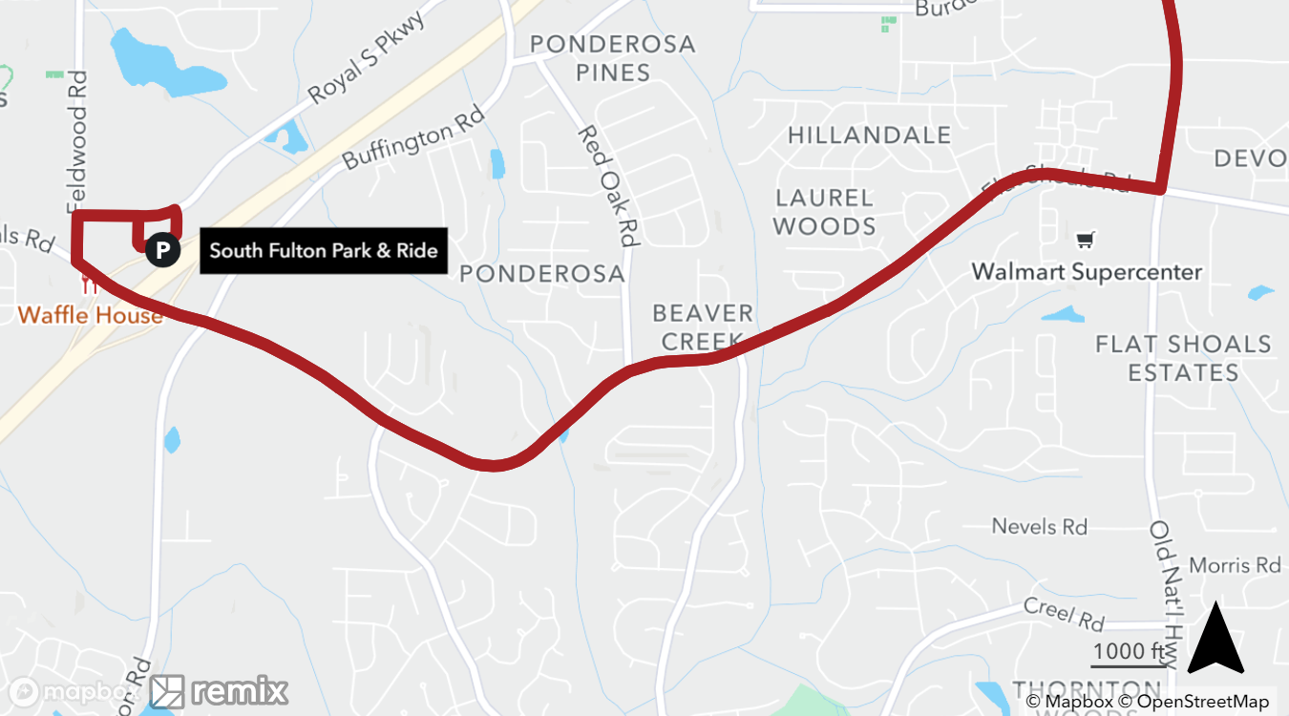
Guidelines: Direct Route Design
Routes should be direct where appropriate. Deviations may provide greater convenience for some, but cause longer travel times for others.
189
Flat Shoals/Scofield - Pattern With Deviations
189
Flat Shoals/Scofield – More Direct Pattern
Dashed segments operate on alternating trips

Slide 7
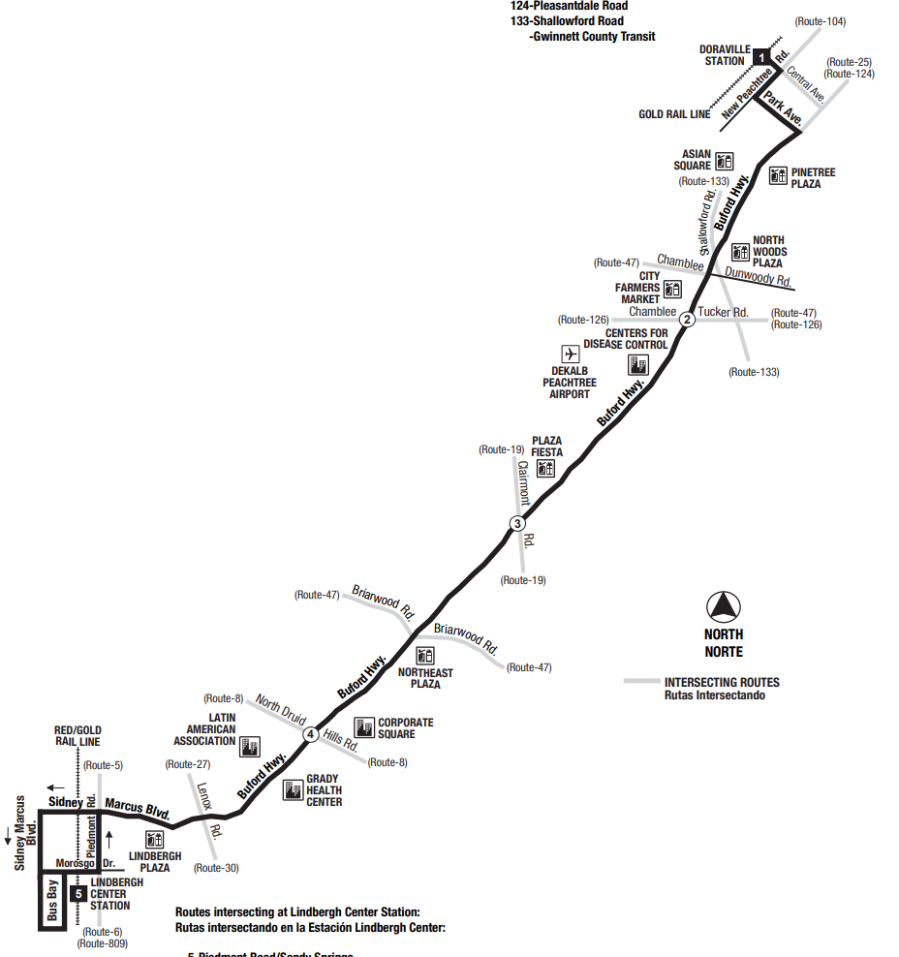
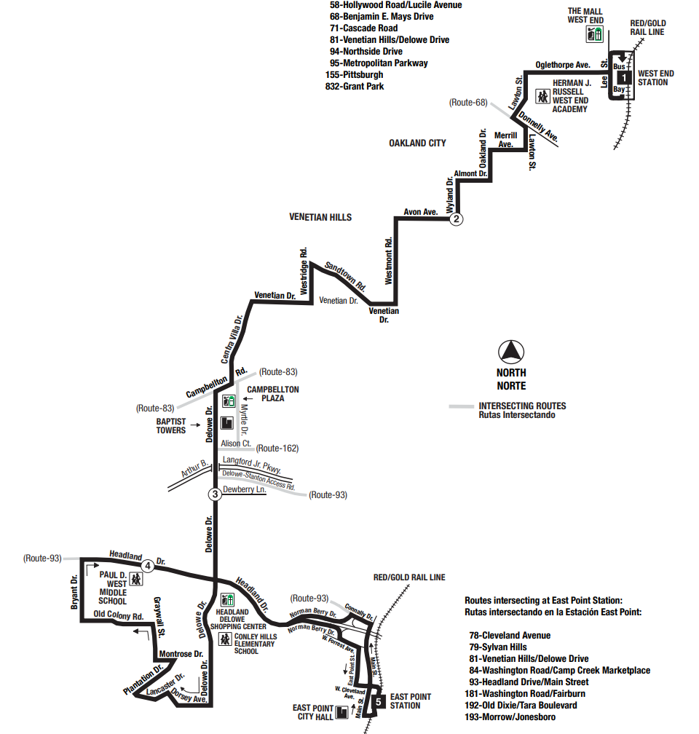
Guidelines: Simple & Consistent
Routes should be simple and linear where possible.
39
Buford Hwy
81
Venetian Hills/
Delowe Dr
7 turns, 1 major arterial
32 turns, many neighborhood streets

Slide 8
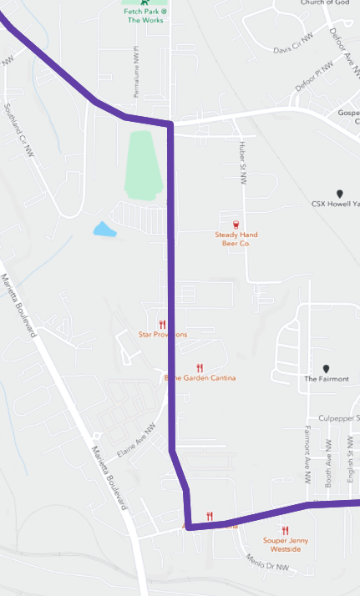
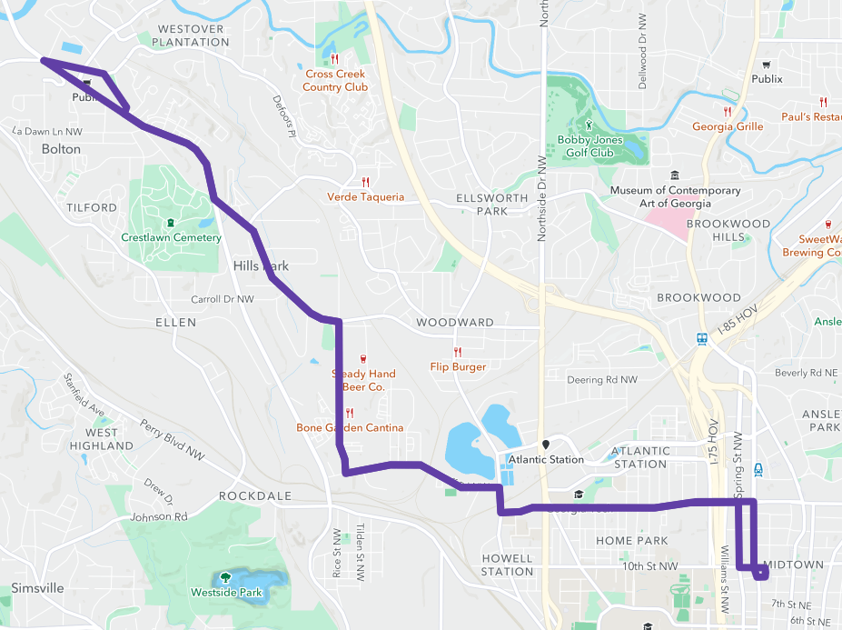
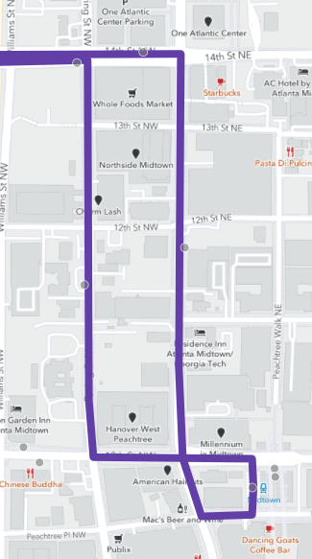
Guidelines: Symmetry
Routes should be symmetrical and easy to understand.
Bi-directional Service
One-Way Couplet
14
14th St
Chattahoochee Ave
Spring St
West Peachtree St
Ellsworth Ind Dr
10th St
Huff Rd
Huff Rd

Slide 9
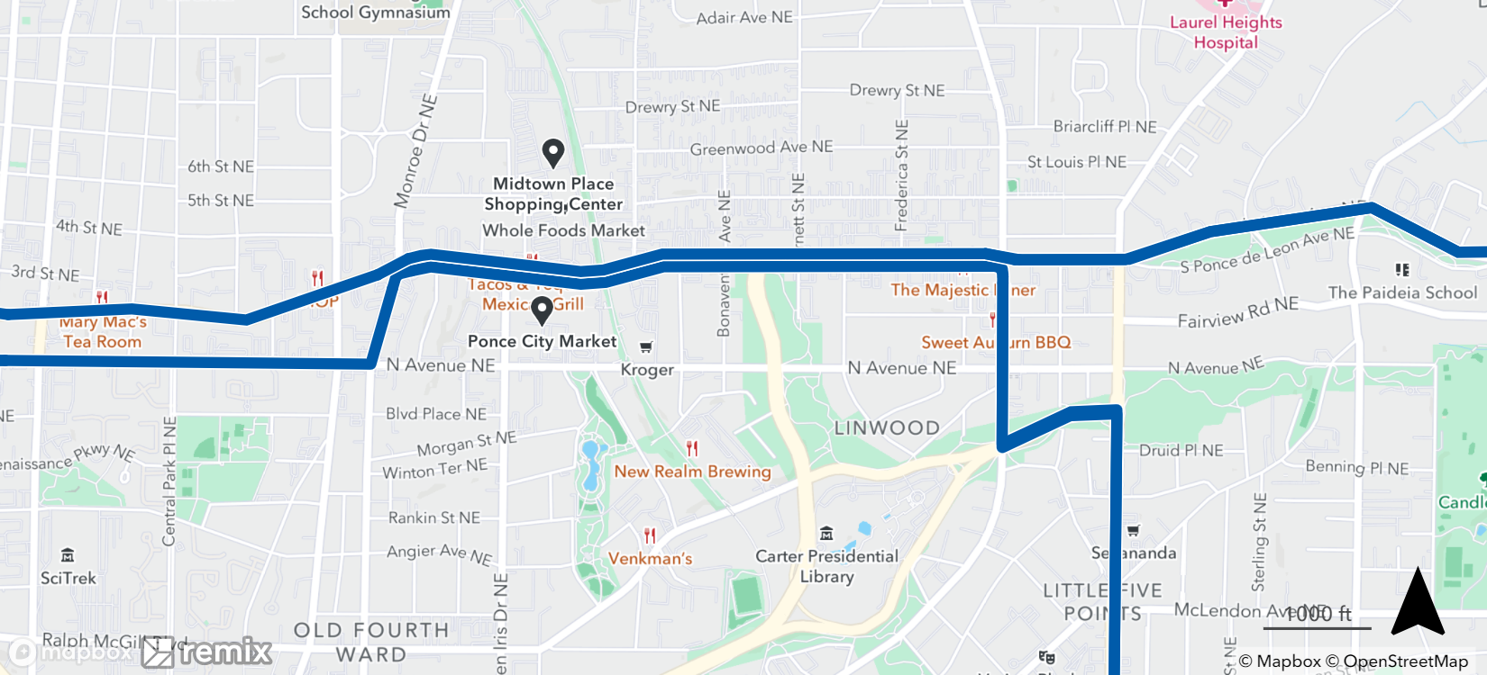
Guidelines: Coordinated Schedules
Routes should be coordinated to connect with each other, to rail service, and may be coordinated for shorter combined frequencies.
Together, routes operate a combined 15-minute frequency on Ponce de Leon Ave
To East Lake Station
Ponce de Leon Ave
2
2
102
North Ave
To North Avenue Station
Each route operates every 30 minutes
Moreland Ave
To Edgewood/
Candler Park Station
102

Slide 10
When Are Changes Made?
MARTA implements planned service modifications up to three times per year, typically in Spring, Summer, and Winter.
Modifications may involve routing adjustments, new routes, and schedule changes.

Slide 11
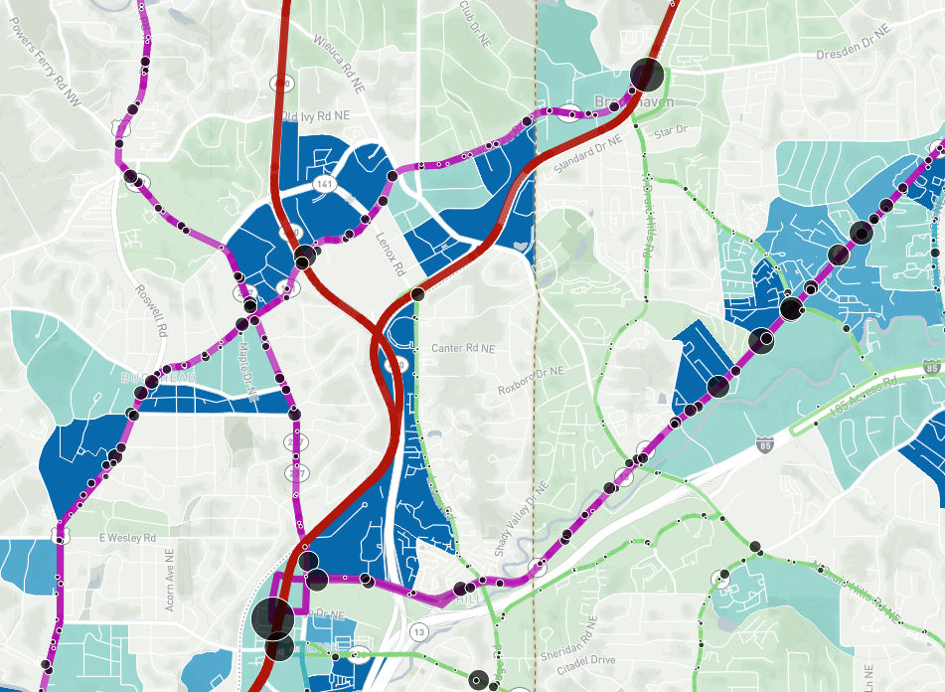
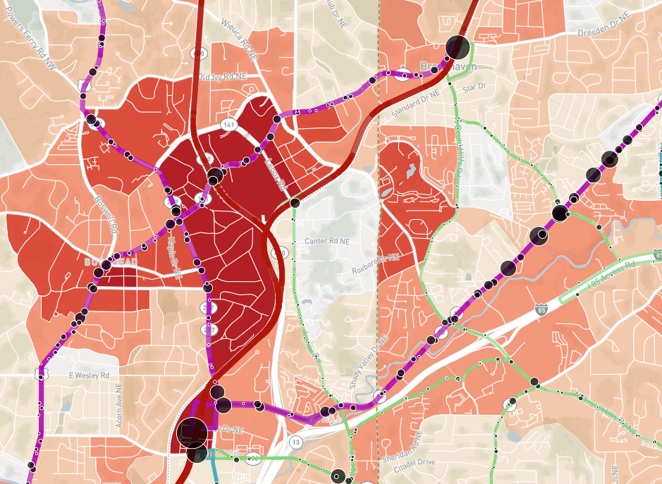
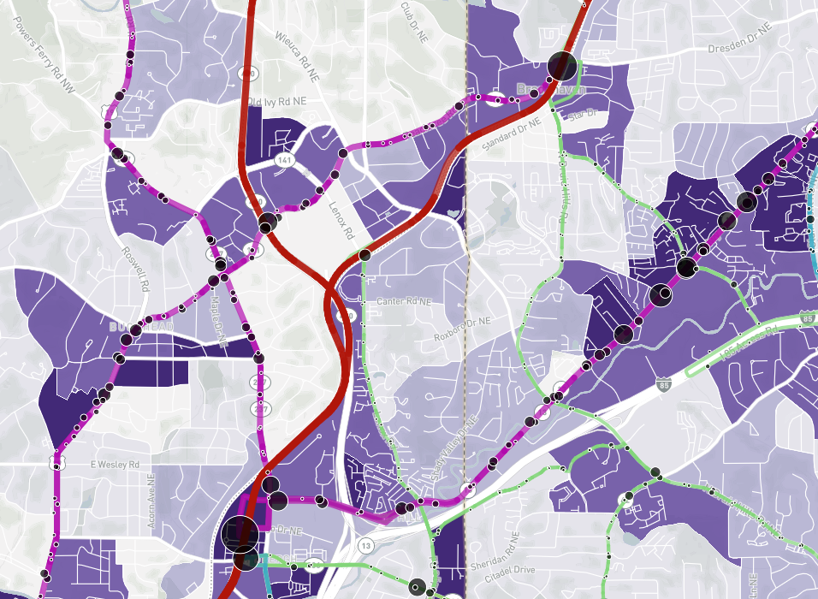
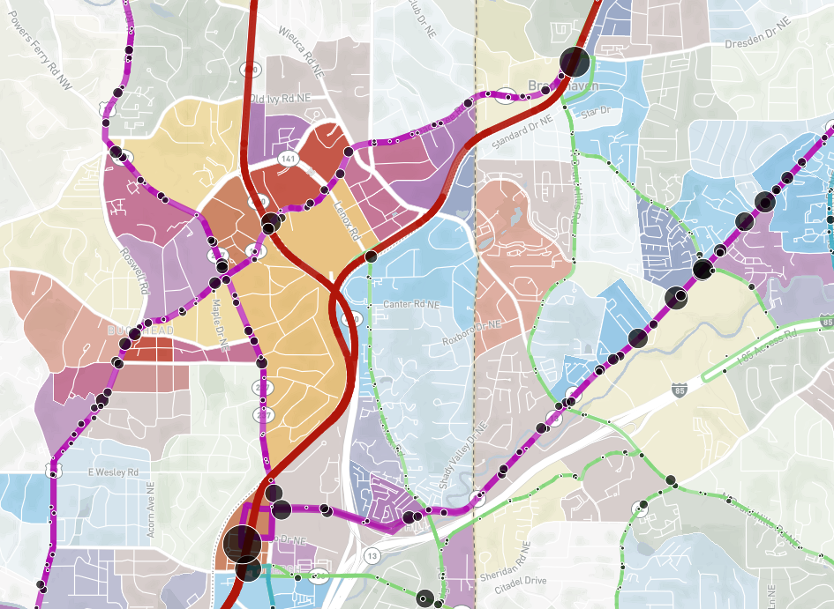
Data When Considering Service
Zero-Car Household Density
Job Density
Alongside input from the community, Service Planners consider demographic data and land use characteristics when considering requests for transit service.
Density of People Experiencing Poverty
Consolidated Activity Density

Slide 12
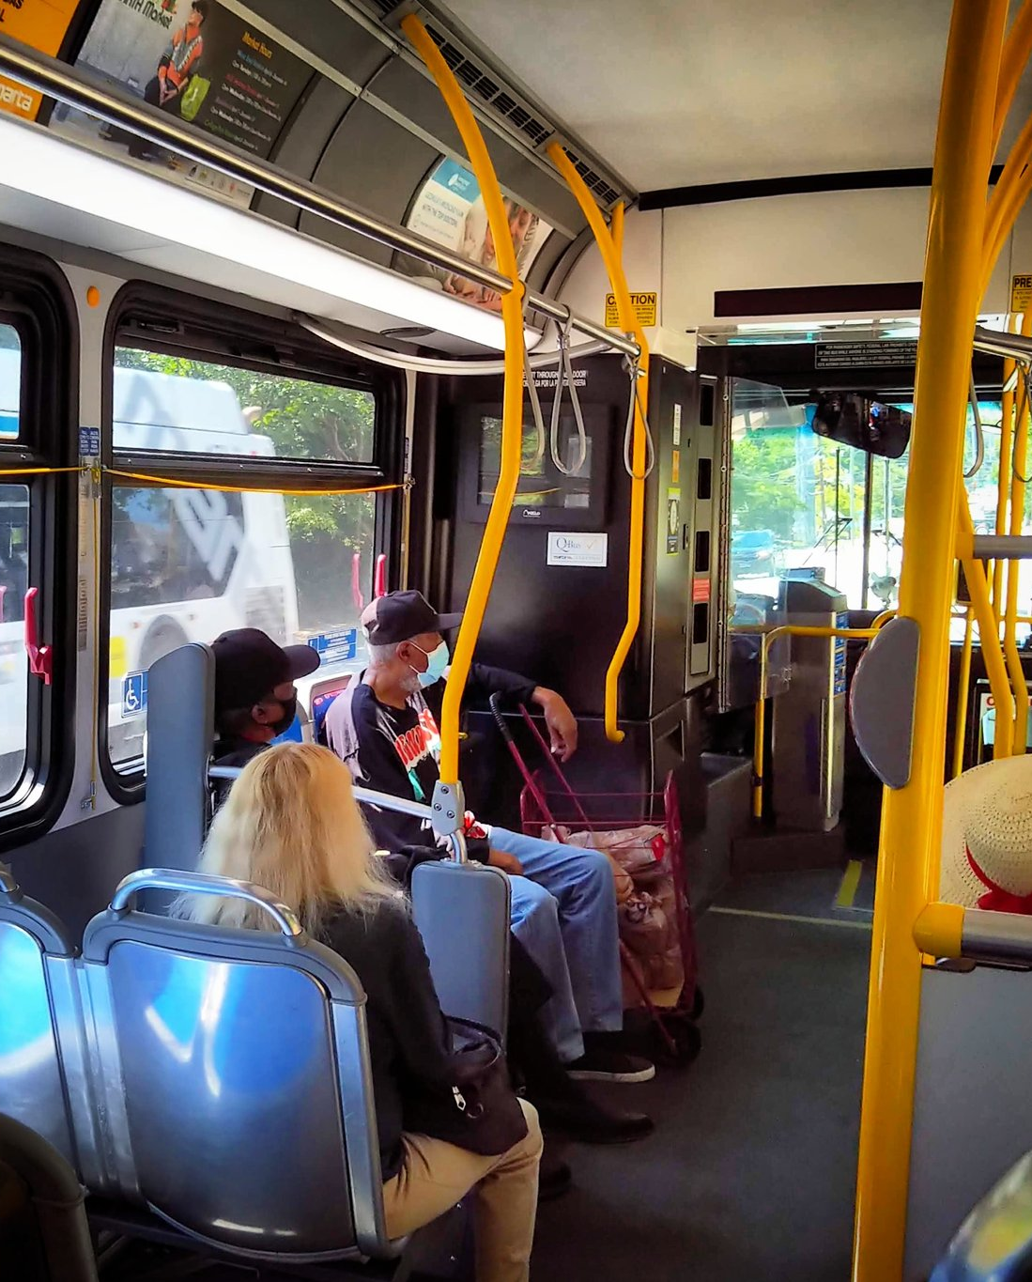
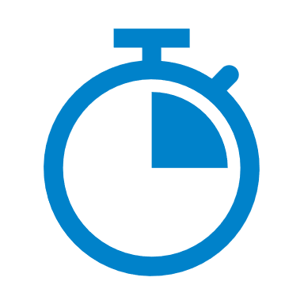








Coordinated Disciplines
Scheduling
Bus Stop Planning
Operations
Safety
Outreach
Technology
Facilities
more…
… plus coordination with external parties like local governments, GDOT, stakeholder groups, institutions, and more.

Slide 13

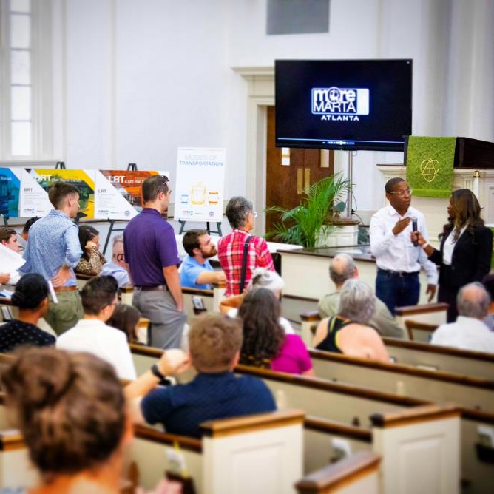
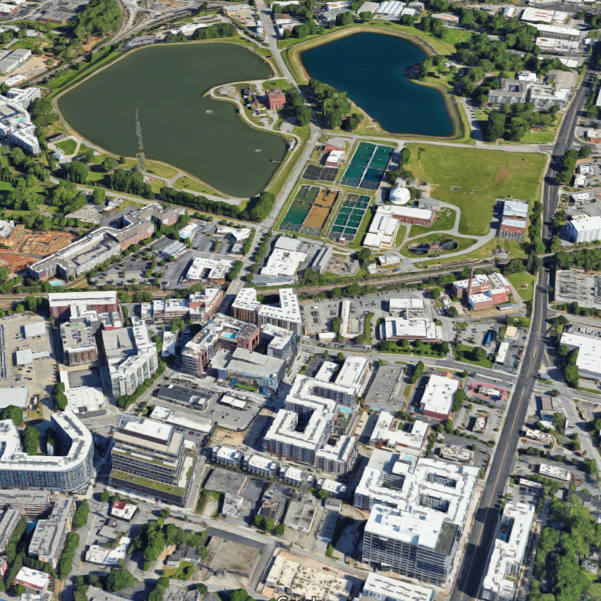
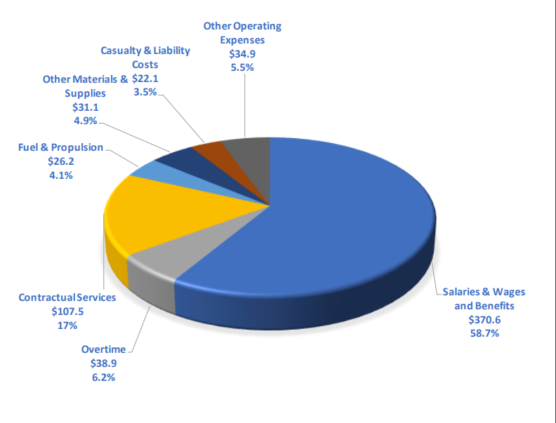
Considerations & Challenges
OPERATOR & VEHICLE REQUIREMENTS
COMMUNITY CONSENSUS
BUDGET
LAND USE & STREET NETWORK

Slide 14
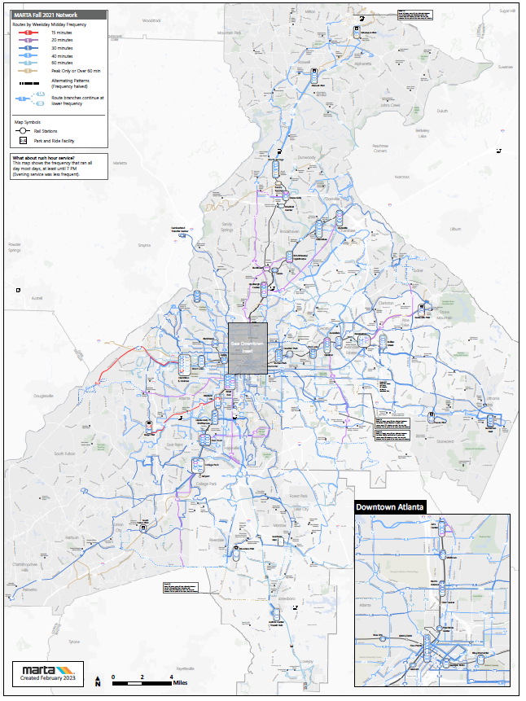
Bus Network Redesign
Multi-year effort to redesign the bus network in Fulton and DeKalb Counties holistically
A draft plan is in development and will be shared with the public in the new year
Includes On Demand service, which will have features similar to that of the MARTA Reach Pilot from 2022
Goal is for a December 2024 implementation
A map of the existing MARTA Bus Network.

